Slide 1
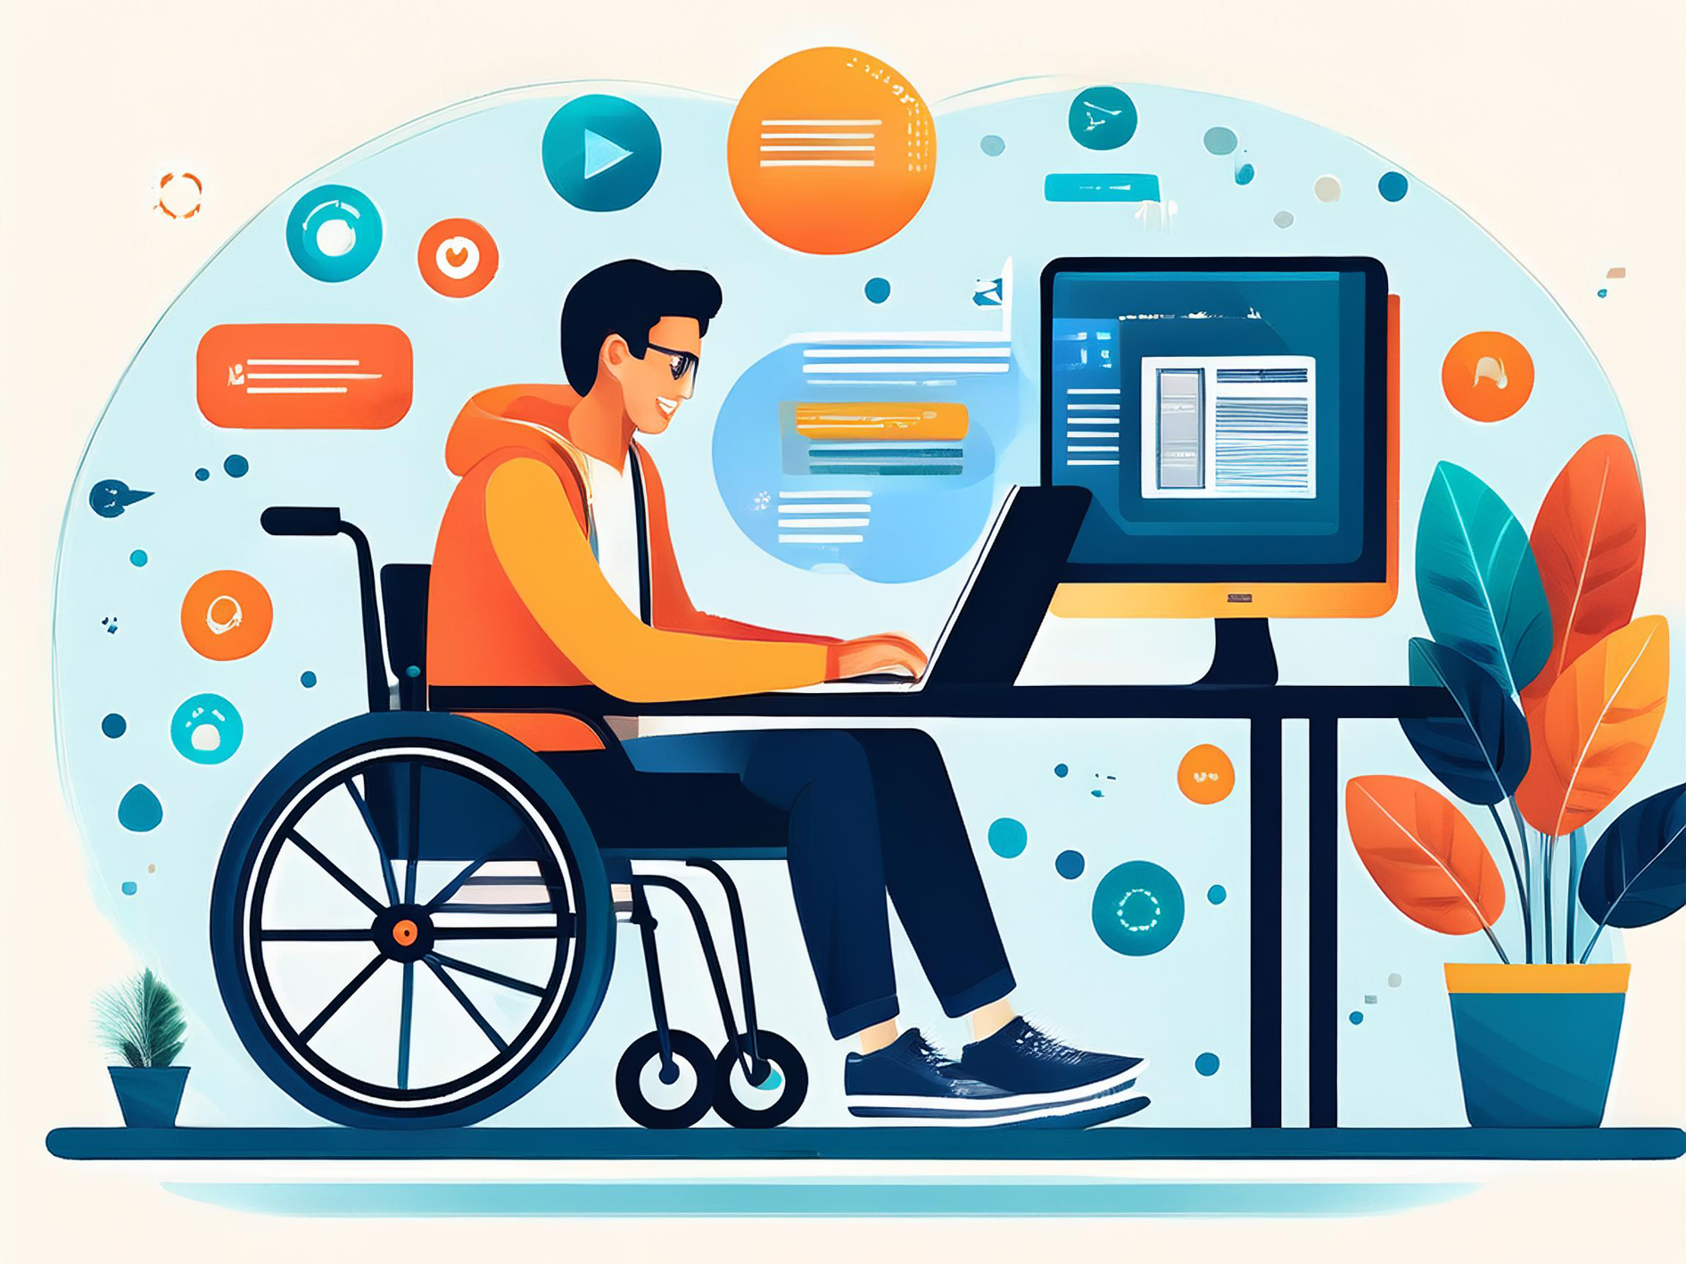
March 2025 Perspectives & Reflections from ADCET Darren Britten
ACODE 93: Accessibility & Technology Enhanced Learning

Slide 2
Acknowledgements
In the spirit of reconciliation, I would like to acknowledge the Traditional Custodians of country throughout Australia and their connections to land, sea and community. I pay our respect to their Elders past, present and emerging and extend that respect to all Aboriginal and Torres Strait Islander peoples and other first nations people from Australia, New Zealand and beyond joining in this presentation today. While virtually connected today we are geographically dispersed, and I would like to acknowledge the Wurundjeri people of the Kulin nation in Victoria where I am presenting from and the Palawa/Pakana people of Lutruwita (Tasmanian Aboriginal Land) which hosts ADCET.

Slide 3
About this presentation
In this presentation I would like to share some perspective from ADCET and from my 20+ years working on inclusive resource development, working with students and staff with disability and working with professional and academic staff in minimising access barriers:
What can history tell us
What can we do/plan for
Teaching & Learning in the age of AI

Slide 4
What can history tell us?

Slide 5
2004
Disability Standards for Education (2005)
Microsoft MSN was the most popular brand on the World Wide Web
Google was the fifth ranked search engine, ranking well below Yahoo and AOL
Time Magazine touted Friendster.com as one of the best websites of the year.
MySpace, launched in 2003, had ambitious plans to become the dominant social network
Facebook was just being launched and trialled

Slide 6
2013 – What were the challenges?
Emerging Technologies (solving old issues/creating new ones)
Interoperability
Adoption of standards
Input / Output (extinction of the mouse?)
Multi-Modal Platforms and Delivery
Distributed Authors, Content and Systems
Connectivity / Credentials / Privacy / Copyright …

Slide 7
What can history tell us?
The future is hard to predict / making assumptions
Change comes slowly
Students and their expectations are changing
Teaching and Learning will continue to change
Students want consistency
Increasing number of diverse students
Institutions are still largely operating in a retro-fit and accommodation model

Slide 8
What can we do/plan for?
Standards & Culture – how do we deliver new standards and change culture
Acknowledge that accessibility benefits everyone and everyone is responsible for it
Accessible ICT procurement
If it seems ‘every student has an access plan’ then are our current teaching methods fit for purpose?
Universal Design for Learning – How do we design proactively
Recognise what we are already doing well and build on it
Recognise, amplify and reward staff
Include people with lived experience of disability

Slide 9
Teaching / Learning and AI
AI is here to stay – for students and staff
The rise of tools for personalised learning and content consumption
What can we learn from students – what are they already using
Digital Capability Building for staff and students
AI and TEL – What are our expectations and are we explicit (AI vs AI)
Funding, Funding, Funding

Slide 10
Questions Thoughts Ideas

Slide 11
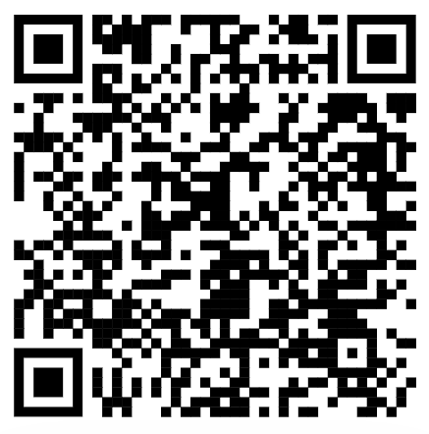
Thank You Visit the ADCET website for more information www.adcet.edu.au Inclusive Learning Opportunities Through AI - ADCET Podcast adcet.edu.au/ilotathings

