Slide 1
ACODE/CAUDIT Survey Assessment/Examination
Professor Michael Sankey
Director, Learning Transformations
President, Australasian Council on Open, Distance and eLearning (ACODE)

Slide 2
Invigilate or…
Of 47 Institutions, 24 used a formal proctoring solution in conjunction with an online exam.
23 chose alternate means, or did not run proctored exams, rather choosing alternate forms of assessment.
michael_sankey

Slide 3
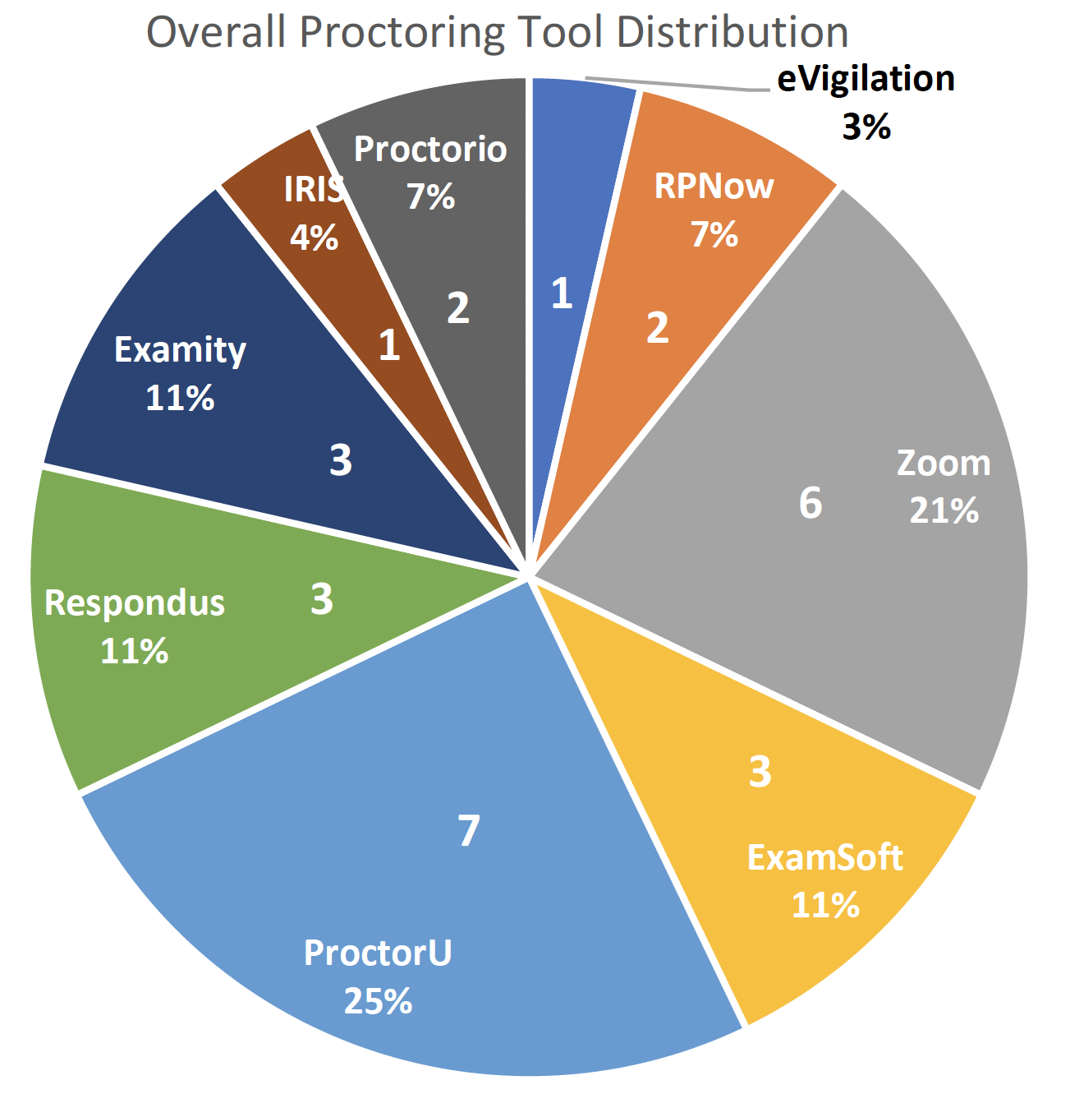
Proctoring tools used
28 (24) used some form of proctoring tool
michael_sankey

Slide 4
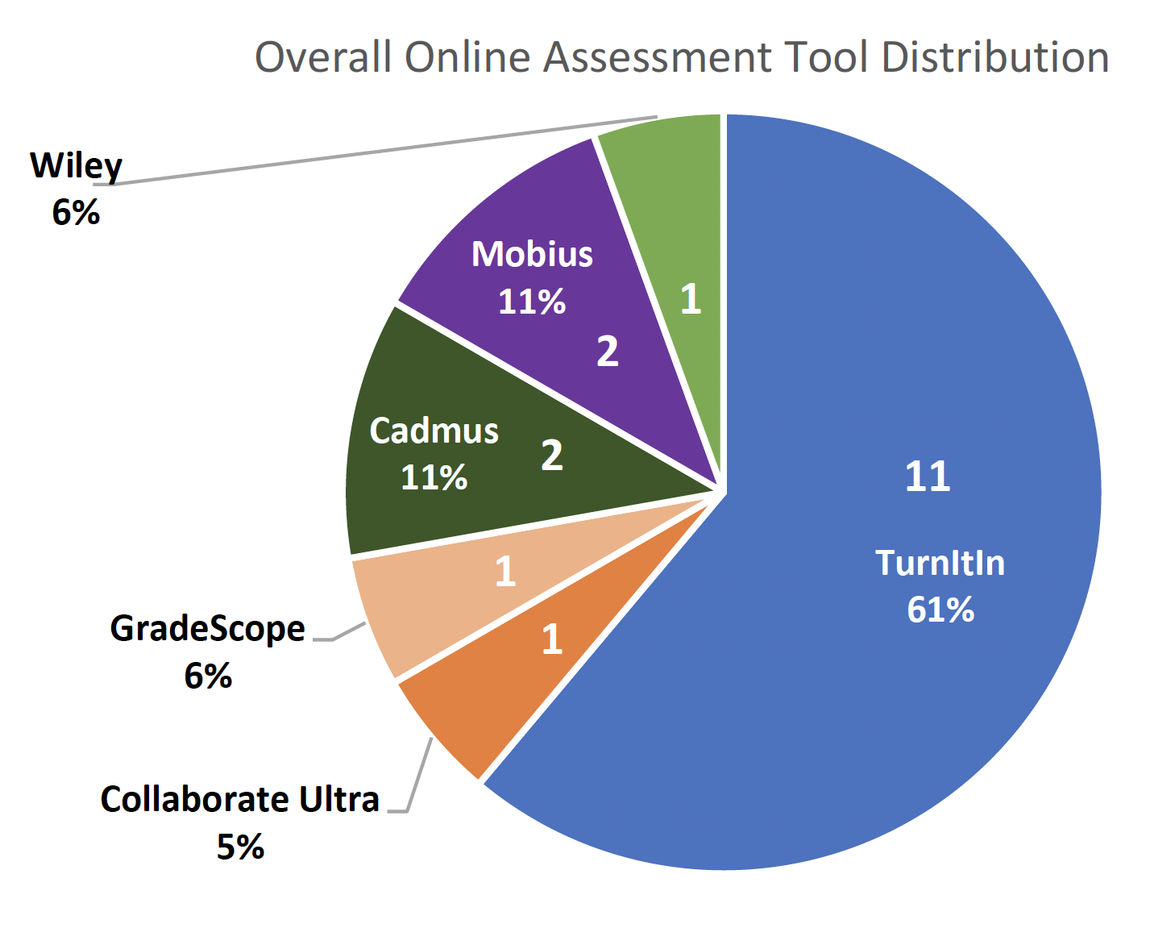
Non-proctored online assessment tools
N=18 – 11 (61%) institutions nominated the use of Turnitin
Assignments where mostly used to replace exams & open book exams.
michael_sankey

Slide 7
The issues identified
Institution Service Delivery Issues relating to the institution and its effort to deliver online exams with a given set of services, and
Technical Issues relating to the service or platform during use.
Institutions, when attempting to implement a new service are restrained by a range of factors, including institutional policy, culture and existing solutions.
Each institution has unique goals to achieve with the new service, and this can influence the success factors.
michael_sankey

Slide 8
Alternatives seen to formal exams
Times Quizzes
Random quizzes based of quiz bank
Interactive oral assessments:
https://sway.office.com/yQ2s0Bm3ILkWtGll?ref=Link
Viva voce, or oral examinations
Open book exams:
https://www.newcastle.edu.au/__data/assets/pdf_file/0006/268980/Open-Book-Exams.pdf
michael_sankey

Slide 9
Some things to consider
Adjust time limits to account for the technology learning curve. Some students are not comfortable taking an exam online, so adjust traditional time limits.
Consider getting rid of forced completion. Some students may be dealing with a number of distractions at home -- children, sharing space with family and so on..
Be flexible with deadlines. Hard deadlines are as out of style as hugs and kisses during the COVID-19 pandemic.
Feed forward mechanisms. Include reflection on the assessment as an additional element to feed into final grade
Cheating behaviours.
michael_sankey

Slide 10
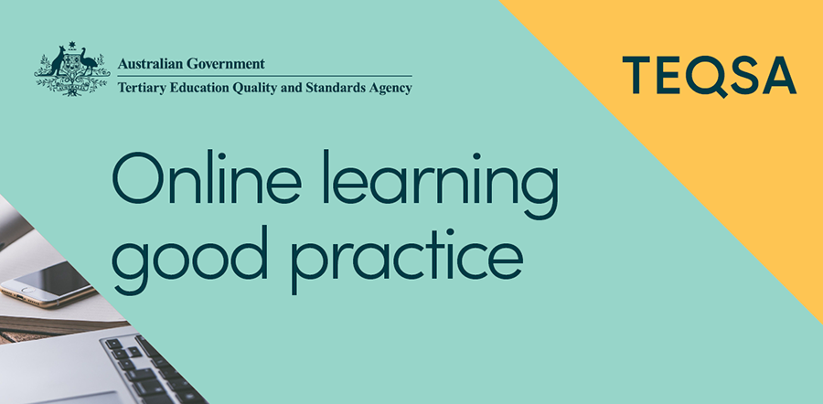
https://www.teqsa.gov.au/sites/default/files/strategies-for-using-online-invigilated-exams.pdf
michael_sankey

Slide 11
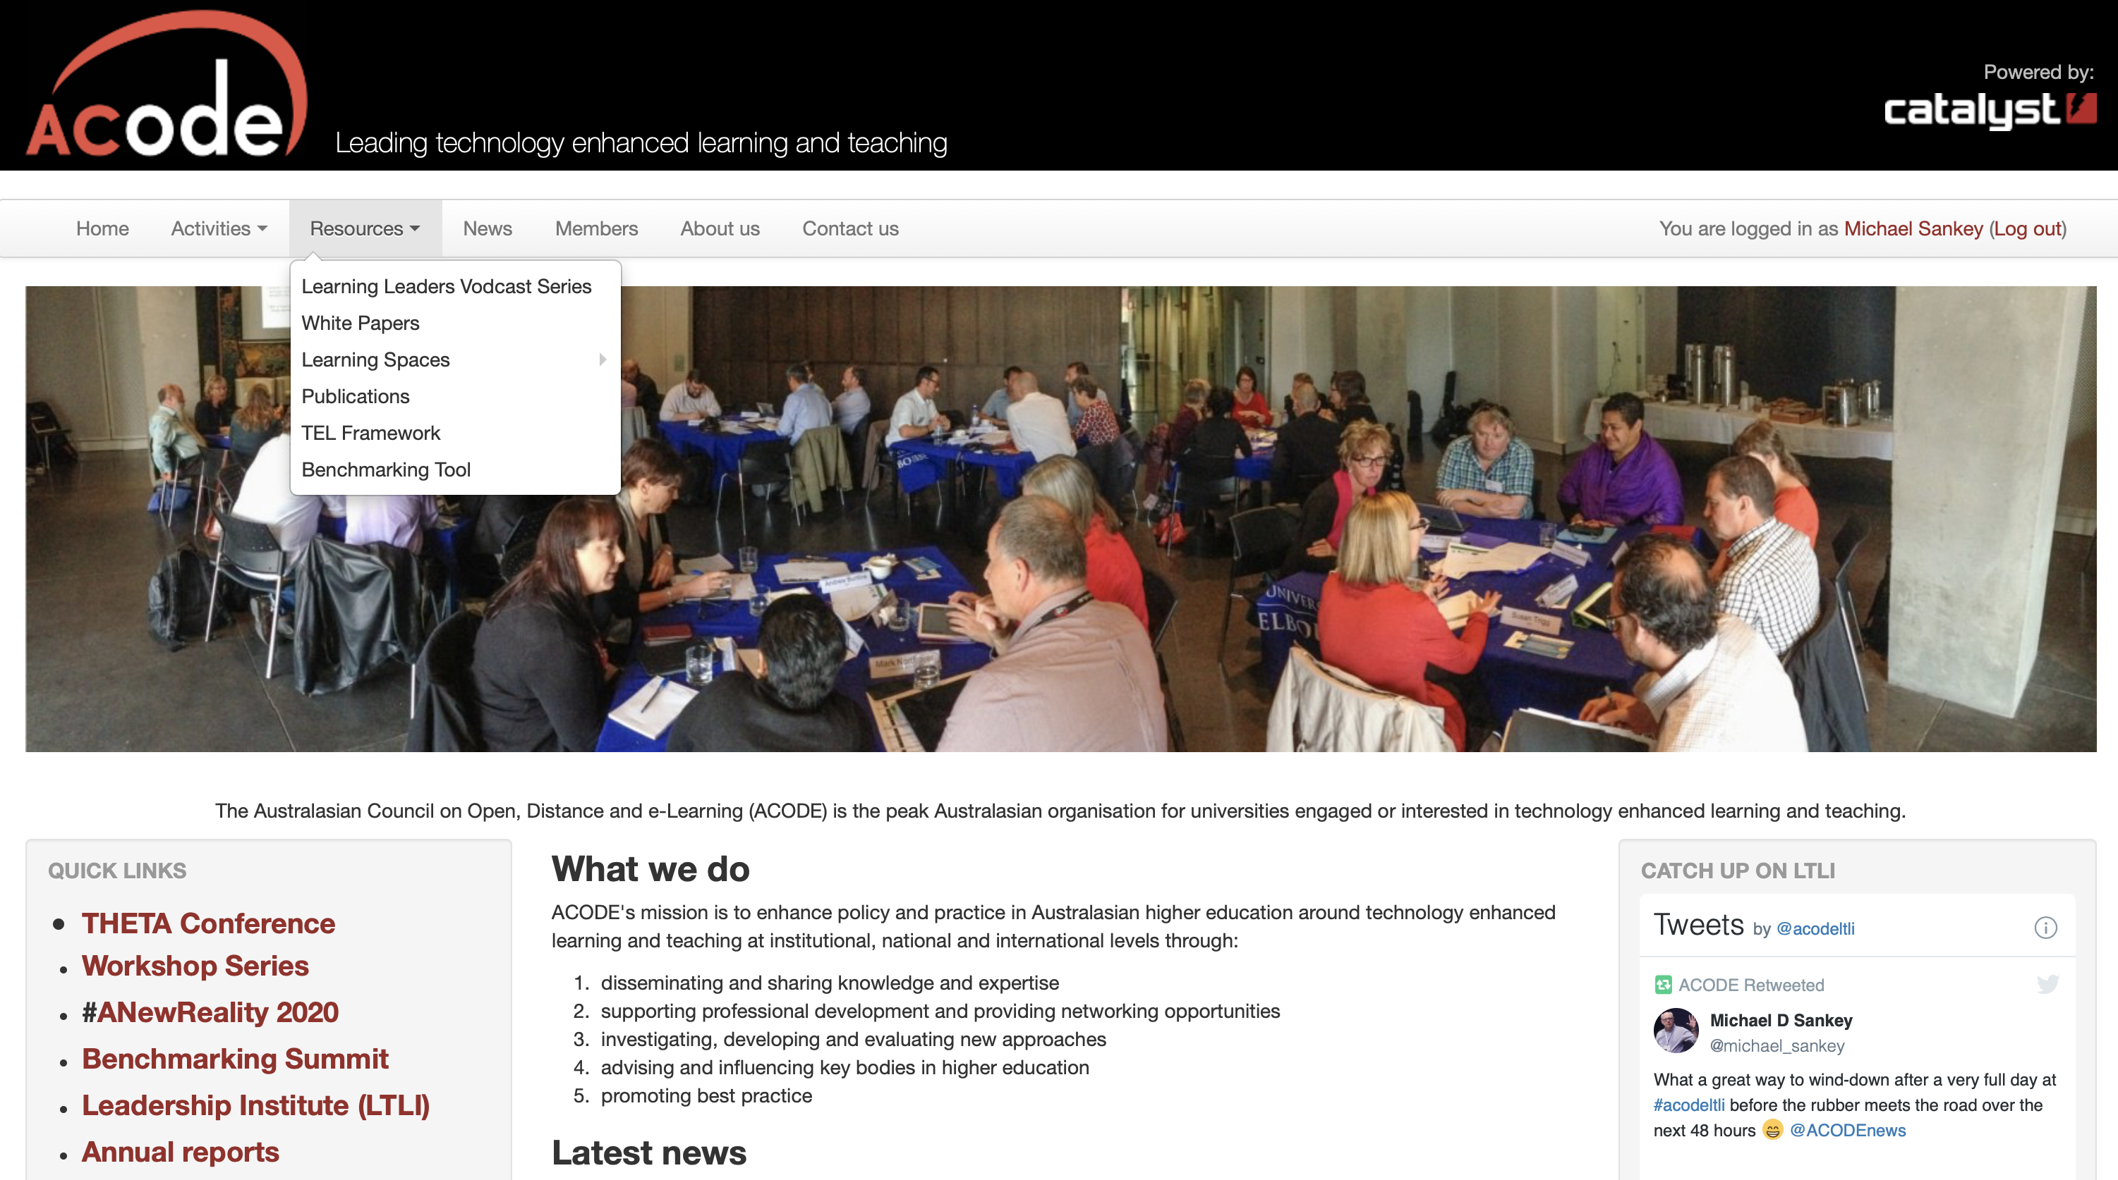
www.acode.edu.au

