Slide 1
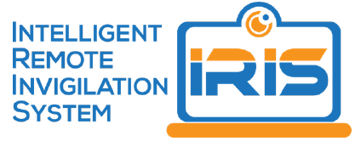
Custom-Built Online Proctoring Experience
Gordon Cunningham, Enterprise Lead, Learning Platforms
Learning Innovation & Teaching Excellence Centre (LITEC)

Slide 2
Online Assessment during 2020
Setting the Scene
Curtin was impacted by COIVD-19, like many Universities
Centrally Scheduled Examinations interrupted
Rush to duplicate Exams online
Alternative Assessment Design > Change to Policy & Practice
Open Book, Timed Assessments, Flexible submission, Limited RP use
Many unknowns of Student Load on the LMS
Senior DVC/A Management concerned with cognitive load on students
Conscious decision not to apply large scale Remote Proctoring

Slide 3
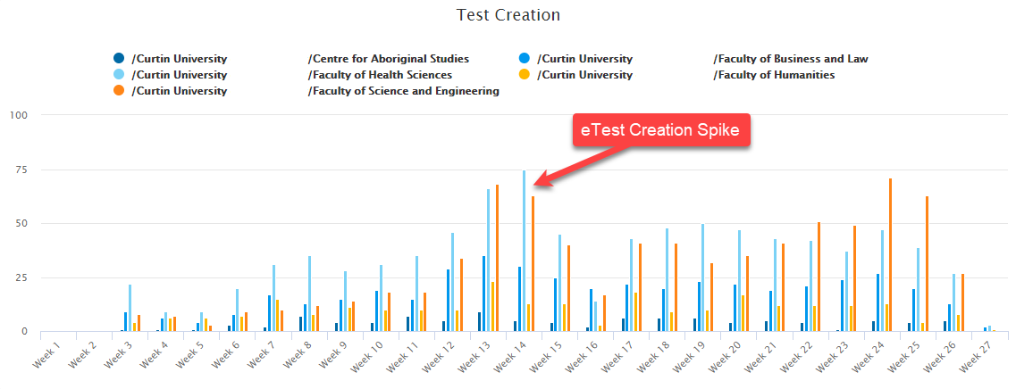
eTest Creation Activity
“The Rush to Judgement”

Slide 4
Intelligent Remote Invigilation System (IRIS)
Background
Co-Developed by Curtin and External Partner
Research project – limited University Use
Browser base plugin – custom built Chrome extension (WebRTC)
Recording of Student behaviour
Web Cam
Microphone
Desktop
Recording Dashboard (Flagging) – Facial recognition, Volume spikes
Authentication – “Face-matched”
Local recording of data, Post Assessment upload to IRIS Servers

Slide 5
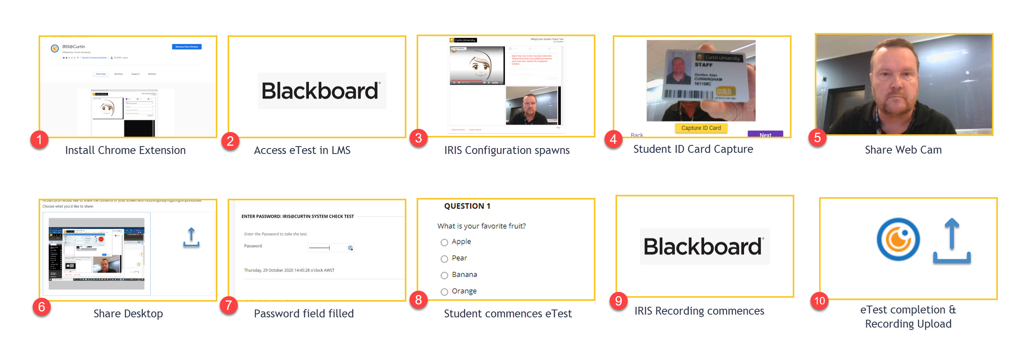
Intelligent Remote Invigilation System (IRIS)
Student Set Up

Slide 6
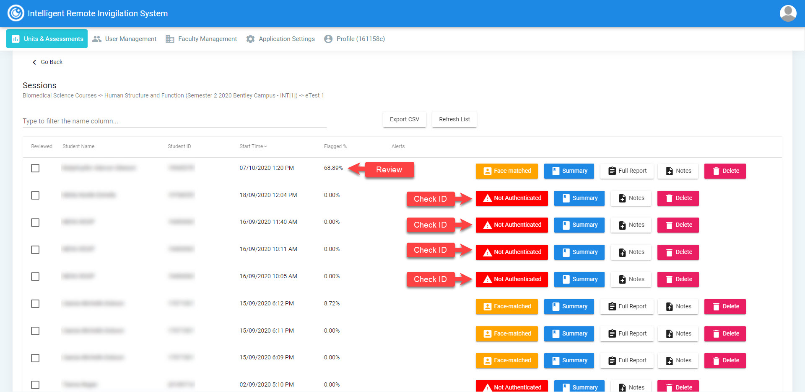
Intelligent Remote Invigilation System (IRIS)
Review and Flagging Interface

Slide 7
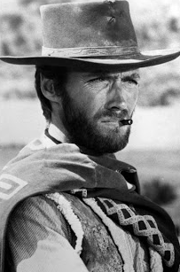
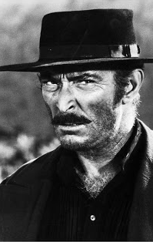
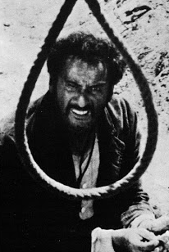
The Good, The Bad and The Ugly
Core Functions of Remote Invigilation– Students, Academics, Admin
No 3rd Party involvement – Data maintained on Curtin Infrastructure
IRIS provides sufficient deterrent to maintain Academic Integrity
Record Review Process Effectiveness - False +ves and Load of Reviews
Scaling User Support is challenging –User Issues – Pre, During, Posts
Remote Invigilation is highly contentious, invasive, Privacy/Risks
Maintaining Development is costly - Build Vs Buy
Student frustration and stress
Untested Scalability (though on AWS)
Security Resilience is a concern with evolving Browser deployment

Slide 8
THANK YOU
Make tomorrow better.

