Slide 1

ACODE Conference
Opening Address
Professor Jill Downie PhD
Deputy Vice Chancellor, Academic
5 November 2020
A global university Western Australia | Dubai | Malaysia | Mauritius | Singapore

Slide 2
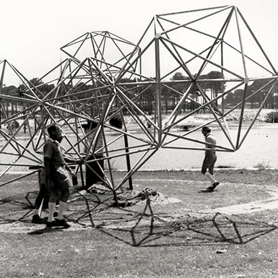
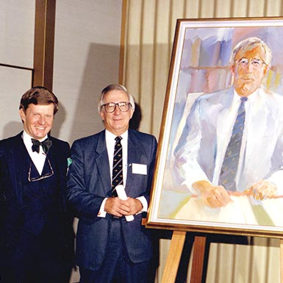


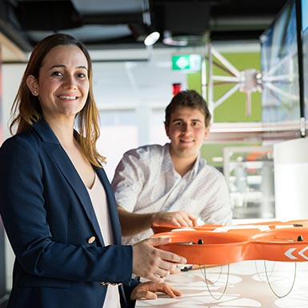
Our journey
Curtin Malaysia opened in 2002, followed by Curtin Singapore (2008), Curtin Dubai (2018) and Curtin Mauritius (2018).
We have more than 225,000 alumni
across the globe.
University status was achieved in 1987.
The Western Australian Institute of Technology opened in 1967 with 2,811 students and 250 staff.
Innovation, engagement and inclusion have always been key
to our vision and ethos.

Slide 3

Curtin Today
Over 57,000 students (37,000 EFTSL);
25% of students are international
12th largest university in Australia &
10th largest for overseas students
Almost 4,000 equivalent full-time staff
Destination of choice for WA university applicants with 53% domestic market share
Major campuses in Perth, Kalgoorlie, Singapore, Malaysia, Mauritius and Dubai

Slide 4

Global Rankings
Curtin has achieved a convergence in national rankings to 9th place for the majority of rankings.
Ranking System | 2017 World | 2017 Natl | 2018 World | 2018 Natl | 2019 World | 2019 Natl | 2020 World | 2020 Natl
Academic Ranking of World Universities | 180 | 9 | 181 | 9 | 212 | 9 | 211 | 9
Univ. Ranking by Academic Performance | 272 | 9 | 249 | 9 | 220 | 9
National Taiwan University Ranking | 326 | 10 | 296 | 9 | 277 | 9
CWTS Leiden Ranking | 355 | 9 | 319 | 9 | 282 | 9 | 271 | 9
Nature Index | 350 | 9 | 375 | 10 | 325 | 8 | 340 | 10
Centre for World Uni. Rankings | 535 | 15 | 400 | 16 | 360 | 9 | 361 | 9
U.S. News - Best Global Univ. Ranking | 264 | 12 | 234 | 9 | 190 | 9
QS World University Ranking | 262 | 15 | 250 | 13 | 230 | 13 | 217 | 13
Times Higher Ed. (THE) Ranking | 397 | 24 | 337 | 20 | 258 | 17 | 246 | 16
Notes:
Source: OSP, "\\staff.ad.curtin.edu.au\common\PER\VC\Shared\OSP\Rankings\05RankingComparisons\2020\RankingsFacultyCampus20200904.pptx"
Note, although Nature edits results for prior years with each new release, old results shown for consistency. Results shown are for “Academic sector” (vs “All sectors”).

Slide 5
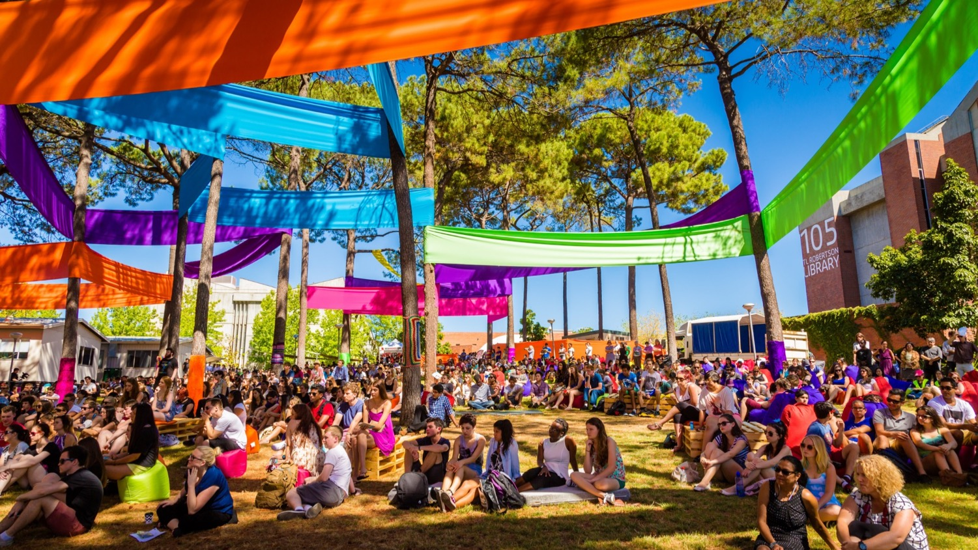
Ever expanding horizons

Slide 6
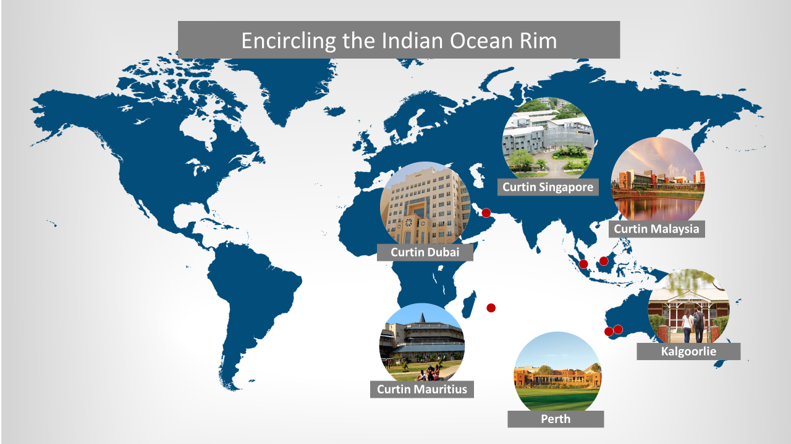

Slide 7
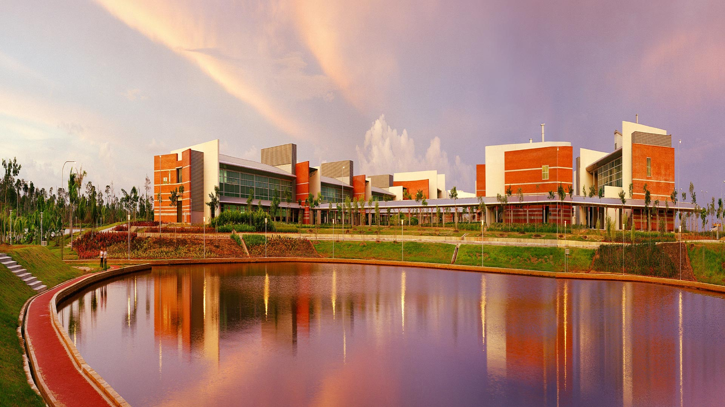
Curtin Malaysia: 2002

Slide 8
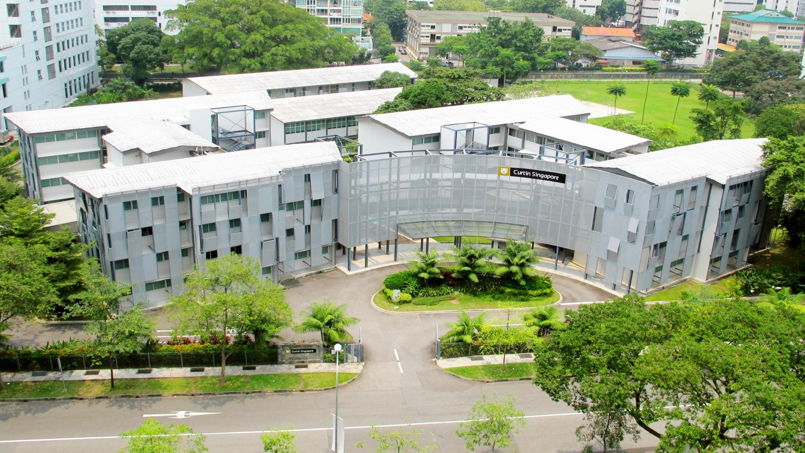
Curtin Singapore: 2008

Slide 9
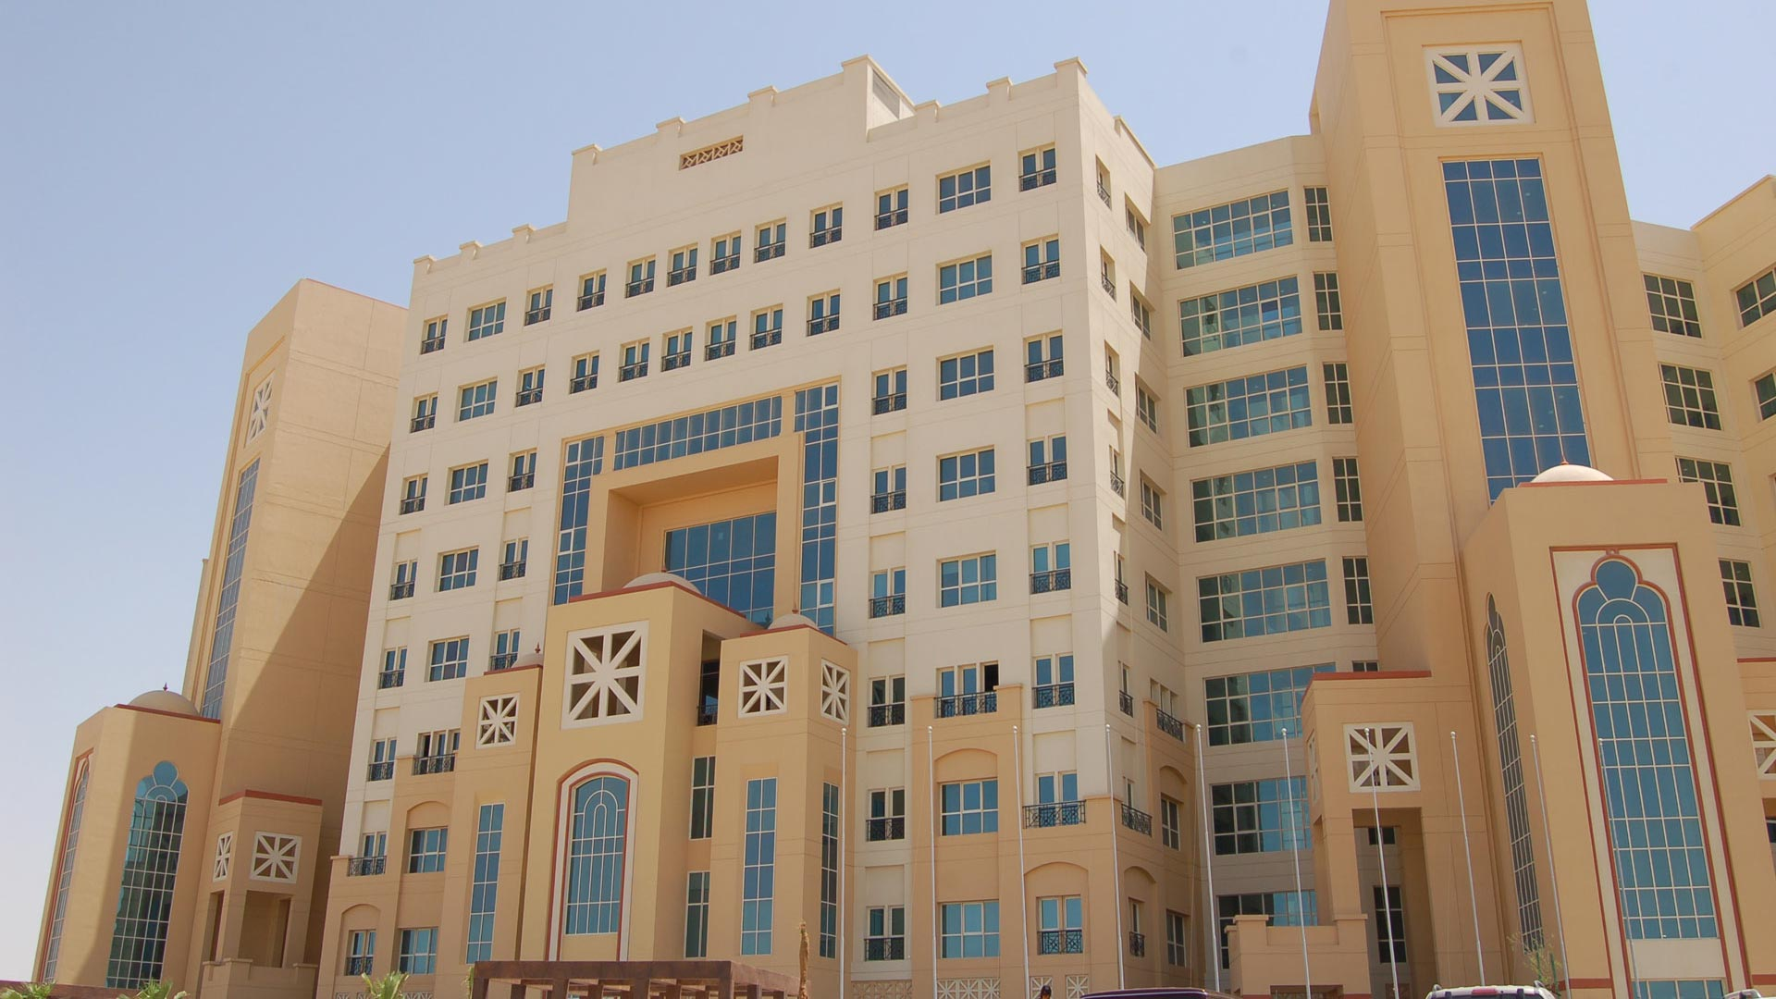
Curtin Dubai: 2018

Slide 10

Curtin Mauritius: 2018

Slide 11

Aberdeen-Curtin Alliance: 2017

Slide 12
Our Strategy

Slide 13
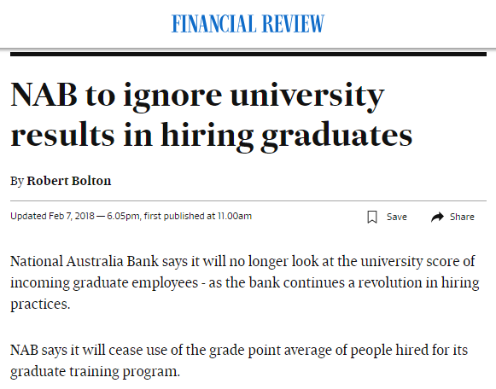
Context of Higher Education
Why Transformation?
Students have unprecedented choice to source knowledge and credentials, globally
Technology has enabled global competition to arrive on Curtin’s doorstep and we must position ourselves to respond
Employers expect something different from graduates and Curtin must engage address this in a whole of organisation way
Data-driven transformation, must inform 21st century learning and teaching practice
Our future is global with an immediate opportunity of 1.53b people in Curtin
In the ‘Era of Intelligence’ data-driven transformation, must inform 21st century learning and teaching practice
Learners choose Curtin because…
Employers choose Curtin learners

Slide 14
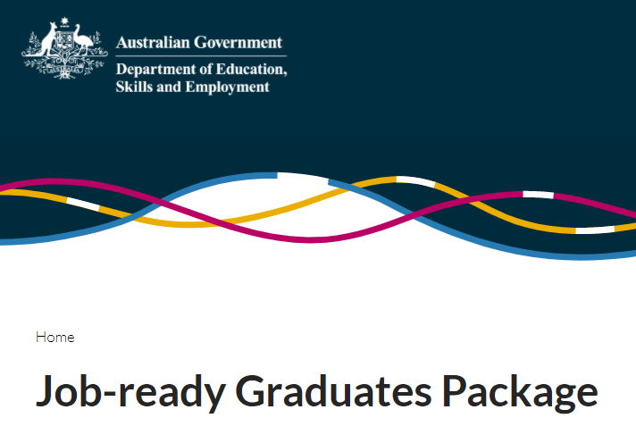
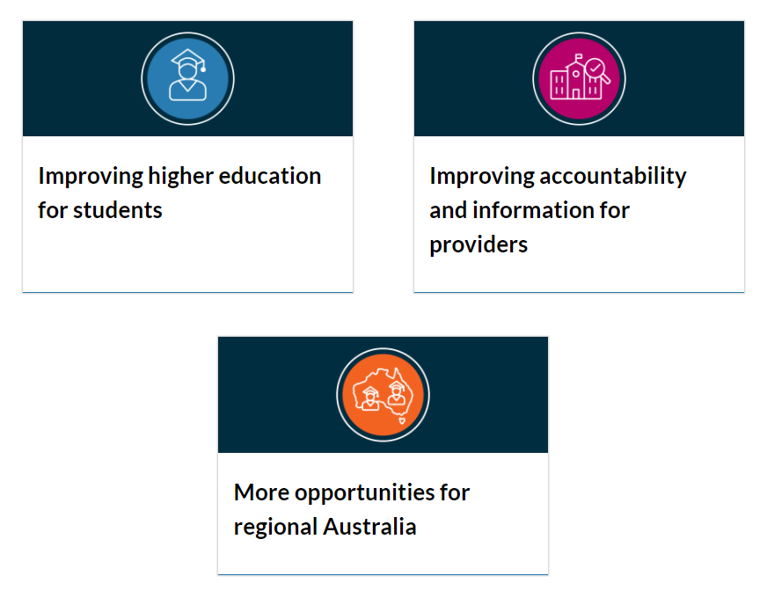
Australian Higher Education
Higher Education Reforms – Job Ready Graduate Reforms. Biggest changes to HE funding in decades. Public opinion?
Changes to Cluster funding and changes to Government and Student contribution for several discipline areas
Revised Indexation for the Commonwealth Grants Scheme – will help funding certainty
50,000 new places for Higher Education Short Courses
12,000 new places for national priority areas?
Napthine Review – additional support for regional Australia
Indigenous, Regional and Low SES Attainment Fund
National Priorities and Industry Linkage Funds? WIL/ Internships ever more important

Slide 15

Innovation in a Covid-19 environment
AGILE Moved 58,000 learners on-line
TECHNOLOGY All lectures recorded on iLecture
  Use of Blackboard (Bb) Collaborate for teaching
  Science Laboratories on-line: videoed
  Virtual labs for Engineering software
GOVERNANCE Changed policies/procedures: Entry pathways, Semester Start and Grades
COMMUNICATION Cisco Webex Meetings – connecting staff
SUPPORT & ENGAGEMENT WITH CUSTOMERS Curtin Calling >5,000 phone calls, Scholarships
MENTAL HEALTH Counselling outbound calls to international students
OPPORTUNITIES for the business/global market – new platforms

Slide 16
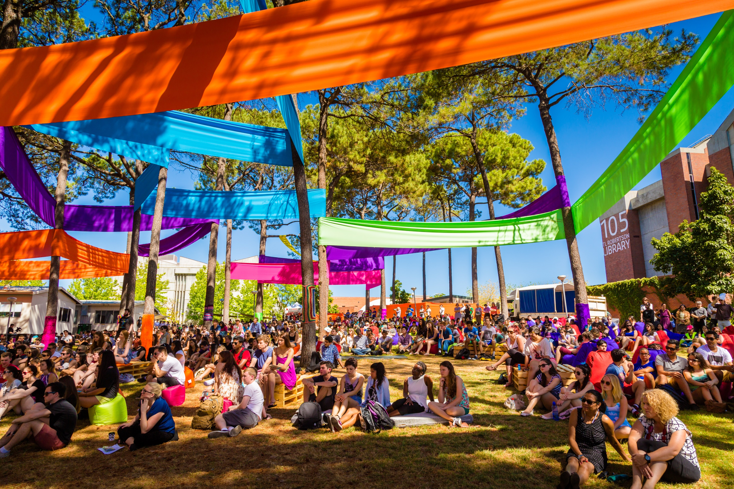
Long Term gains Post Covid-19
Capitalise on the SILVER LININGS – Lectures, not to return and changes to Assessment - no Exams
WORKFORCE RESTRUCTURE - cultural inertia,
re-skilling exercise, scale, step-wise change
WORK PRACTICES - Changed for the foreseeable future. Working from home. Capitalise on this. EBA.
ACCELERATION IN AI/ TECHNOLOGY - Increased use of Technology and Virtual labs. Automation/AI
INDUSTRY SOLUTIONS - Microcredentials to be accepted by industry – here to stay. Create a vision for step wise change.

Slide 17

Learning for Tomorrow Strategy
What are we trying to achieve?
Enable teaching and learning in modes that best support learning outcomes, in ways that scale profitably
Personalised learning at scale
Engage in industry embedded and industry enabled courses, globally
Ensure Curtin Learners are equipped as graduates for the future workforce
Facilitate the identification and exploitation of new markets
Be a leader in innovation and data-driven transformation

Slide 18
Curtin Credentials – Nano/Micro/Macro
Employers
Learners
$22.15 billion worth of economic value is generated in the Perth CBD
Care more about actionable learning than university credentials.
Seeking direct link from investment in learning to organisational value.
Seeking exposure to new ideas and access to credible expert facilitators.
Signalling maturing support for demand-driven research.
Interest in non-traditional credentials
Credentials are valued secondary to the learning experience
Preference for bite-sized, modular, compact offerings.
‘Universities are writing and distributing albums - we want to stream songs and make our own playlists’
Top 5 Industries
Professional, Scientific & Technical
Other industries
Public Administration & Safety
Health Care
Financial & Insurance
Mining
…Market Insights

Slide 19
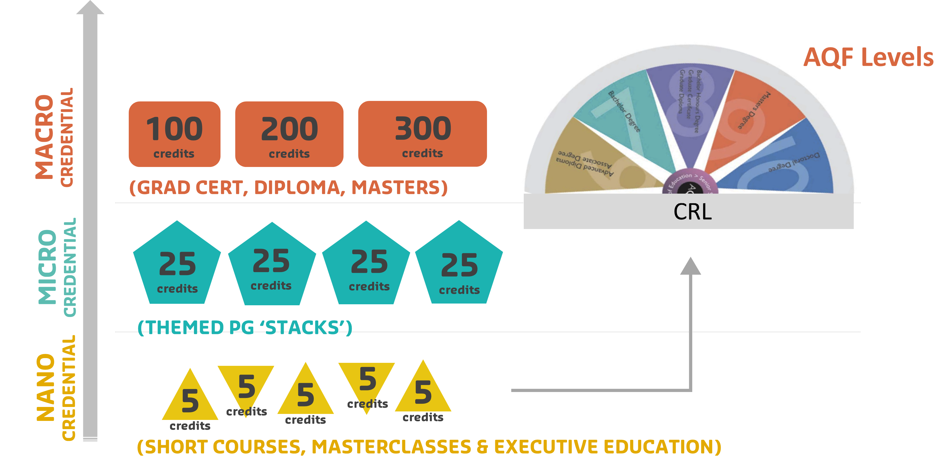
New models of credit for lifelong learning

Slide 20

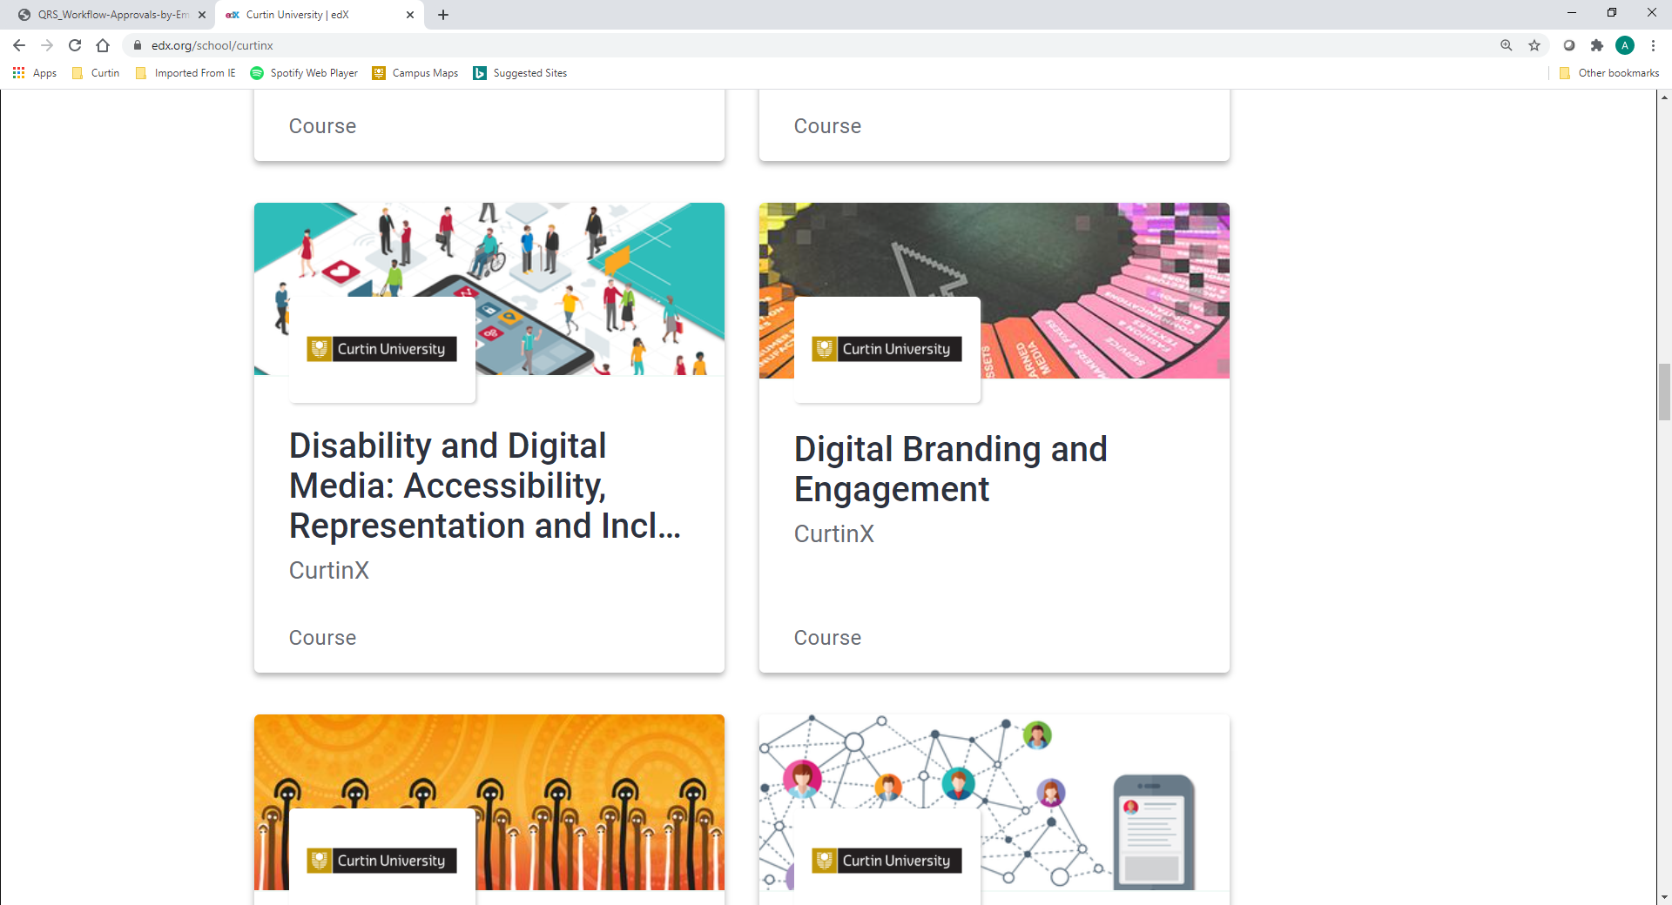
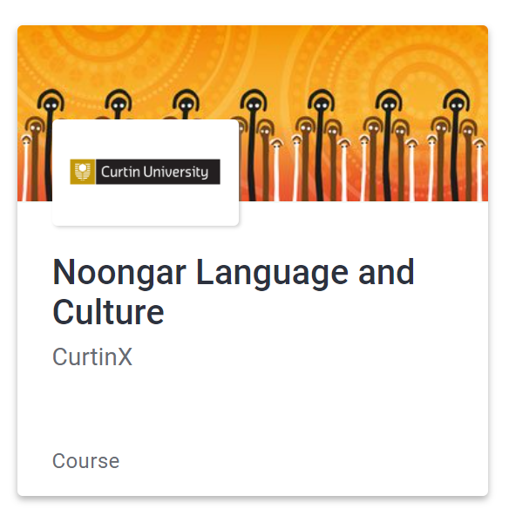
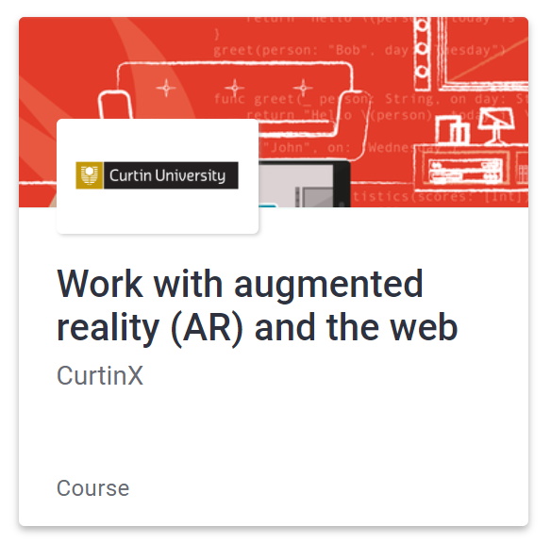





Partnership
762,200 edX learners (205,201 new edx learners in 2020)
25 current courses, 4 in development
2 MicroMasters Programs, 1 Professional Certificate Program and 1 XSeries Program
  New Professional Certificate Program The Foundations of Modern Mining co-created with The University of Queensland
New MOOCs
  Talk to me: Improving Mental Health and Suicide Prevention
  Talk to me: Managing Study, Stress and Mental Health at University
Curtin invited by edX to be a Charter member
Notes:
The MicroMasters in the Internet of Things has been nominated as a finalist in the WA IT and Telecommunications Alliance (WAITTA) INCITE Awards in the category “most transformative impact on education”.
As part of its Mahindra Rise initiative, technology giant Tech Mahindra will interview candidates in India who have successfully earned this MicroMasters certificate and meet other role-specific criteria. Valid through 2020.
DASE1x Disciplined Approach to Social Entrepreneurship, will commence as a self-paced course on 9 July. Learners will gain the relevant knowledge and skills to develop their own project plan. The course is underpinned by in-depth interviews with four successful social entrepreneurs, Selco in India, Friendship in Bangladesh, Edible Garden City in Singapore and Greenbatch in Perth, Australia. This course is a cross-faculty initiative led by Subra Ananthram and Danelle Cross (Business and Law), Jo Li Tay (Humanities), and Chris Rawson (Science and Engineering) as an outcome of their participation in the prestigious global Bootcamp on Entrepreneurship hosted by Massachusetts Institute of Technology (MIT).

Slide 21


What does the future hold?
AI & Machines will fulfil part of the Teacher’s role
Automatic questioning and correction, diagnosis of learning problems, timely feedback, assessment of problem-solving skills. There will be an augmented environment.
Makerspace classrooms – flexible student journey’s
There will be different ways to achieve learning outcomes, evaluate learning. Teachers will be more innovative and develop new knowledge.
Multidisciplinary learning – Microcredentials, Student Choice?
Creation, Collaboration, Construction. Multidisciplinary and personalized
learning based on learning needs. AI Learning Assistant’s for self-learning.
New space created by the interaction of the physical and virtual worlds
Technologies will deeply transform current teaching methods, Holograms, deep learning, ways of giving feedback will change. Facial recognition.
Professor WU Zhaohui, Zhejiang University, China

Slide 22

Thank you
Make tomorrow better.

