Slide 1
Staff development for technology-enhanced learning and assessment
an institutional overview
Carol Russell

Slide 2
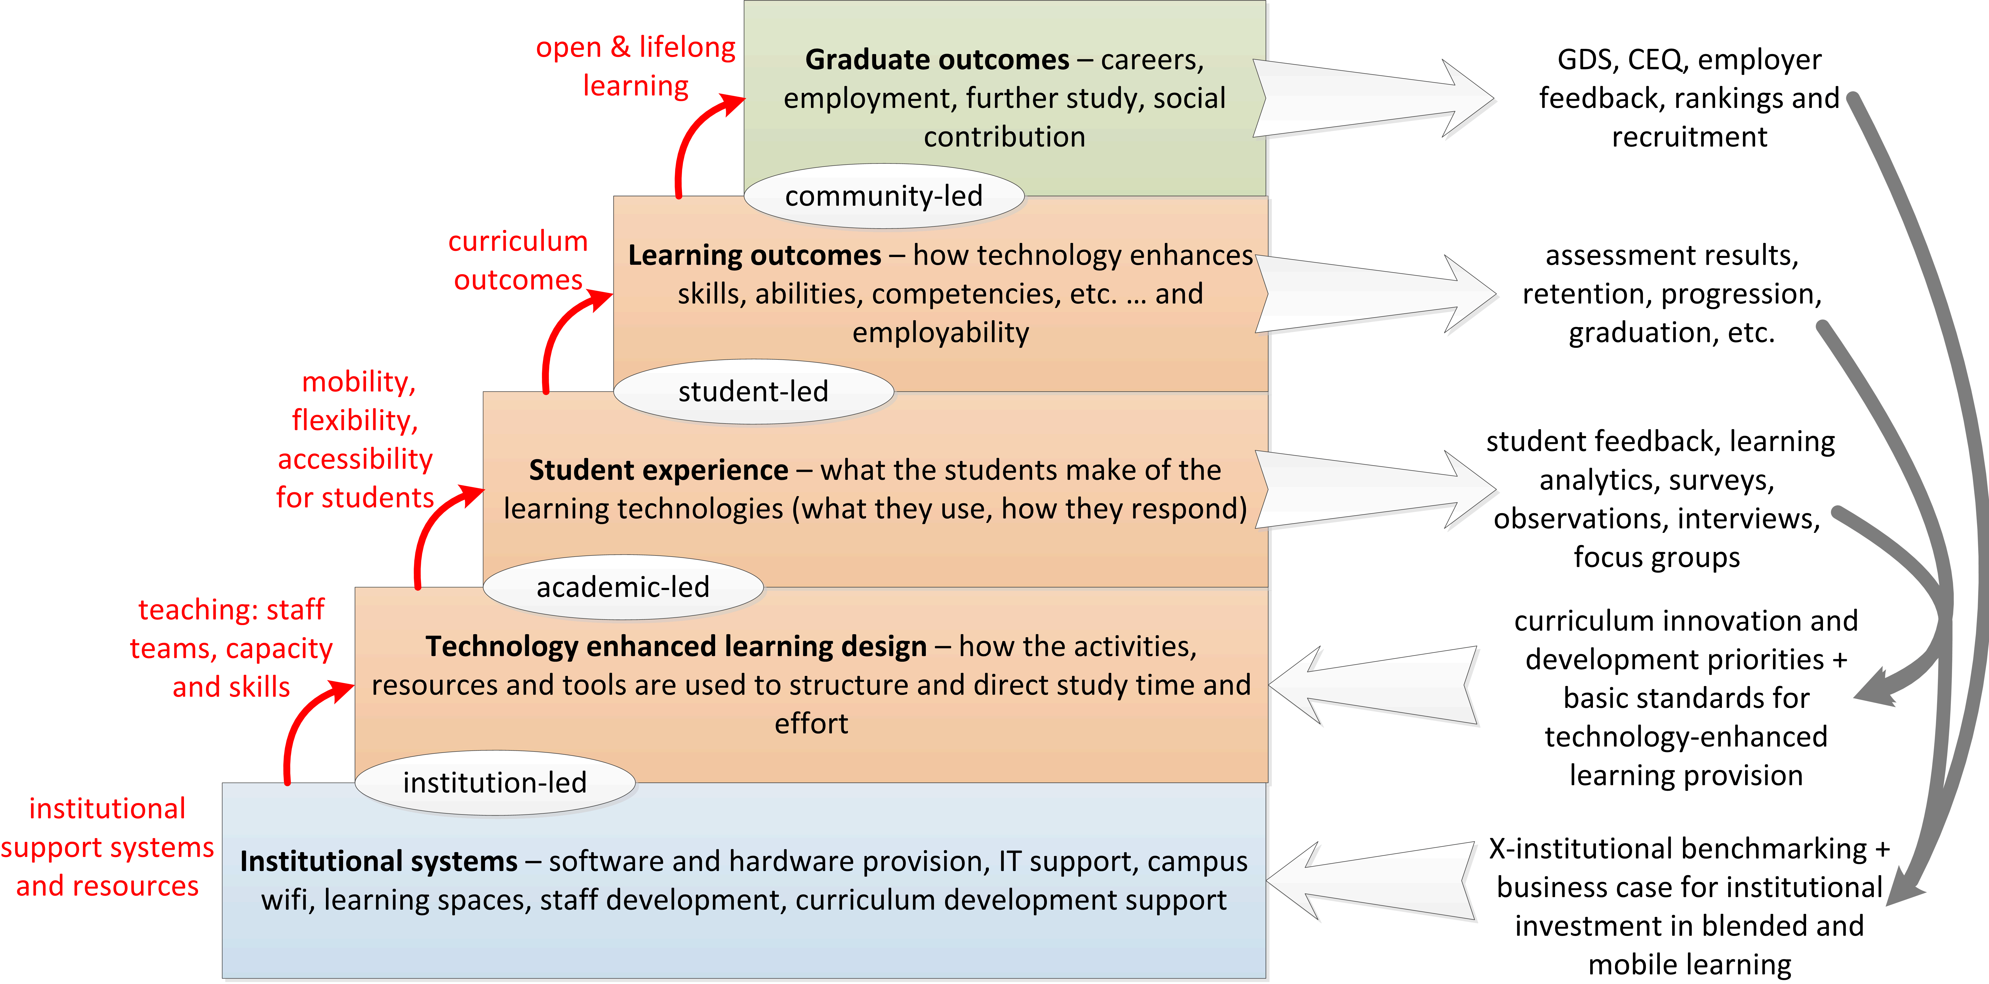
Why staff development?
… supporting strategic outcomes from the bottom up

Slide 3
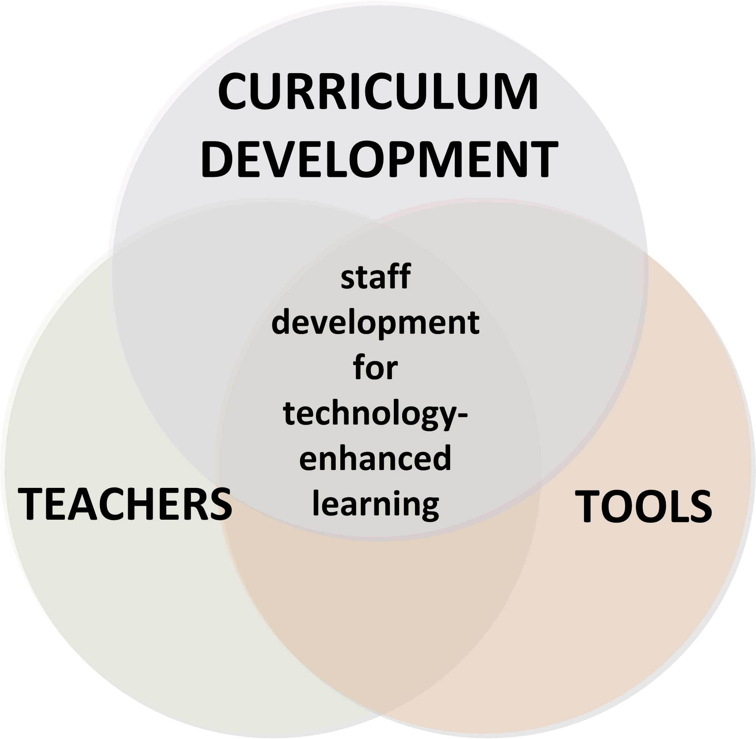
Overall strategy

Slide 4
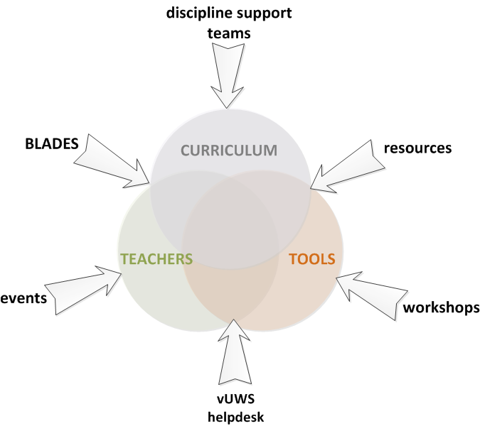
Inputs

Slide 5
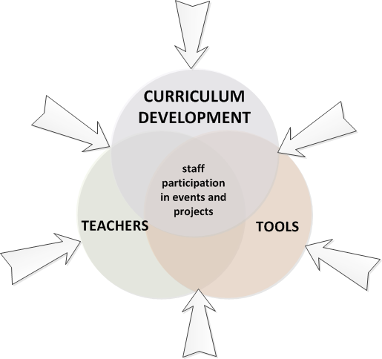
Processes

Slide 6
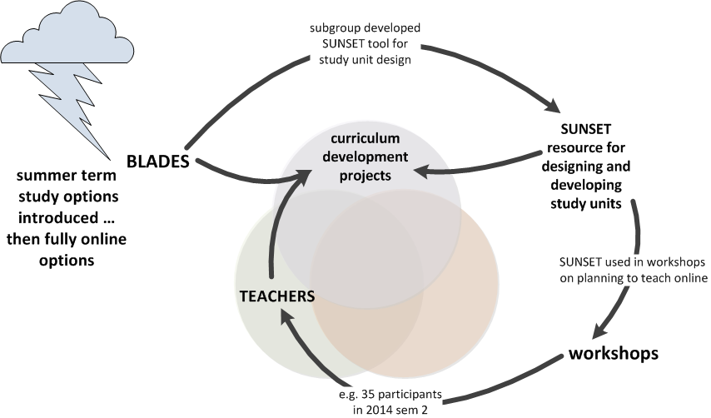
Example 1: designing for study units

Slide 7
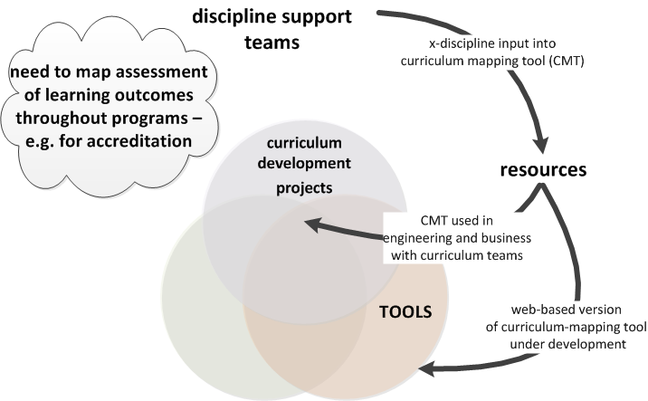
Example 2: designing for degree programs

Slide 8
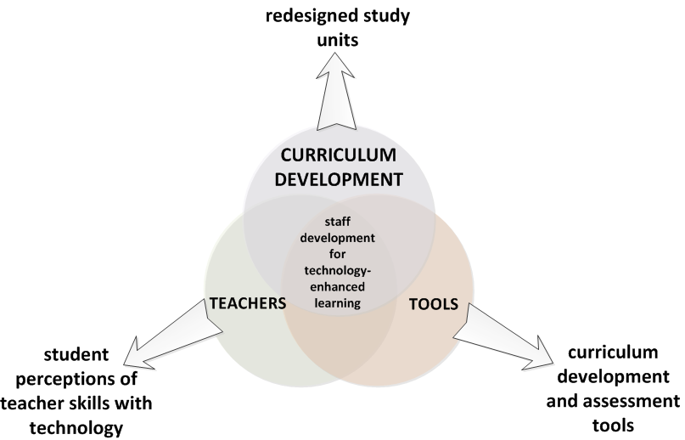
Measurable outcomes

Slide 9
Our Future Program
Summary of redesigned study units by SchoolBLENDED LEARNING STATUS
Progress
School Unit Status
UWS Unit Status
** Some of these units will complete early in 2015
Quarter | Completed | On Track | Yellow | Red | Total
January | 414 | 8 | 38 | 32 | 492
– behind schedule requiring a plan to rectify; –behind schedule with a plan to rectify; –on track; –completed
As at January 31st 2015

Slide 10
Tools
monitoring and evaluating
designing and developing curriculum
delivering learning activities

Slide 11
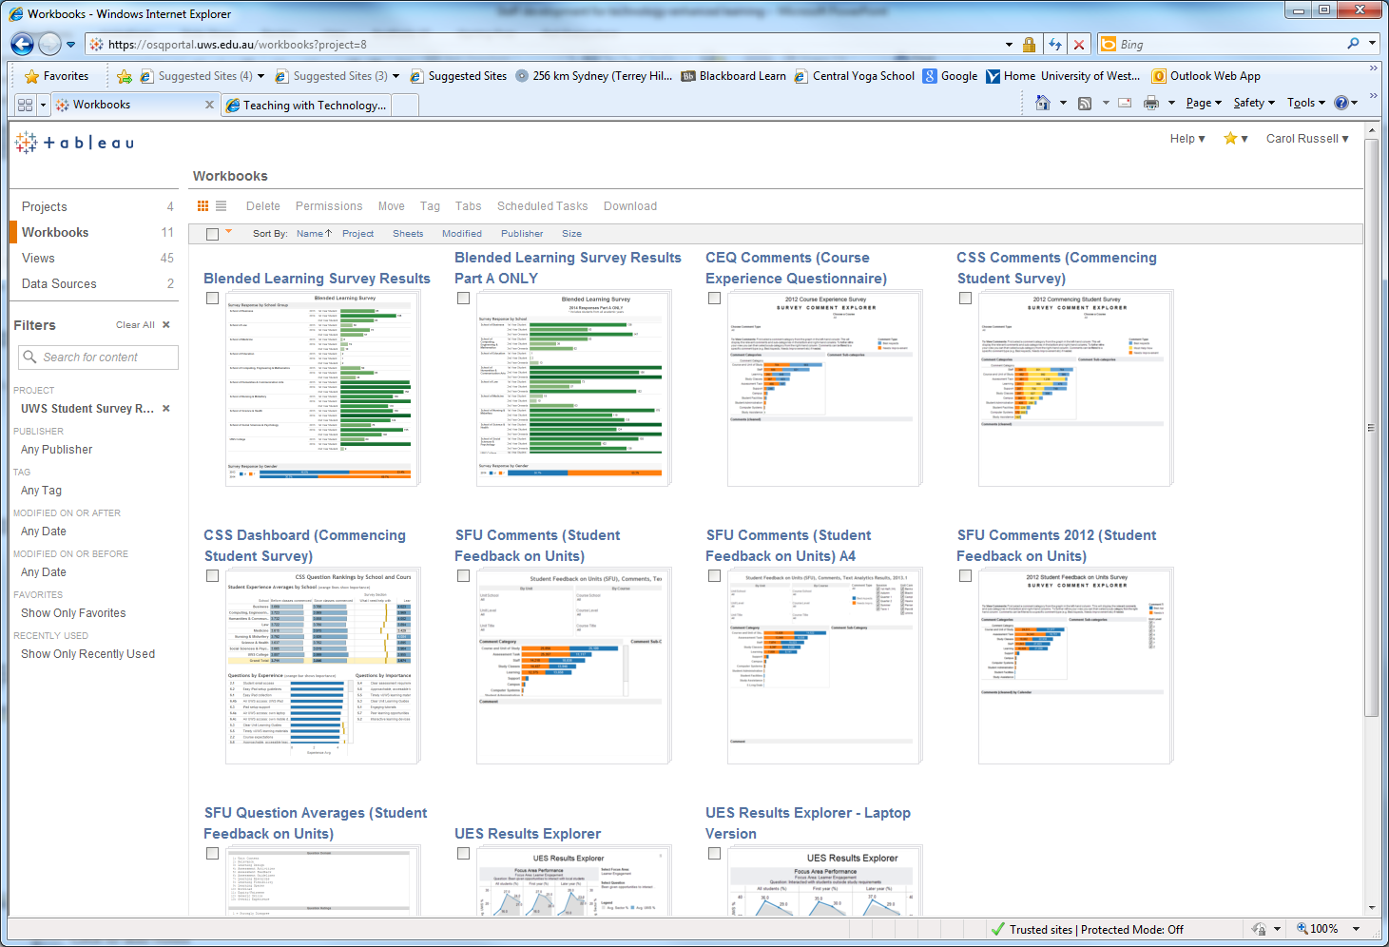
Student feedback

Slide 13
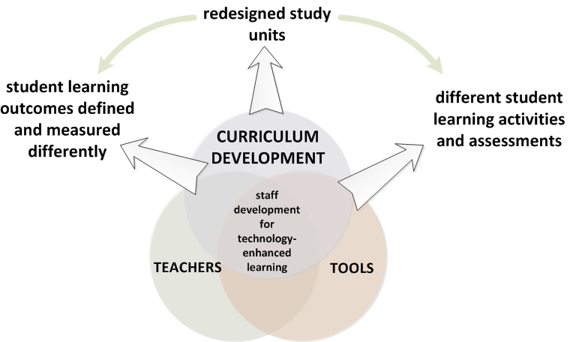
How do we prove it’s better than before?
e.g. more work-integrated learning & team projects
e.g. ‘choose your own adventure’ case study assessments

Slide 14
Evidence for institutional investment?

Slide 15
Questions
What systemic curriculum changes (i.e. in assessed learning outcomes) are taking place?
How are you supporting staff in making these changes?
What evidence do you have that it’s worth the investment?
What other evidence is needed?

