Slide 1
Developing student capabilities through self, peer and benchmarking assessments with SPARK and REVIEW

Slide 2
1980s graduate application
Written CV and application letter
Fly to a capital city for interview
Lunch

Slide 3
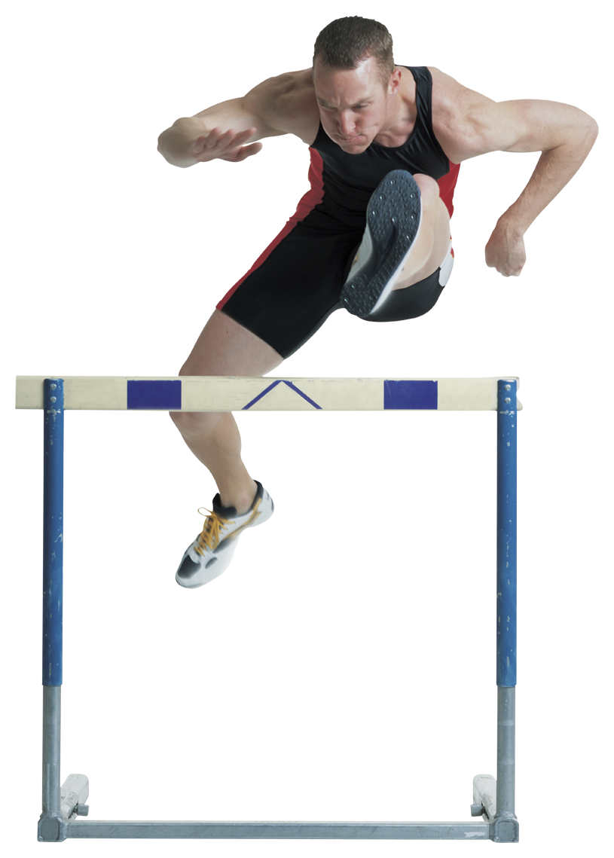
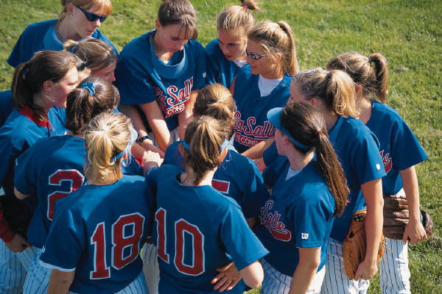
2013 graduate application
Online application form
Online tests – psychometric, skills
Skype interview – 30 secs read question, 2 mins answer, repeat
Whole day team problem-solving activities

Slide 4
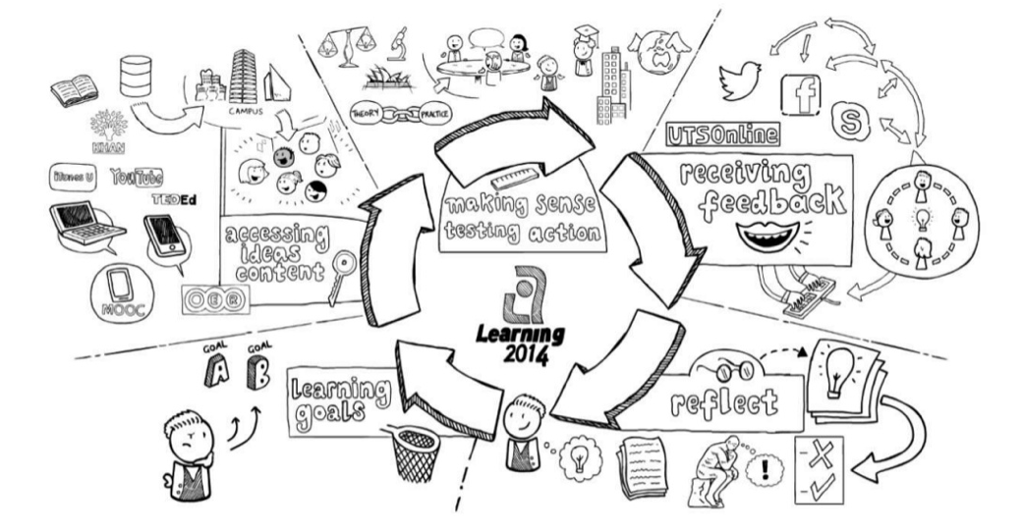
learning.futures: Learning2014 practices
http://www.uts.edu.au/research-and-teaching/teaching-and-learning/learning2014/new-approaches
Notes:
4.1 and 4.3 The Learning2014 strategy focuses on what students need to do in order to learn – set goals for their learning, access and engage with learning resources from all sources, come to class and make use of what they’ve learned, face to face and using technologies in class, receiving feedback and reflecting. Learning technologies are an integrated part of the UTS Learning2014 – soon to be renamed – strategy. Based on generative learning, connectivist and experiential learning principles.

Slide 5
learning.futures: Learning2014 practices
http://www.uts.edu.au/research-and-teaching/teaching-and-learning/learning2014/new-approaches
Notes:
4.1 and 4.3 The Learning2014 strategy focuses on what students need to do in order to learn – set goals for their learning, access and engage with learning resources from all sources, come to class and make use of what they’ve learned, face to face and using technologies in class, receiving feedback and reflecting. Learning technologies are an integrated part of the UTS Learning2014 – soon to be renamed – strategy. Based on generative learning, connectivist and experiential learning principles.

Slide 6
The original
of contribution to group effort in group projects

Slide 7
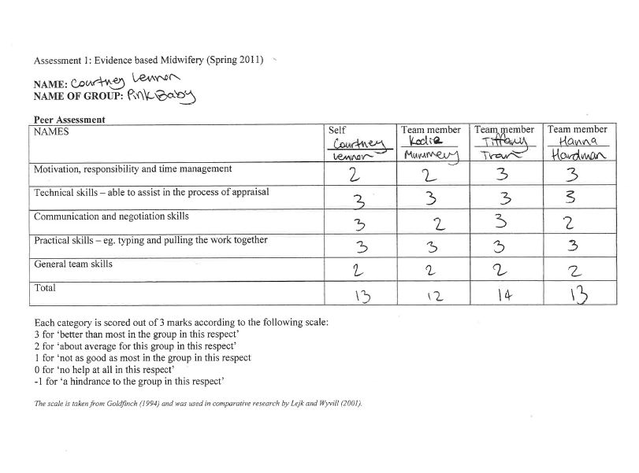

Slide 8
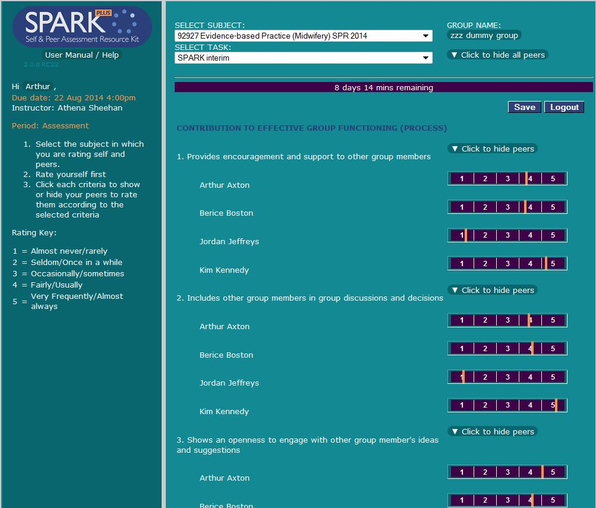
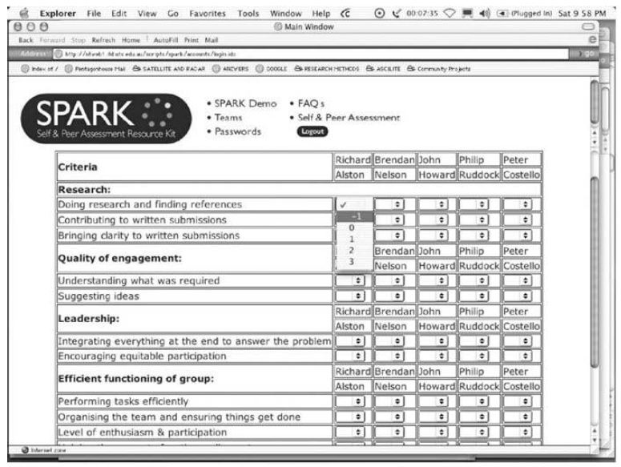
Developing judgement and teamwork skills
Feedback on performance relative to others

Slide 9
of other students, artifacts, questions, to support pre-work and collaborative learning in class

Slide 10
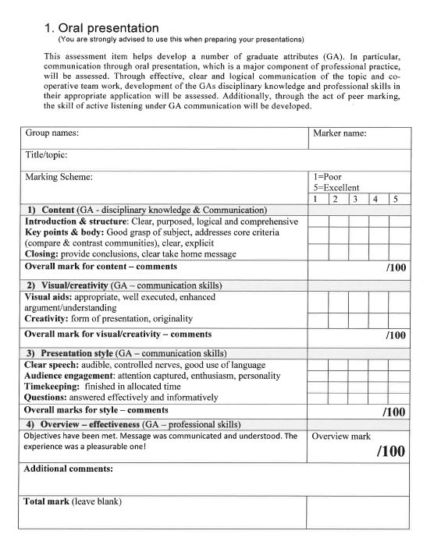
Classroom assessment of peer work

Slide 11
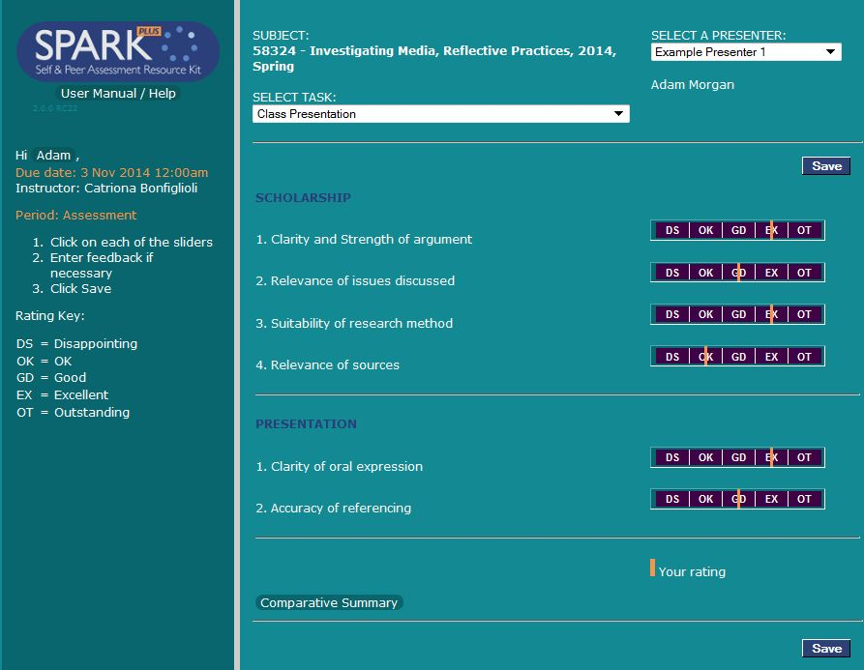

Slide 12
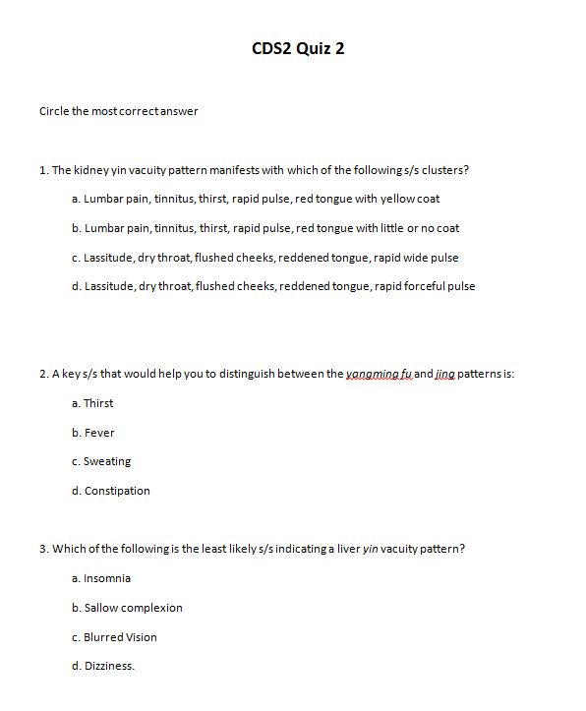
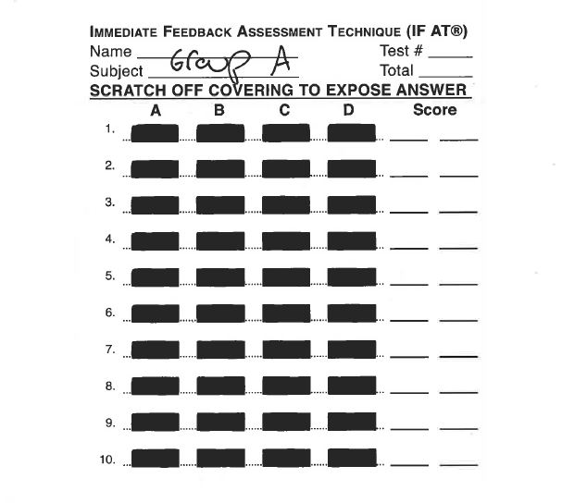
Formative quizzes before or during class
Quiz

Slide 13
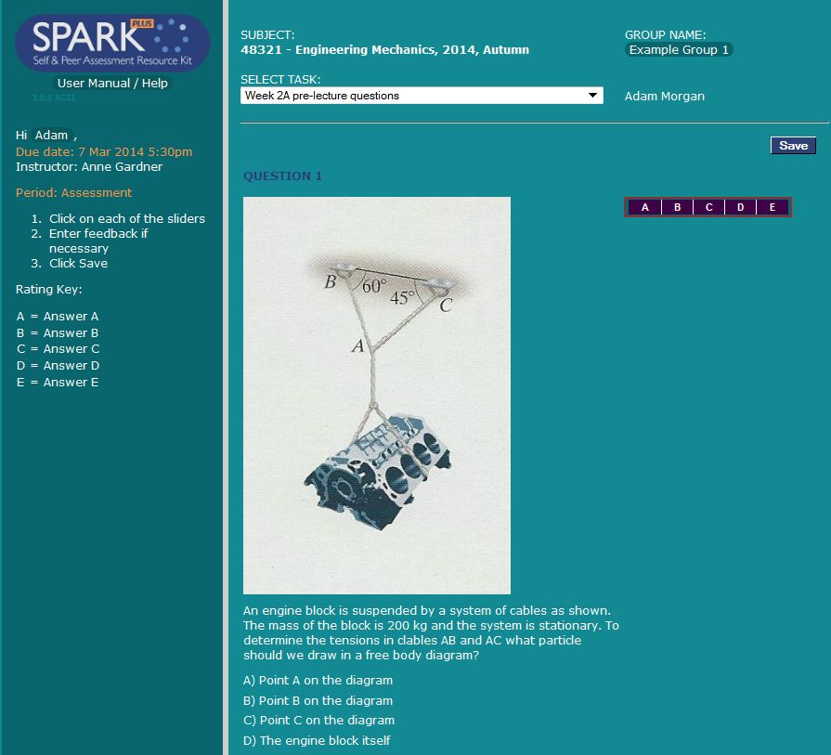
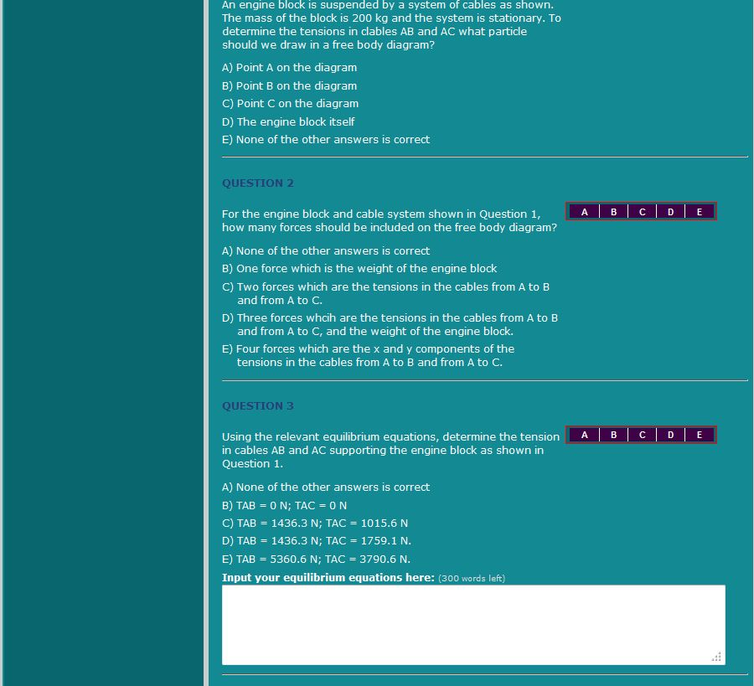
Classroom
Quiz

Slide 14
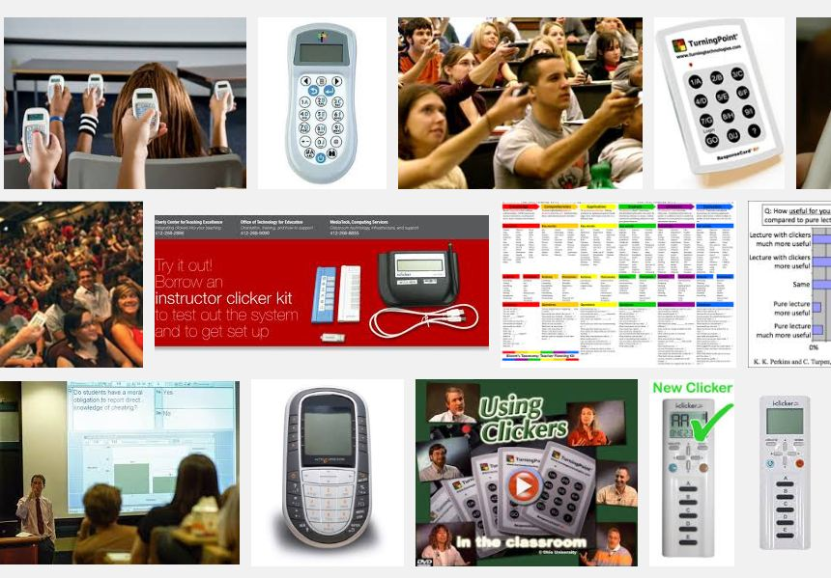
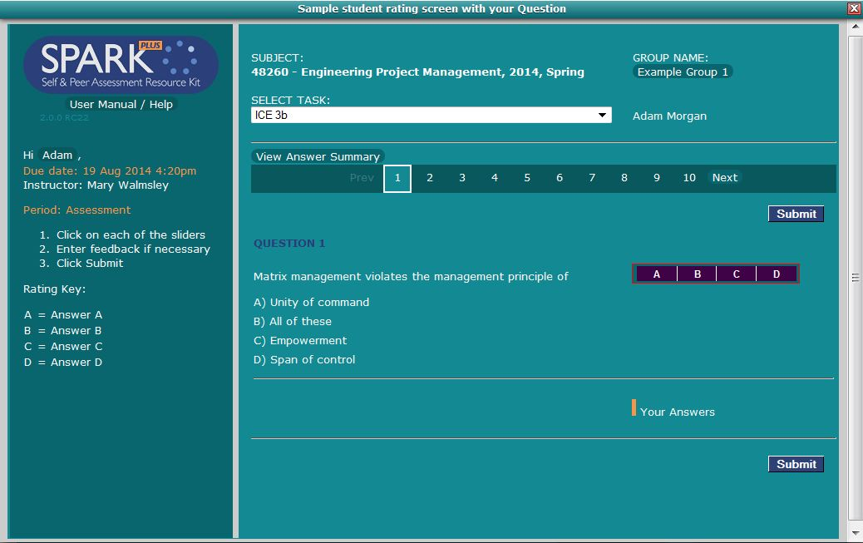
Classroom response
POLL
A, B, C, D

Slide 15
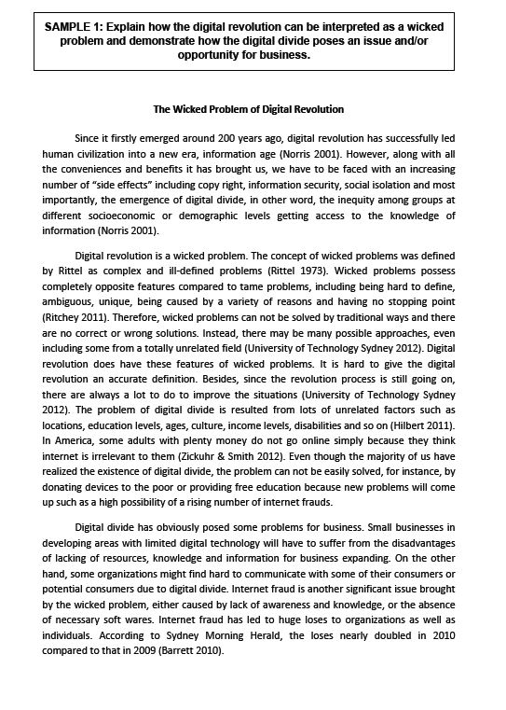
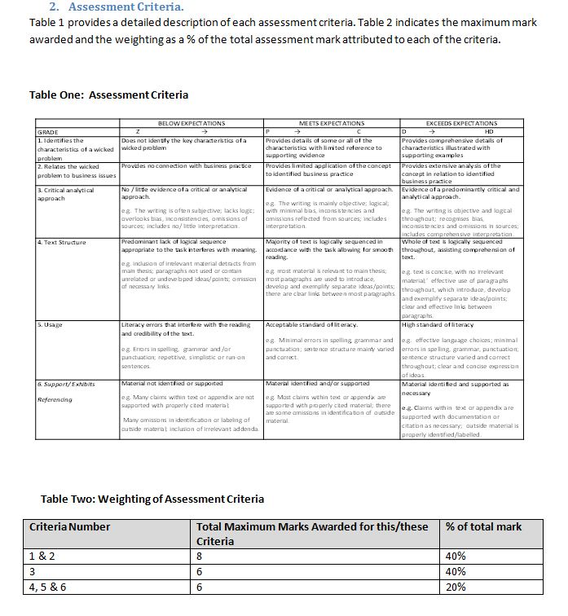
Classroom

Slide 16
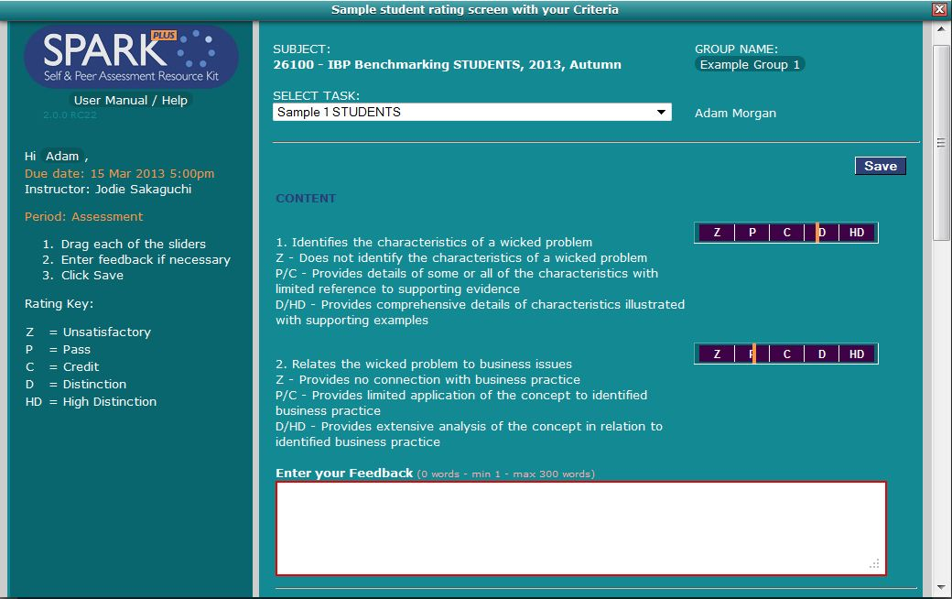
Classroom

Slide 17
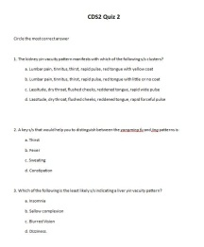
multiple assessor mode
eg assessing presentations
contribution to groups mode
multiple/quiz/clicker choice mode
benchmarking mode
eg for helping students to understand criteria

Slide 18
What the student sees (& does)

Slide 19
same log-in
as UTSOnline

Slide 20
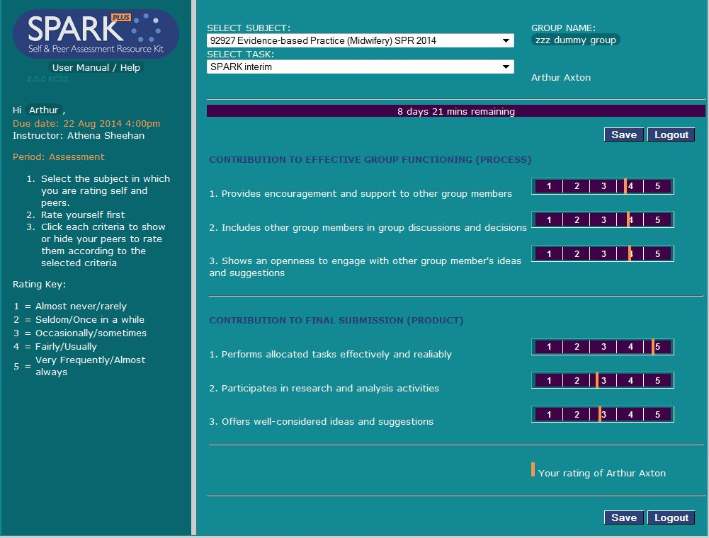

Slide 21
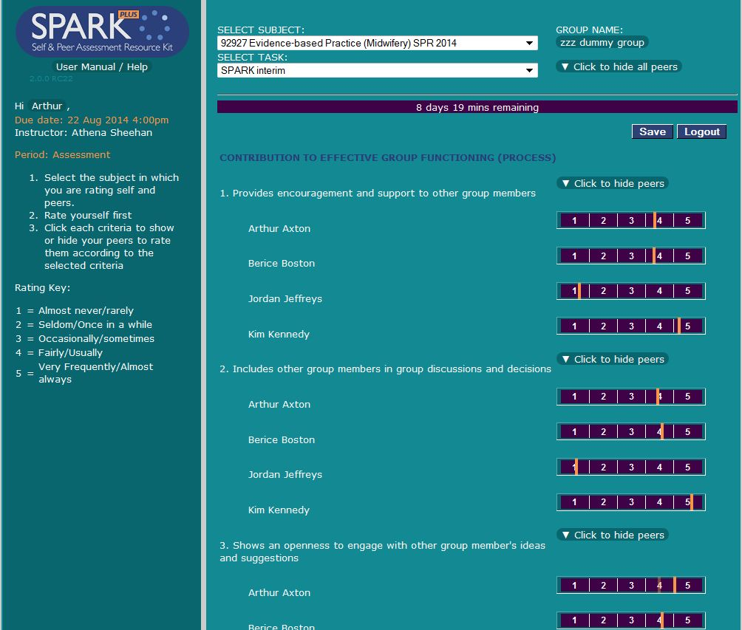

Slide 22
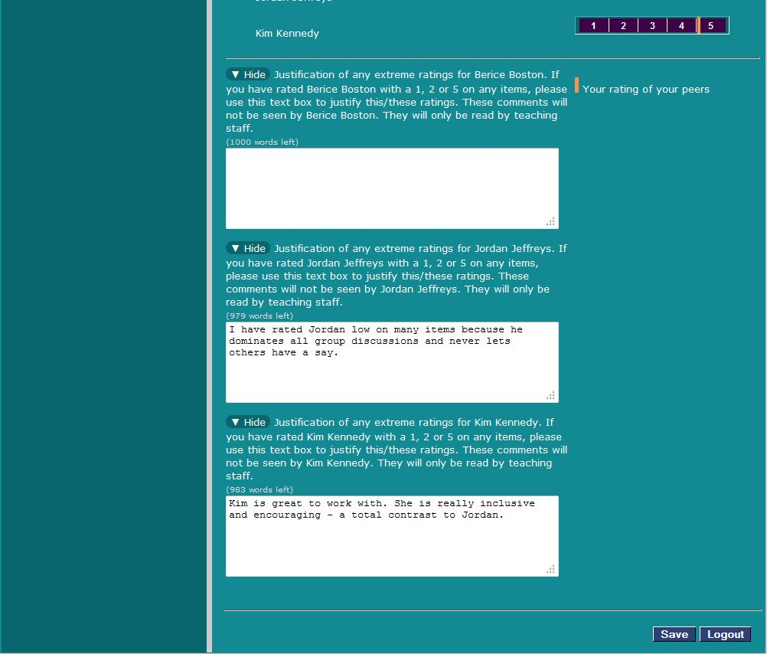

Slide 24
What the “instructor” sees (& can do)

Slide 25
same log-in
as UTSOnline

Slide 26
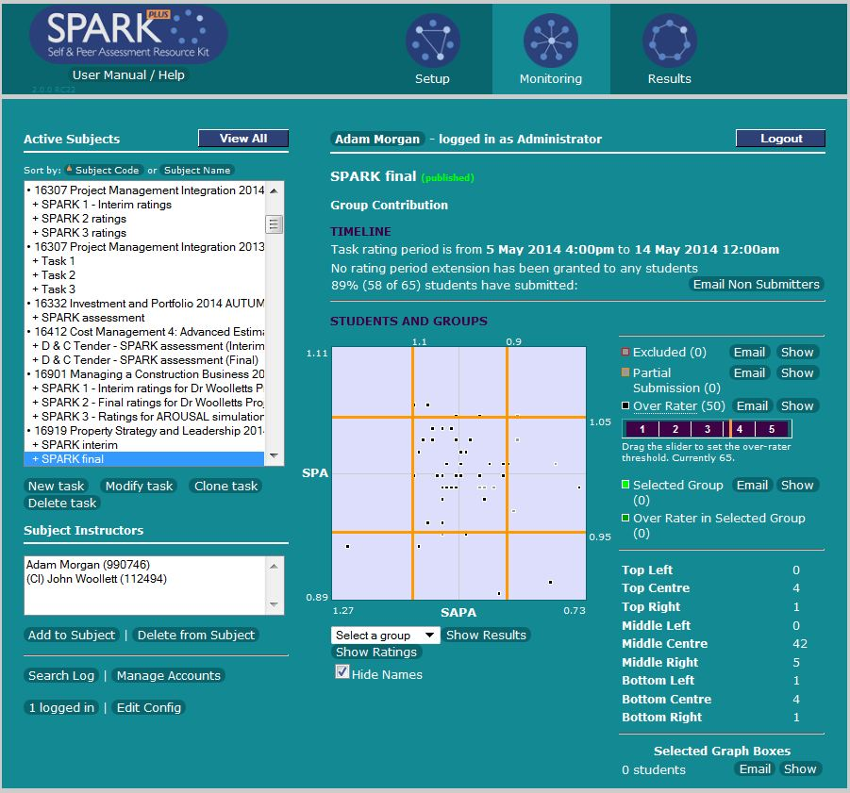

Slide 27
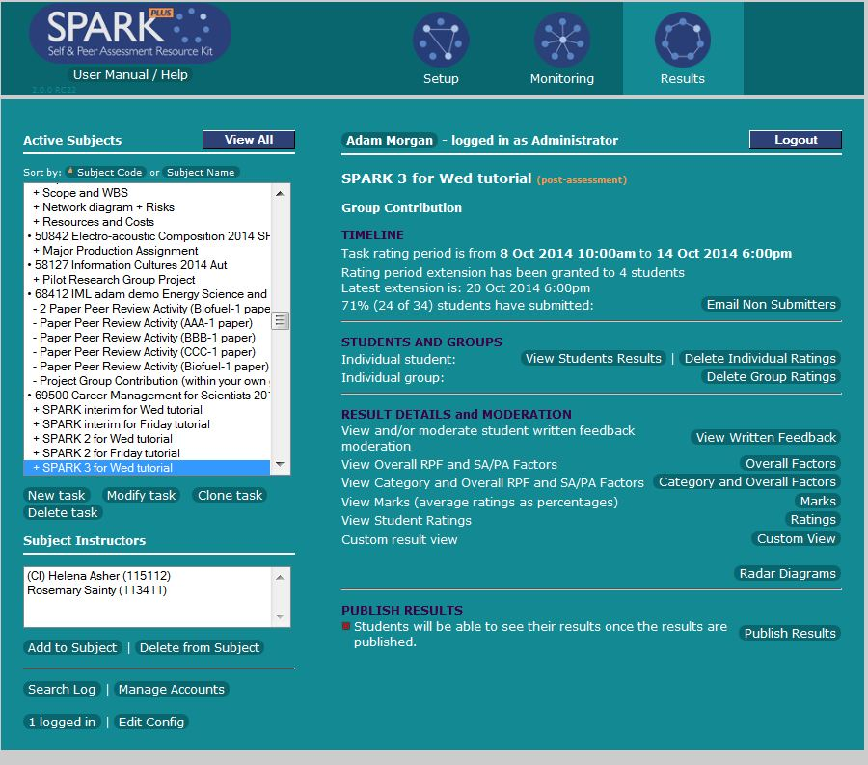

Slide 28
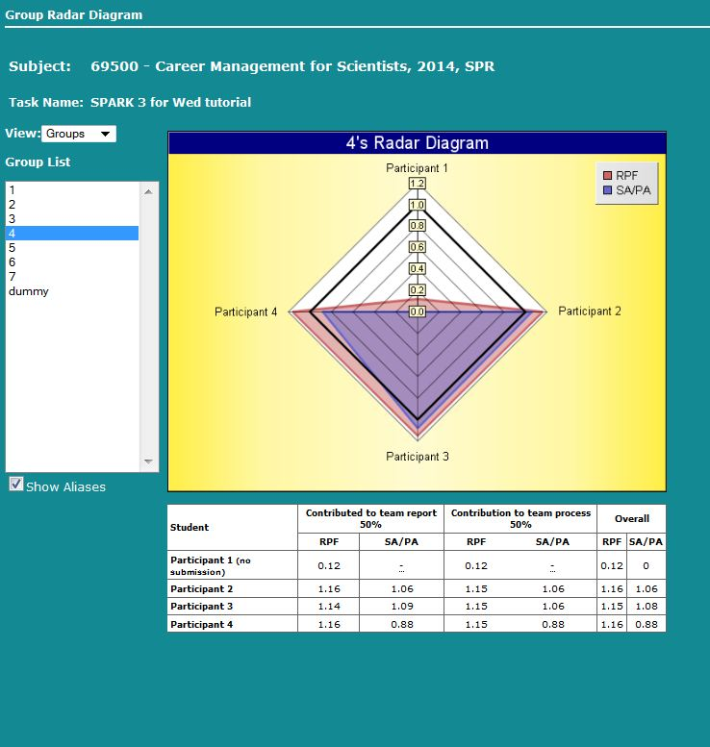

Slide 29
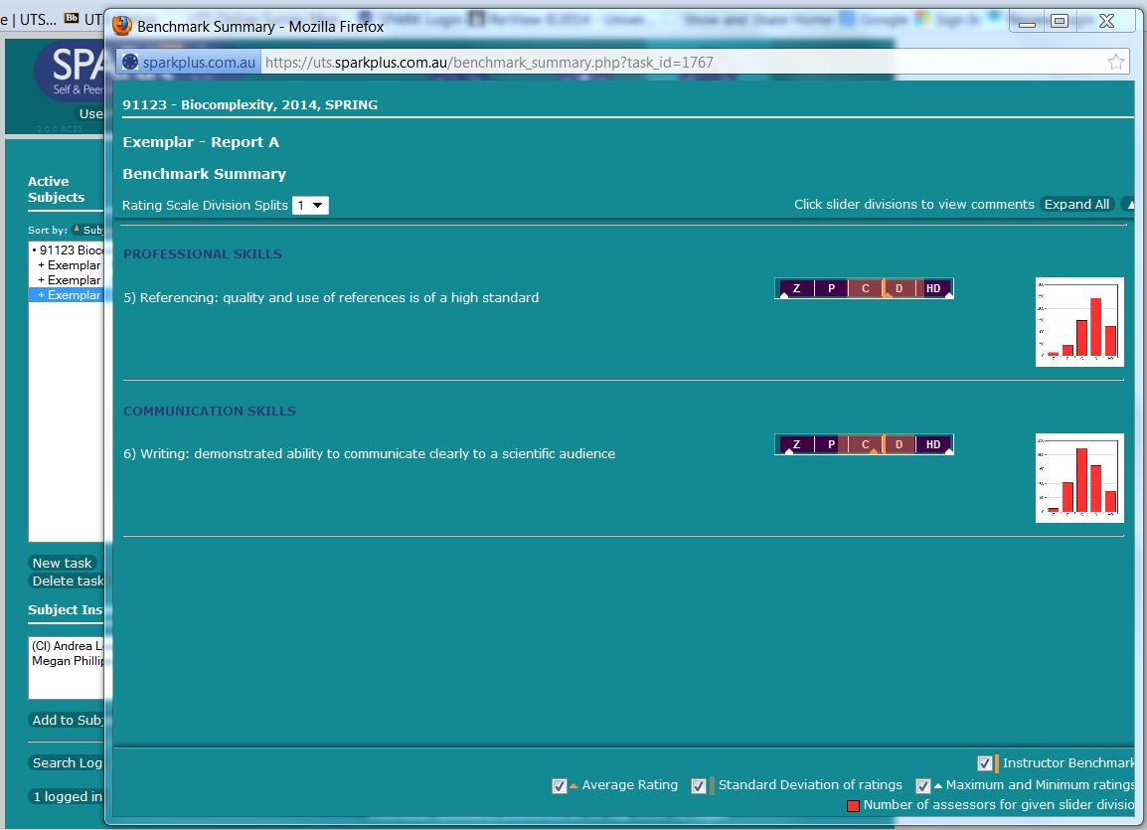

Slide 30
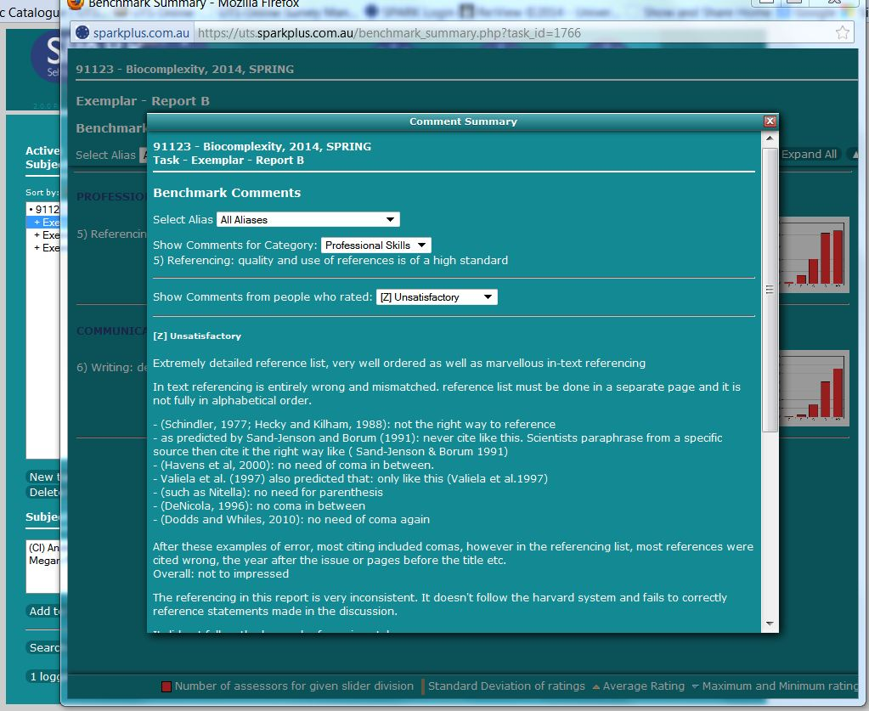

Slide 31
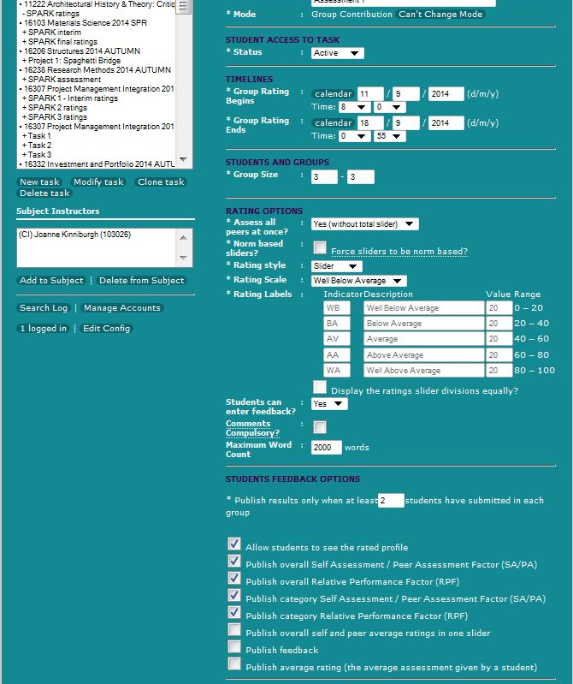
flexible

Slide 32
the text box

Slide 33
Questions?

