Slide 1
ACODE 67 Simulation design for authentic learning and assessment
Stephen Guinea
Australian Catholic University

Slide 2
Introduction
Simulation at ACU
Simulation and authentic learning
Simulation, authentic learning and authentic assessment

Slide 3
Simulation at ACU
Faculty of Health Sciences
6 Schools
13 health disciplines
Notes:
Simulation at ACU
My role at ACU
FHS and the Schools that this contains
Generally the focus of simulation within the FHS is on learning rather than assessment. This is changing.

Slide 4
Simulation and Authentic Learning
Drivers for authentic simulation activities:
Requirement for non-traditional clinical placements
Requirements set by credentialing bodies
Collaboration between education and industry

Slide 5
Simulation and Authentic Learning
Drivers for authentic simulation activities:
Growing acceptance for innovative approaches to clinical experience
Better understanding of simulation pedagogy
Design of authentic learning experiences
Herrington and Oliver (2000)
Lave and Wenger (1991)
Notes:
Simulation and authentic learning
Increasingly the concept of authenticity is being employed as the framework from which to design simulation activity
Driven by a greater understanding of simulation pedagogy
Gaining momentum in designing immersive simulation activity upon sound educational theory
LPP: observation from the boundary or "legitimate peripheral participation." As learning and involvement in the culture increase, the participant moves from the role of observer to fully functioning agent. Legitimate peripheral participation enables the learner to progressively piece together the culture of the group and what it means to be a member.
Authenticity: operationalises the principles of learning through participation in the authentic practices of work..

Slide 6
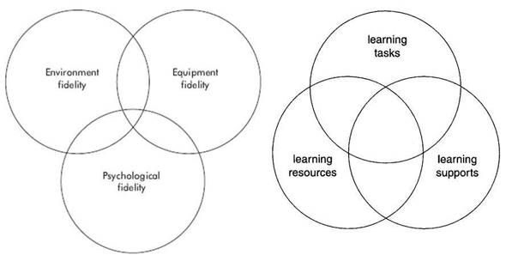
Simulation and Authentic Learning
Elements of
Authentic Learning
Elements of Fidelity

Slide 7
Simulation and Authentic Learning
Characteristics of Authentic Learning Environments:
Authentic context
Authentic tasks (processes)
Expert performances
Multiple roles and perspectives (negotiated meaning)
Collaborative construction of knowledge
Opportunities for reflection (evaluation)
Opportunities for articulation of tacit knowledge
(shared repertoire)
Coaching and scaffolding
Authentic assessment
(Herrington & Oliver, 2000)
Notes:
Current literature suggests that useable knowledge is best gained in learning environments which feature the following characteristics

Slide 8
Simulation and Authentic Learning
Case One: Paramedicine
Notes:
First attempt:
Evaluated according to rather than designed according to…

Slide 9
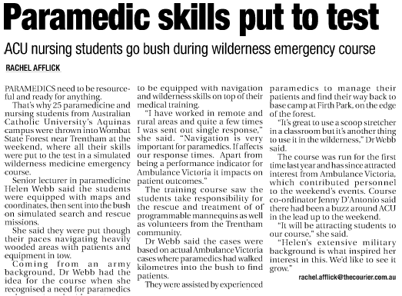
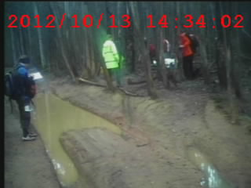
Ballarat Courier, Monday 15th October 2012
Notes:
Simulated search and rescue
Joint exercise with SES, AV volunteers, academic staff and students
2 days in Wombat State Forest
Set up camp, search strategies, stabilisation and retrieval.

Slide 10
Authentic Learning
Outcomes
New understandings of interpersonal relating
New understandings in maturity, respect and tolerance
New understandings of self-awareness within a team
Belonging and professional identity
Ford, R., Webb, H., and Allen-Craig, S. (2014). A simulated wilderness exercise: the
development of relational competence in paramedic students.
Journal of Paramedic Practice, 6(11), pp:574-581
Notes:
Design:
Herrington and Oliver:
Authentic (extreme) context
Authentic activities, tasks, work
Expert performances
Multiple roles and perspectives
Collaborative construction of knowledge
Reflection and evaluation
Articulation of tacit knowledge
Learning as an outcome of participation in authentic work
Negotiated meaning
Engagement with authentic tools, language, people
Coaching and scaffolding
Authentic assessment (formative)
Outcomes
Learning focused more than assessment focused.
New understandings of interpersonal relating
New understandings in maturity, respect and tolerance
New understandings of self-awareness within a team
Belonging and professional identity

Slide 11
Simulation, authentic learning and authentic assessment
Case Two: Occupational Therapy
Notes:
Simulation, authentic learning and authentic assessment
Occupational Therapy
Need to have demonstrable outcomes as this was part of the curriculum
Authentic assessment – SPF-R

Slide 12
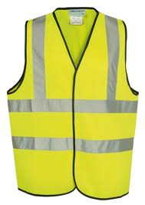
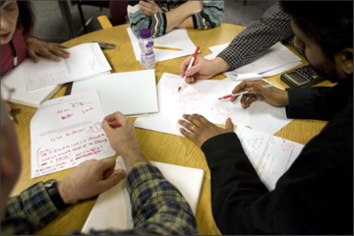
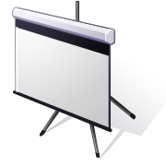
Monday
Students oriented to workplace, clinical supervisor, work process and receive referral
Tuesday
Interview simulated clients and health professionals
Wednesday: conduct workplace visit with clinical supervisors / academic staff
Friday
Case presentation to clinical supervisors and peers
Thursday
Assessment reports and intervention plans

Slide 13
Simulation, authentic learning and authentic assessment
SPF-R short version
Communication
Professional behaviour
Self-management
Client reports and documentation
Return to work plans
Notes:
Learning and assessment
Feedback throughout (colleagues, facilitators, clients, interviewees)
Formalised workplace assessment
Documentation
Return to work plans (accountability)

Slide 14
Where to next…
Case Three: Nursing
Notes:
Simulation, authentic learning and authentic assessment
Occupational Therapy
Need to have demonstrable outcomes as this was part of the curriculum
Authentic assessment – SPF-R

Slide 15
Where to next…
E-Health record for learning:
Context authenticity
Process authenticity

Slide 16
Where to next…
E-Health record for assessment:
Mechanisms for:
Peer evaluation
Academic evaluation
Linkages to portfolios

Slide 17
Conclusion
Health simulation needs to learn from others
Designing according to fidelity does not facilitate authentic assessment
Adopting principles of authentic learning environments aids alignment of assessment

Slide 18
References
Ford, R., Webb, H., and Allen-Craig, S. (2014). A simulated wilderness
exercise: the development of relational competence in paramedic students. Journal of Paramedic Practice, 6(11), pp:574-581
Herrington, J., & Oliver, R. (2000). An instructional design framework for
authentic learning environments. Educational Technology, Research and Development, 48(3), 23-48
Lave, J., & Wenger, E. (1991). Situated learning: Legitimate peripheral
participation. New York, NY: Cambridge University Press
Rodger, S., Bennett, S., Fitzgerald, C., & Neads, P. (2010). Use of simulated
learning activities in occupational therapy curriculum. Final report.: Health Workforce Australia

