Slide 1
Assessment Practice and Technology Enhanced Learning Educational Futures

Slide 2
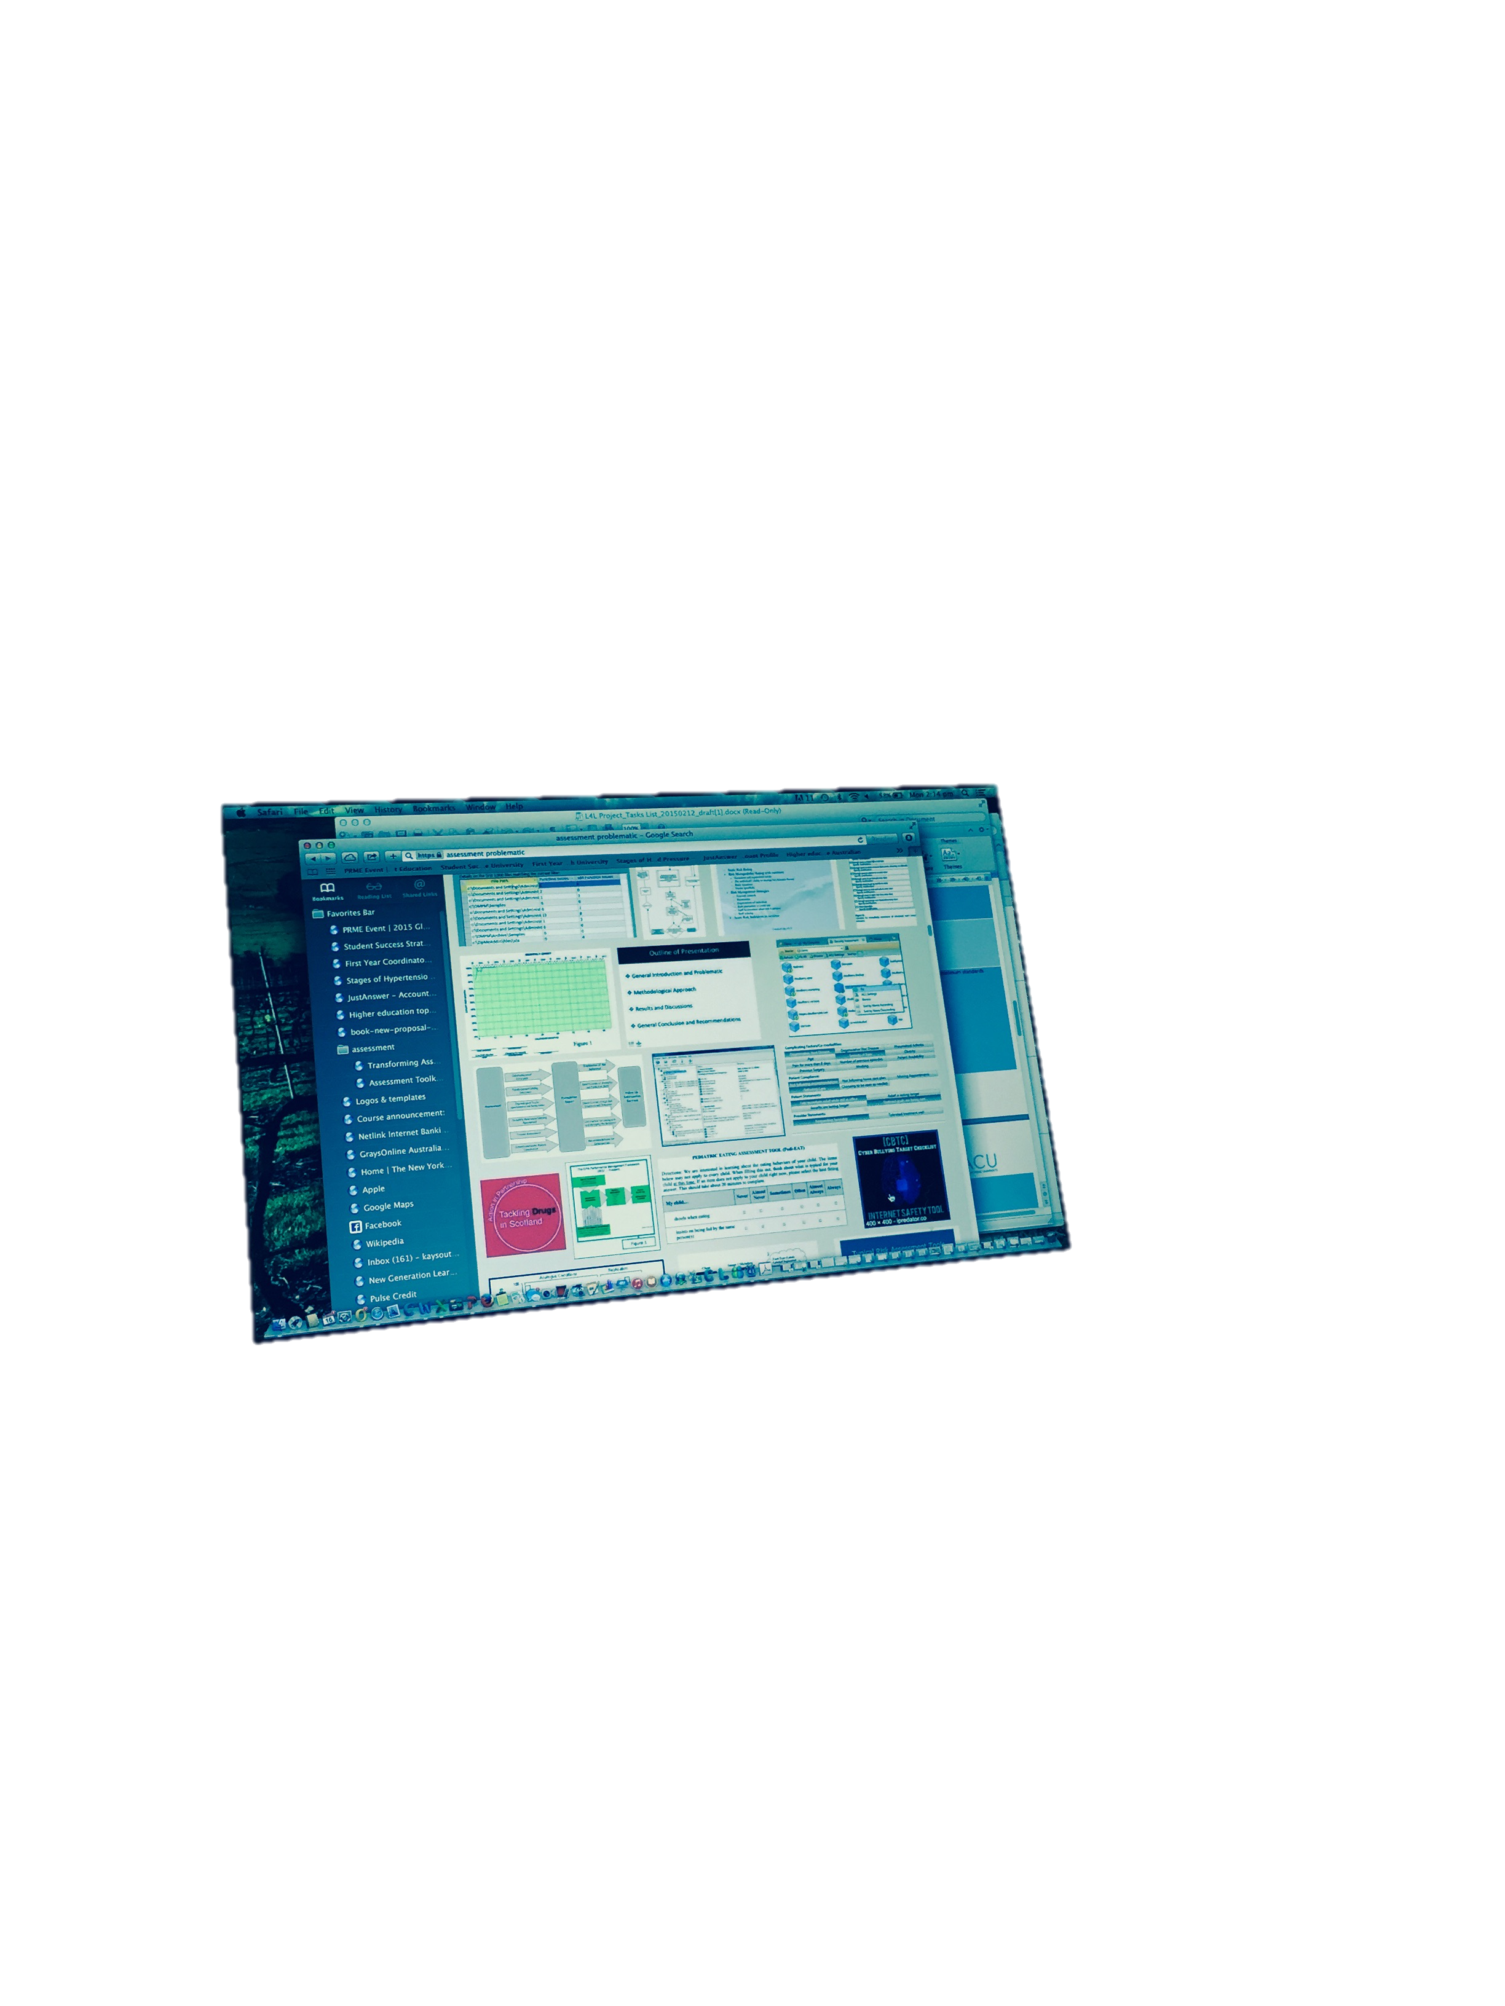
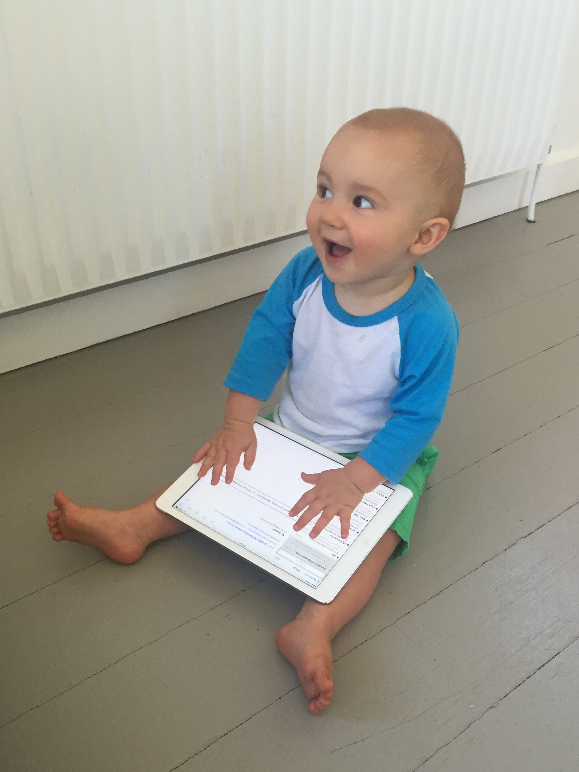
Utopias/dystopia

Slide 3
We can’t predict the future because we don’t know the context
Check out attempts to do so, like Walter Cronkite’s hilariously gendered view of the modern office https://www.youtube.com/watch?v=V6DSu3IfRlo)

Slide 5
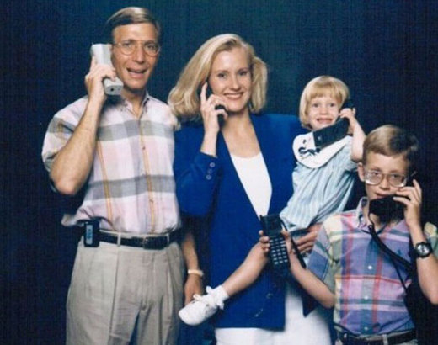
Getting it right

Slide 6
Summary of horizon reports
Notes:
Audrey Watters, Feb 2015. Says she’s interested in the history rather than getting it right.
I am quite interested in getting it right, but the history is interesting too imagining a future where we will have more leisure to sort things out (like gamifications which always seems to be about 4 years out)
Discussion:
What do you think the reports mean?

Slide 7
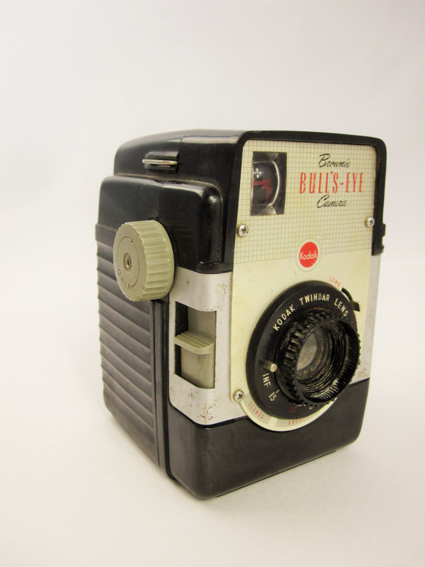
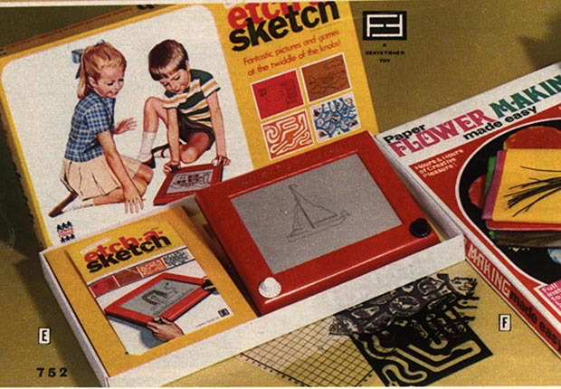
60s fun tech

Slide 8
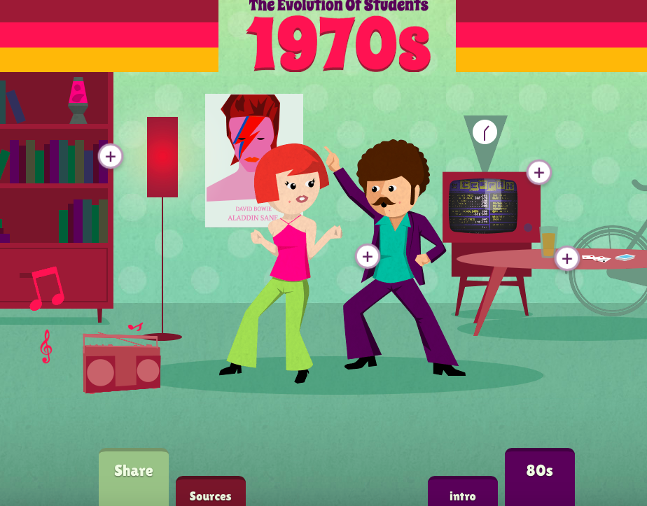
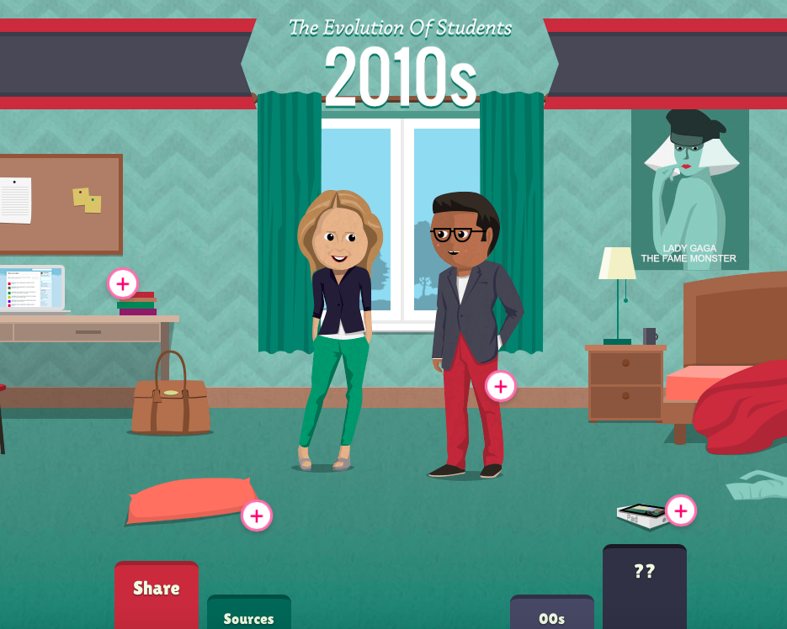
Evolution of students

Slide 9
What do images of student life/enjoyment have in common?
Utilitarian aspects in dialogue with or subordinated to creative
Imaginings of the future often omit this element
There is usually a crass element
.
Notes:
The main thing that strikes me in these imaginings of the future, compared to what we have with baby Frankie and his iPad (2014), is the liveliness of the baby’s interaction with the tablet. The two imagined futures, 60 years apart, are by contrast formal, regimented, strangely joyless. The real-life baby is engaged with technology; the future imaginings are strongly depersonalised

Slide 10
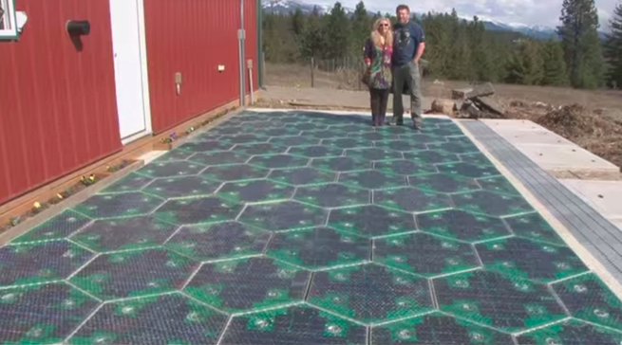
Excellent technologies become seamlessly embedded into life. They support life, rather than directing or regimenting it
.

Slide 11
In fact, there is evidence that the everyday use of excellent technologies
can be much lamer than that…

Slide 12
Famous question: What would be the hardest to explain to the 1950's?
I possess a device, in my pocket, that is capable of accessing the entirety of information known to man.
I use it to look at pictures of cats and get in arguments with strangers.

Slide 13
Future technologies are invariably imagined as offering more chances to be deeply serious:
Radio/ movies/television/the internet were going to educate the masses
Google glasses will power real-time research
Gaming will be harnessed for seriousness

Slide 14
How do future imaginings impinge on the present?
Notes:
Discussion question

Slide 15
How is all of this this playing out in Higher Education?
It’s not all about how we teach and learn. Higher Education is under stress in many ways.
industrial problems, such as a rapidly growing underclass of adjuncts, one of who recently described suicide as her retirement plan (Scott 2014)

Slide 16
Criminality shadows many institutions, such as a ‘rape culture’(White House task Force 2014)
sexual and academic scandals in professional athletics (Luther, 2013, Gurney and Willingham 2014).
There is a growing level of student debt (Selingo, 2013).
Grades may be systematically inflated (Arum and Roska 2011).
Notes:
Changes in student preferences about how and when to learn.
Large numbers of young people swim in technology ‘always on’, connected to friendship networks in ways that earlier generations couldn’t imagine. They tell tales of clueless middle-aged lecturers publicly bemoaning the fact that they are forced to put material online, or speaking as if the now highly unhip Facebook is the cutting edge of virtual sin. Students are used to engaging and user-friendly online environments; universities are locked into clunky LMS systems which bear the traces of the book as early movies featured a proscenium arch. It’s a problem that affects many businesses

Slide 17
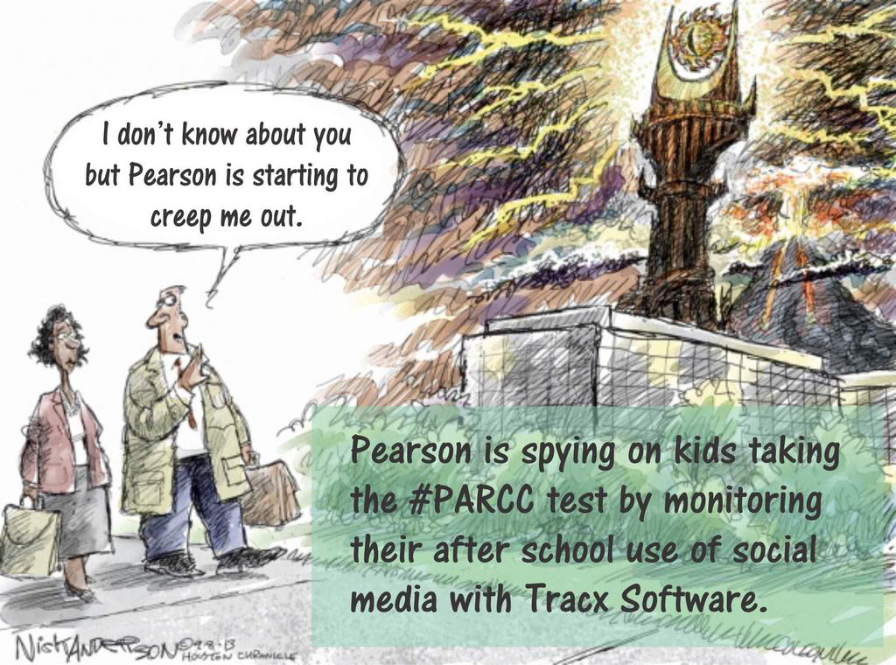
… teaching morphing into surveillance?
“Pearson, always watching”
Guardian, 19/3/15
#MonitoredByPearson.

Slide 18
“Pearson is involved in social media monitoring, as is almost every major corporation, not because they care about students. It’s because they care about their brand. They care about their intellectual property. Corporations like Pearson monitor social media, in part, so they can provide customer service. Pearson monitors social media so it can glean insights based on social media sentiment about its brand.”
Audrey Watters, 17 Mar 2015

Slide 19
What are we building? Does blindness to context put us in danger of importing this joylessness into the learning futures we are building?

Slide 20
Dystopias
Where universities repel active learners and stay prescriptive, locked into
Stultifying compliance tasks
Impenetrable mountains of data
large lectures
rules about attendance
inauthentic assessment
clunky enterprise systems.

Slide 21
Dystopian universities use technology so badly that
students revolt and demand the return of small tutorials
rolls are kept to force students into lecture attendance,
lectures are videoconferenced to remote campuses or adjoining lecture theatres,
LMS systems are used to store PDFs for students to read in isolation, and so on.

Slide 22
In fact… the enterprise has become everything the internet is not
Notes:
(personal communication from student hearing I was about to lecture, 2012)
Students are annoyed by the idea of physically presenting themselves for information that can be found elsewhere (Clay and Breslow, 2006). The large lecture is often seen as an alienating and pointless experience.

Slide 23
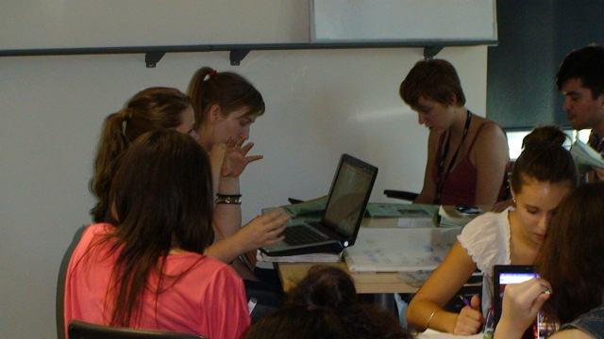
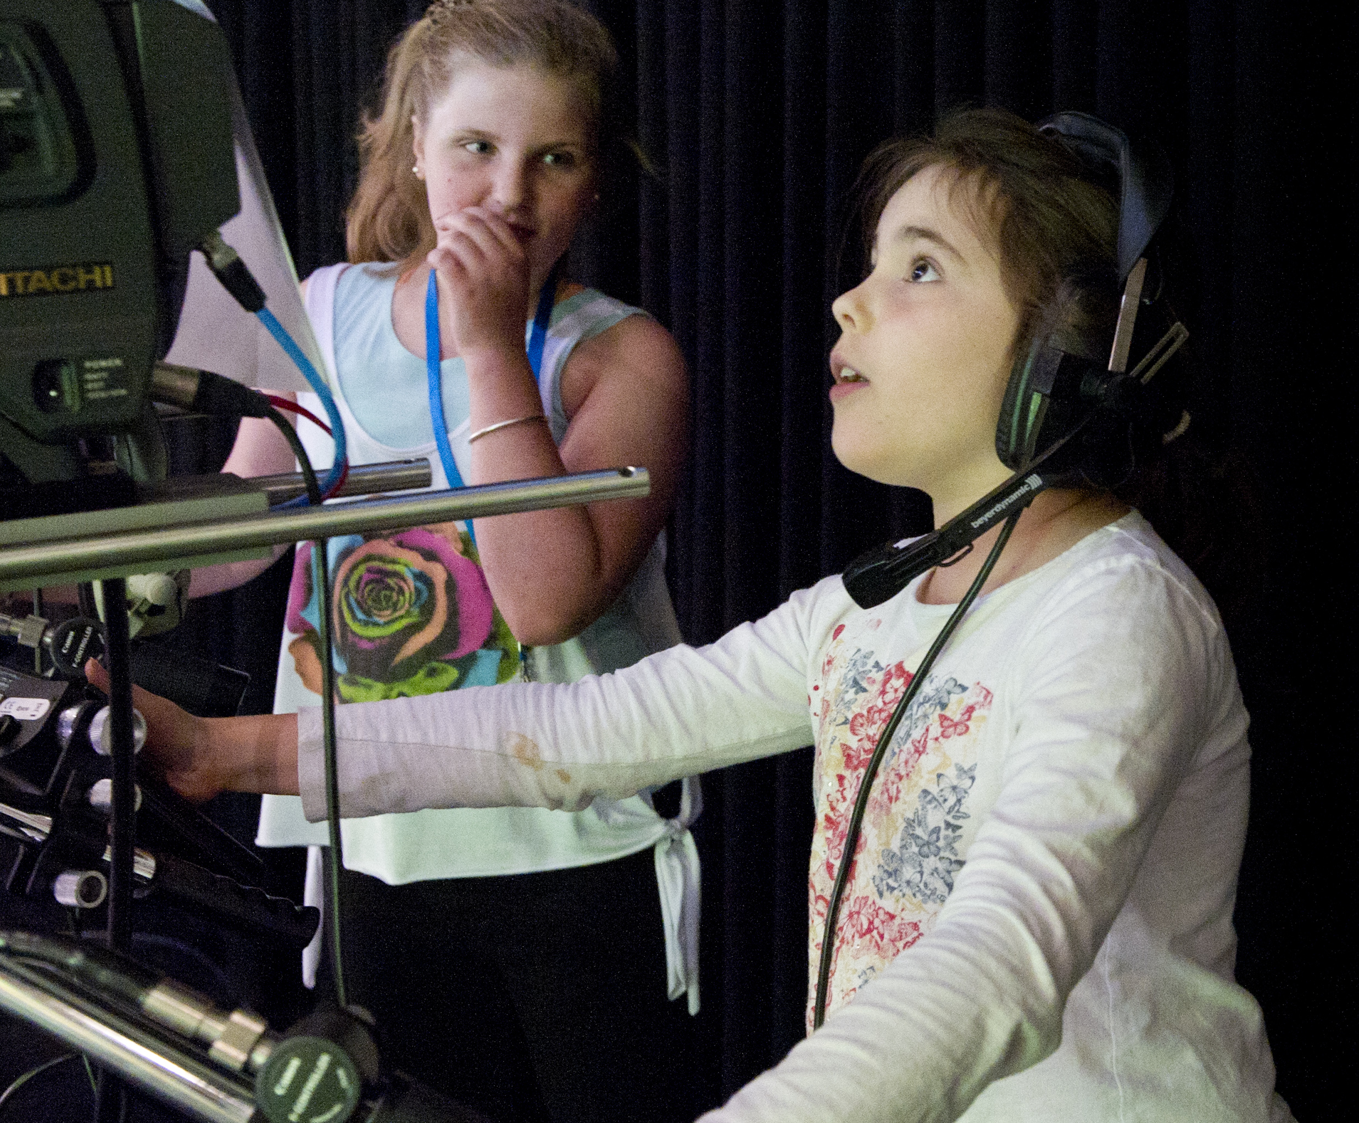
“oh, please don’t be boring”!

Slide 24
How do we improve things?
Can we mess with time for learning advantage?

Slide 25
Warping of time (Claudia Hammond, 2013)
“The happier the time, the shorter it seems”, Pliny, AD 105.
Forward telescoping, backward telescoping
Holiday Paradox
Avoiding routines; doing lots of new things
Making time go faster by getting absorbed in things

Slide 26
Utopias
Where academic and professional staff work with students to create learning experiences which are
Memorable
Narrativised
Networked
Social
Open
Flat
Hyperlinked
Scalable
Searchable
Permissive
Massively Open.

Slide 27
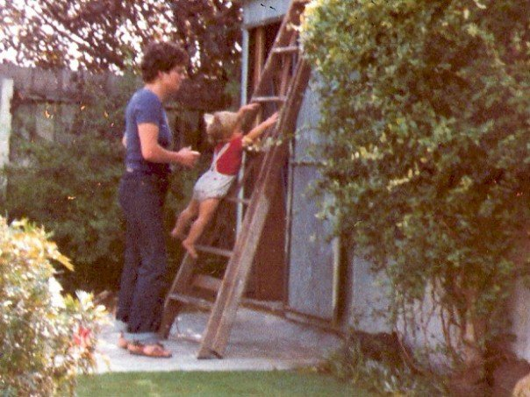
Effective assessment
We remember events that are
Distinctive
Vivid
Personally involving
And you have recounted
many times
(Time Warped, Claudia Hammond, 2013)
Notes:
How to use technology to do this?

Slide 28
personalise and connect
…all learning experiences, online, blended and face-to-face
Use new technology to make assessment really interesting
Make it part of material existence
Make it engaging
Make it a story
Make it a big deal
Make it part of life

