Slide 1
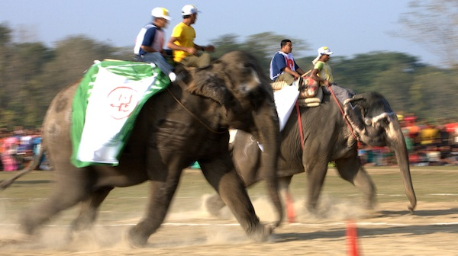
Punting on Elephants
http://www.theatlantic.com/politics/archive/-conservatives-who-havent-endorsed/251284/2012/01/the-influential
Notes:
No racehorses here– large unwieldy systems.

Slide 2
The elephants of enterprise systems
…acronym hell
LMS + Plugins
Eportfolios
Microcredentialing
Blogging
Text matching
Content management
etc etc
then…
Student System
Email
Lecture capture technology
Video-conferencing etc
Notes:
“LMS must die”
As LMS’s bolt on more and more, they become more unusable

Slide 3
Institutional approaches
Planned?
Driven by management looking
to make a splash
To keep up
To minimise risk
Unplanned?
Stuck in ancient decisions
When funds become available
Ad hoc choices by IT, architects, consultants

Slide 4
Meantime, academic staff are begging to build e- shanty towns for their urgent
e-accomodation
How to reconcile??

Slide 5
Reading the tea leaves
http://cdn.nmc.org/media/2014-technology-outlook-australian-tertiary-education-EN.pdf
http://cdn.nmc.org/media/2014-technology-outlook-australian-tertiary-education-EN.pdf

Slide 6
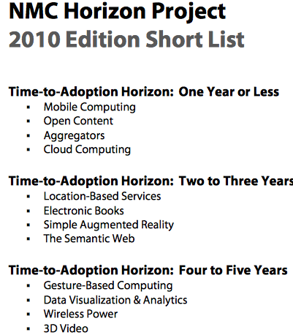
http://www.nmc.org/pdf/2010-Horizon-Report-Short-List.pdf

Slide 7
But how to align?
Institutions try to match mega trends
Mobility
Flexibility
Personalisation
Collaboration
Big data
With the university needs, plan and niche

Slide 8
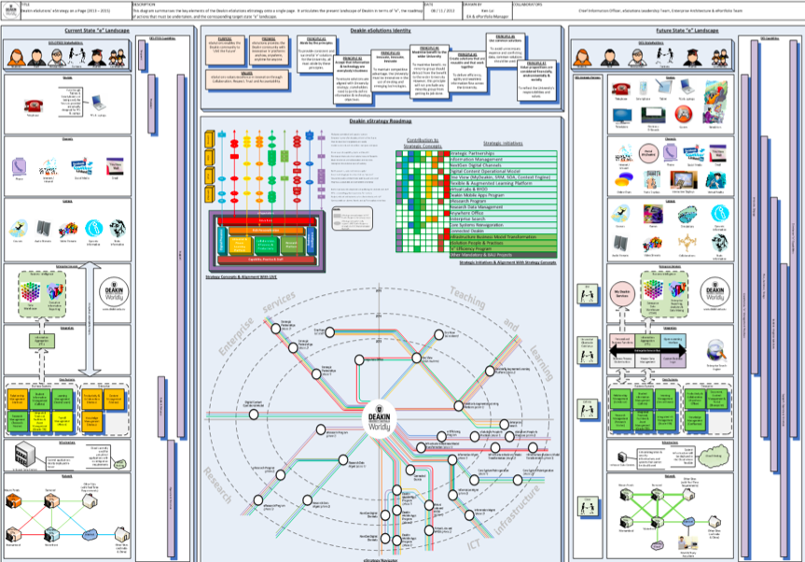
How to avoid the Death March Project?
Behind each of these Horizon report ‘Moments’ are giant sets of cascading spreadsheets

Slide 9
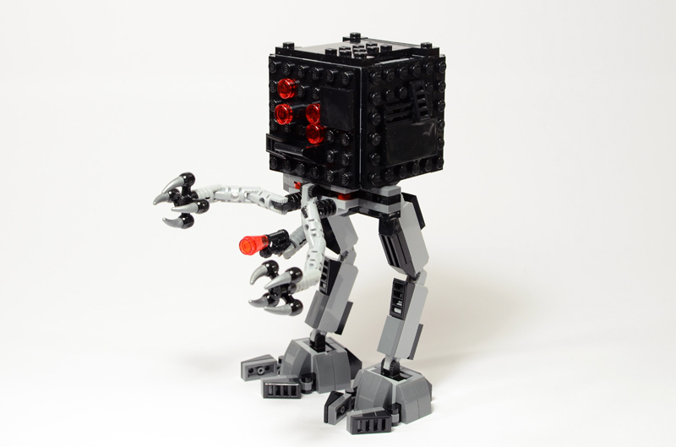
Send in the micromanagers?
http://www.eurobricks.com/forum/index.php?showtopic=90274
Notes:
Meantime, universities proilferate what people want or need, like wiring in India

Slide 10
Avoiding white elephants

Slide 11
PLANNING FOR A COHERENT WHOLE
HAVING A BRAIN
TOLERATING THE ORGANIC
ADDRESSING CULTURAL CHANGE

Slide 12
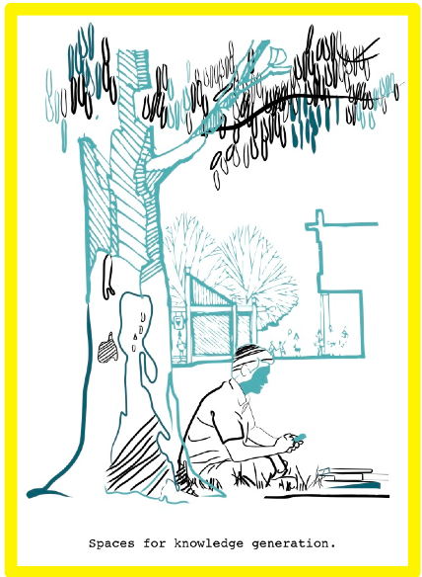
SKG Design Principles
Comfort
Aesthetics
Flow
Equity
Blending
Affordances
Repurposing

Slide 13
To sum up: in the future, dodge elephants
Staff preferences are for stuff that works with ready, multi-channel support.
Student preferences are for comfort, flexibility, mobility.
Developing systems that are simple, comfortable, personalisable, well supported, speak to each other.

Slide 14
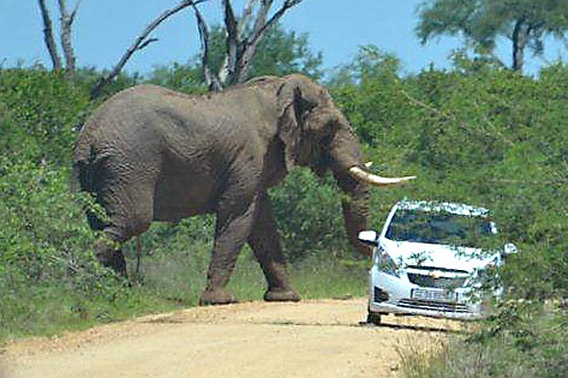
Thank you!
http://www.gistmania.com/talk/topic,136694.0.html

