Slide 1
Preparing staff for teaching in collaborative environments
Regina Obexer
Director, eLearning Services
CRICOS No. 00213J

Slide 2
Overview
Preparing staff: What’s happening at your institution?
The QUT experience: the LATICE project
Lessons learned and challenges ahead

Slide 3
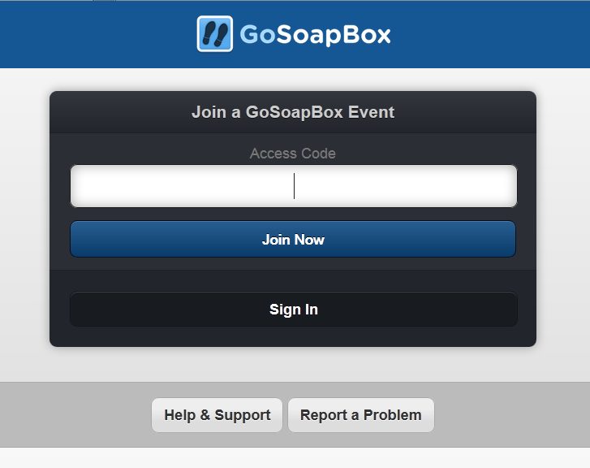
What's happening at your institution?
You can use your laptop, smart phone, or tablet
Please go to: app.gosoapbox.com
Access Code: ACODE61
Please complete the short survey.

Slide 6
Vote counts
Providing online resources for just-in-time learning | 1
Establishing and supporting a community of practice | 1
Establishing and supporting peer learning | 0
Running face-to-face workshops | 2
Providing technical support and training | 5
A combination of the above | 14

Slide 8
Environment
Strategy
Dissemination
Engagement
The LATICE project

Slide 9
Strategy
Developing a strategy to integrate a range of scalable, transferable and sustainable models for learning and teaching in new physical and virtual spaces, strategically aligning with University initiatives.
Learning Space Working
Groups
Learning Spaces Tools
Patterns/ Exemplars (artefacts)
Respository
Student Patterns
Showcases
Pilot Studies
Mini Showcase
Program of Engagement
Collaborative Learning Community
Change Champions
Peer Review
Staff Survey 2011─2012
Inductions
Staff Profile
2012 55 units
2011 10 units
Curriculum Design (STEM)
Readiness Profile
Blended Learning Training
Drop-in
Staff Development
Benchmarks
Grad Cert Module
Inductions
Student Survey 2011─2012
Student Profile
Collaborative Technologies
AV Support
Timetabling
Course Design
LATICE – Learning & Teaching in Collaborative Environments – Visual Mapping
Richard Evans – Learning Designer – eLearning Serives-Queensland University of Technology-2012

Slide 10
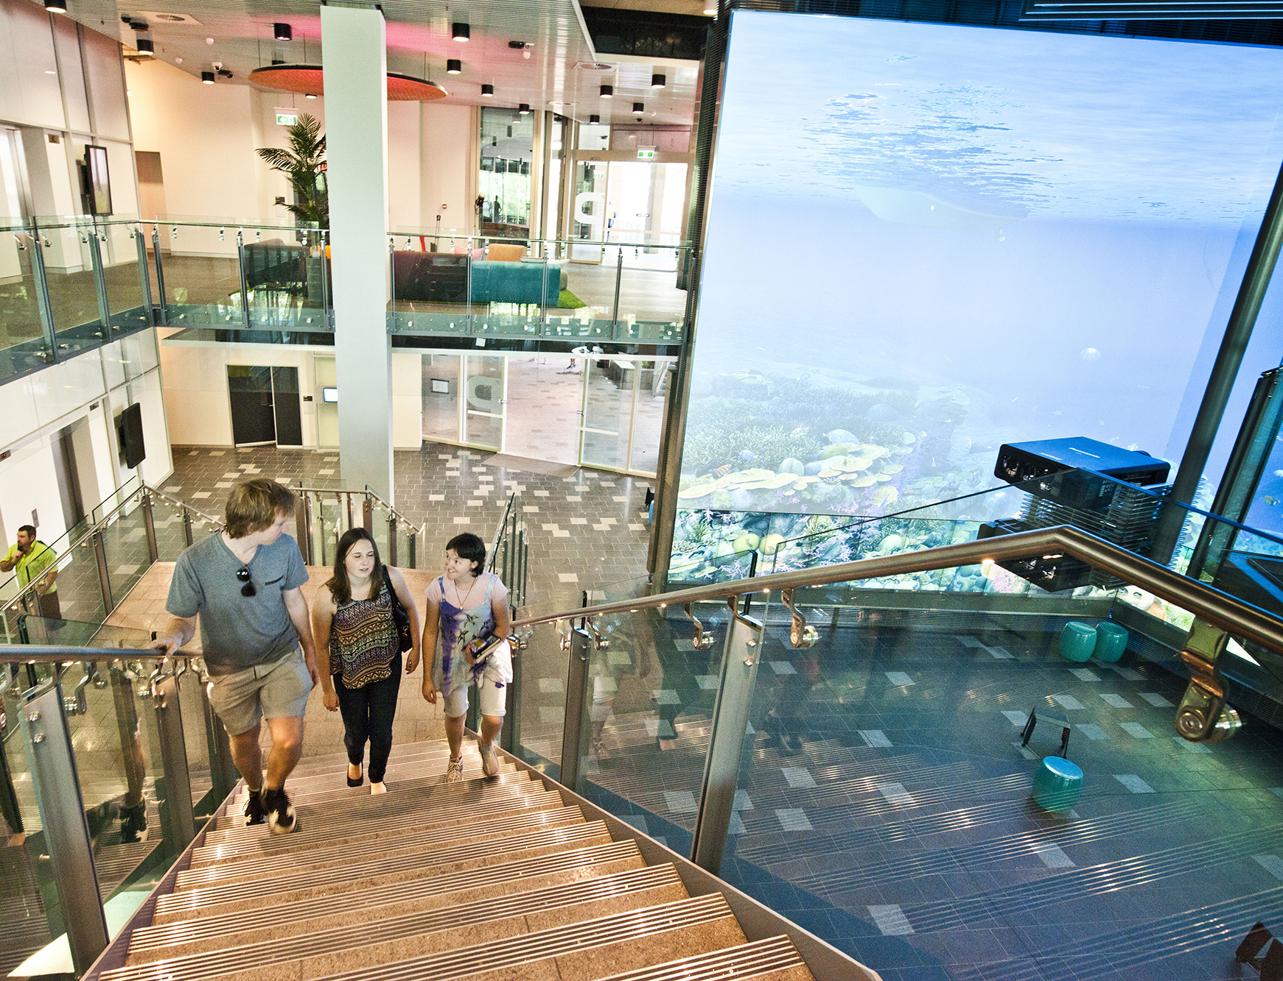
Environment
Ensuring provision of support for appropriate collaborative technologies. (Hardware and software selection to support collaborative Learning and Teaching models for in class physical and virtual collaboration / communication)
COW and Lectern Developments
New Design + Window 8 touch screen on CoWs
AV Support
2013
Learning Spaces 2013
14 Collaborative Learning Spaces
4 Active Theatres
Flexible
furniture
Screen Sharing
Hardware
Learning Spaces Tools
Software
Informal spaces
Support
Space

Slide 11
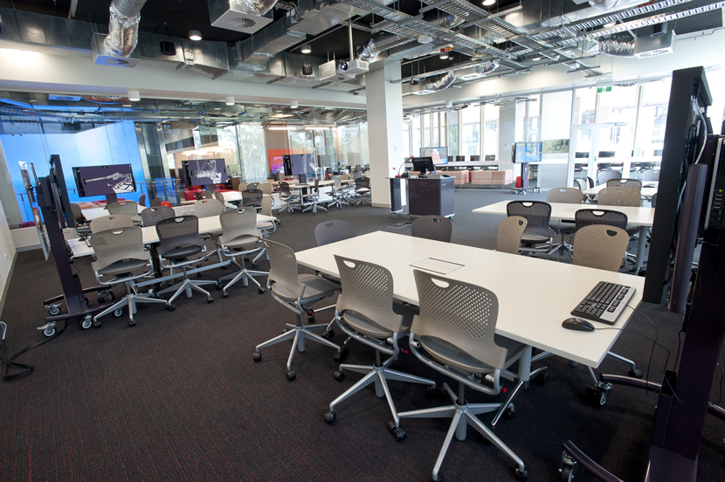
Engagement
Peer Review
2012: Staff
Assisting academics to design, develop, and implement new pedagogies that utilise more flexible interactive and collaborative learning space.
Learning
Community
110+ Staff Monthly meetings Mini Showcases
Units
2011: S2 = 10
2012: S1 = 55
2012: S2 = 48
Showcases
Staff Development
IZN005
(Pilot)
17 Staff
Learning Community
Induction Sessions
2011: 25+ Staff
2012: 83+ Staffs
2013: 60+ Staff
Learning and Teaching Showcases
Customised Staff Development
Education faculty/
Sessional staff
Drop-in sessions
2013

Slide 12
IZN005
2013
Student Forum
2013
Dissemination
Learning Space Tool
Phase 2: Pilot Pedagogy and Technology 2013
University sector and inter faculty collaboration, advancing research and evaluation of new learning environments; focused on pedagogy, space and technology
Evaluation Report
July 2013
Conferences & Publications
2012─2013
Website
2012-2013
Partnerships
Symposium
June 2013
Student Exemplars
2013
Learning Community
2013
External Collaborations
Academic Exemplars
2012─2013
Pilot Studies
2013
Change Champions
2011, 2012, 2013
Exemplars
Benchmarking
2013
Evaluation

Slide 13
Learning Community Feedback

Slide 14
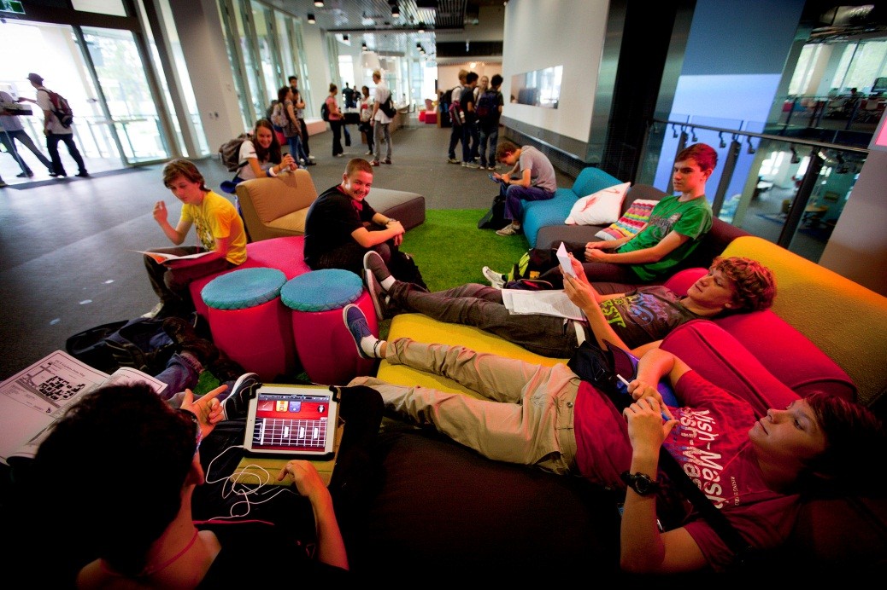
Key lessons learned
Start early
Connect people & support leadership
Become best friends with all support areas across space, technology and pedagogy
Model student activities in collaborative spaces
Provide time to explore spaces and tools in groups and individually
Integrate with existing activities

Slide 15
Challenges
Academic workload and focus
Technology
Working in teams and across various areas
Available spaces and timetabling
Transferability of learning designs between spaces

Slide 16
Acknowledgements
The LATICE project team
Richard Evans, LATICE Project Manager, eLearning Services
Elizabeth Greener, Manager, Learning Design, eLearning Services
Roger Cook, Learning Designer, eLearning Service
Dr Sheona Thomson, Associate Director, Academic, Learning & Teaching Innovation
Dr Geoff Mitchell, Director, Learning Environments & Technology Services

Slide 17
Your Questions?
A jolt of the old....

