Slide 1
Redesigning Learning Spaces and the Curriculum
Dr Lisa Germany
Associate Director Blended Learning
Victoria University

Slide 2
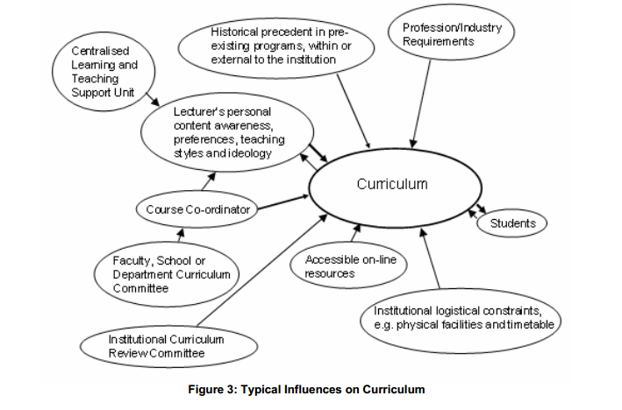
Curriculum
“Curriculum in higher education in Australia – Hello?” Owen Hicks
http://www.herdsa.org.au/wp-content/uploads/conference/2007/PDF/R/p227.pdf
Notes:
- an attempt to highlight at least some of the factors influencing curriculum in present university arrangements in Australia. It is not exhaustive in its inclusions but does highlight a range of elements needing consideration when reflecting on curriculum. Given a more prominent and elaborated meaning, curriculum could act to bring many of these elements together more effectively.
- To see how physical facilities or learning spaces influence the curriculum – let’s start with a little activity.

Slide 3
Scenario
You have just walked into this space. What is your initial instinct about the type of activities that should take place here?
Notes:
I’m going to show you a learning space and I pose to you the following question ….
I’m looking for your initial gut instinct
I want you to write it down on a piece of paper in front of you

Slide 4
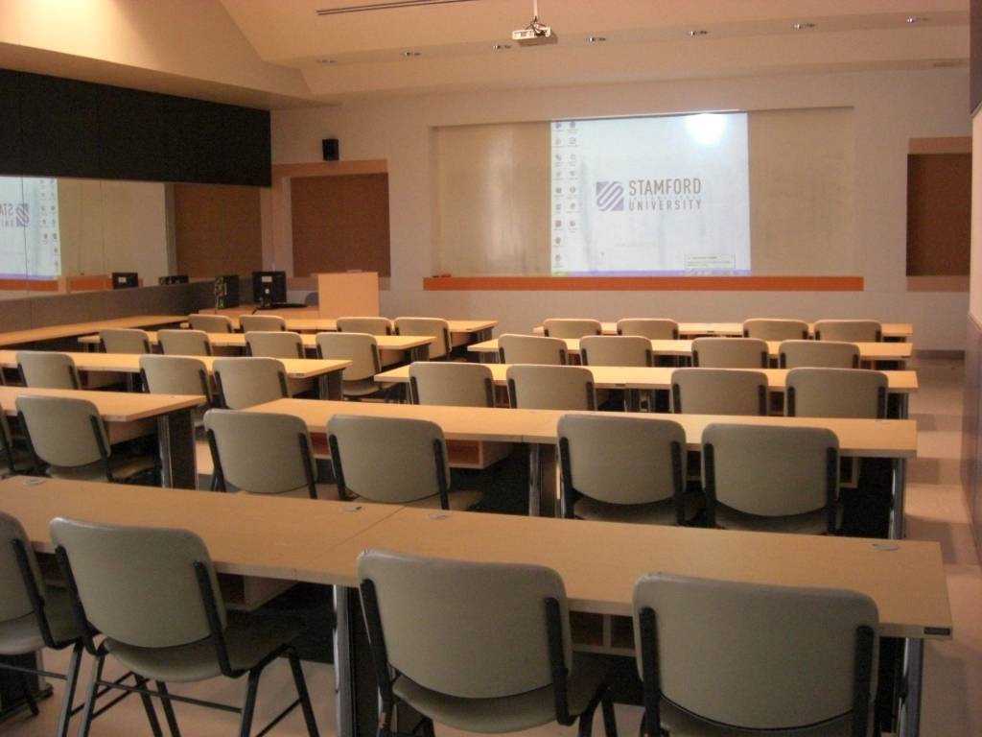
Notes:
Pose question: “If you walked into this classroom, what would be your initial gut instinct of what activities should take place in there?”
Should be responses like "stand at the front and talk“
If someone mentions moving the tables: say “yeah, but the previous class ran overtime so you were late getting in, you have a mountain of material to cover, can you be bothered? Or will you just ‘stick it out’ for this class?”
If no-one mentions moving the tables: ask: “Is anyone inclined to move the tables?”
Is this what we believe to be the best approach for student learning?
Yet what fraction of our learning spaces are arranged like this?
___________________________________________________
Another scenario. Again – what is your initial gut instinct as to what type of activity should take place in this space. Again I’ll get you to write it down.

Slide 5
Most effective way for students to learn?
Fraction of spaces like this?

Slide 6
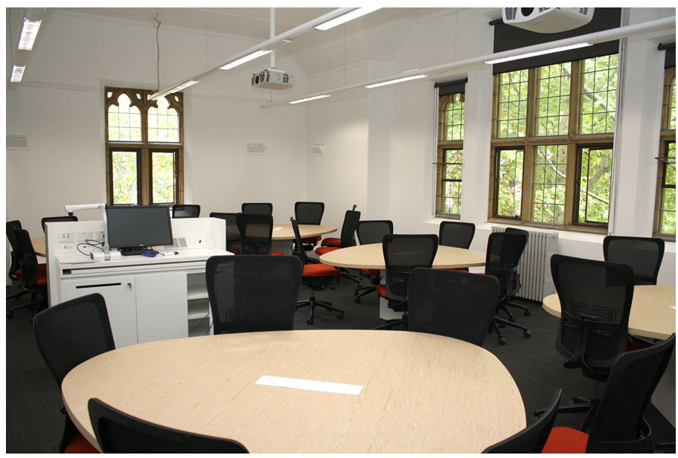
University of Melbourne
Notes:
Graduate school of Humanities and Social Sciences
Answers should be different – more around collaboration / group work.
If we take this room at face value – there is not really any more technology than in the previous space, yet your answers are totally different.
Does this promote the type of learning we believe to be most beneficial for our students?
Yet what fraction of our learning spaces are of this type?
_________
One more scenario. Same deal. Initial gut instinct, write it down.

Slide 7
Most effective way for students to learn?
Fraction of spaces like this?

Slide 8
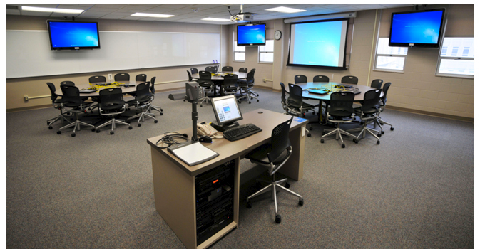
University of Iowa
Notes:
TILE classroom - TILE (Spaces to Transform, Interact, Learn, Engage)
Given the presence of more technology in the space, I’m sure If I asked many teaching staff what they would do in a room like this, they would respond “Panic”
But does this reflect and enable how we think our students should be learning?
Yet what fraction of our spaces look like this?
____________
Now if we have these initial gut reactions when we walk into a rooms with these designs, if we are not inclined to move furniture around, and we actually think about this stuff, what chance to teaching staff have?

Slide 9
Most effective way for students to learn?
Fraction of spaces like this?

Slide 10
Changing Practice is Hard
Few people have the time or inclination to think outside the box
We start off teaching in the same way we were taught
We are visual creatures and take our position from visual cues
Notes:
Put words into other’s mouths by making 4 bold statements
The first one (title) I don’t think any of us would disagree with – changing practice is hard
A normal staff member will have a quick look at the room they have been allocated, and follow their gut instinct which is fed by previous experience and visual cues
Looking forward to Regina’s session later today where hopefully she’ll give us all the “magic bullet” for getting staff to think about space and engage.

Slide 11
Implications
Exploration of physical space should be an integral part of curriculum reform or course redesign/redevelopment
Equally important as the exploration of the use of technologies
Notes:
Because changing practice is hard – most staff will need some encouragement/support to think outside the box, really interrogate what they are doing and how they are doing it and whether it is the best way to be doing it
Many universities have done this for eLearning tools – getting staff to rethink how they might teach with incorporating technology.
But for the majority of students in the majority of universities, face-to-face instruction is still the dominant mode of interaction and so physical space and how it is used to enhance student learning is perhaps even more important …. Yet it is rarely considered to the same level as technology.

Slide 12
What we are doing at VU
Curriculum Reform with emphasis on Blended Learning
Learning Spaces Recommendation Report
Blended Learning Steering Committee
Senior Leadership Team (incl. VC)
Notes:
I only started at VU last April and my boss (PVC L&T) only started January last year. Prior to that – our positions didn’t really exist.
Acknowledging that physical space is as important as virtual space (and this is perhaps more true for VU than other unis given our student cohorts), we are focusing on Blended Learning approaches rather than eLearning approaches. My role: Associate Director Blended Learning (though not what it says on my business card)
We are just about to embark on a curriculum reform program one of the central tenants is Blended Learning.
I’m sure many of you are aware that VU is currently upgrading our eLearning Environment from early 2000s vintage to something more befitting the state of play in 2013 - and this will allow us to ramp up the use of eLearning tools as appropriate across the University – so we do have a large emphasis on the use of technology to enhance student learning (well we will once the platform is in place).
Unfortunately many of our formal learning spaces are equivalently vintage and we have a vast number of them (~900) – so myself, Facilities and ITS AV have co-authored a paper that provides 9 high-level key recommendations about what VU needs to do around its learning spaces to bring them up to scratch. This includes establishing a standard nomenclature for our spaces that is used across the organisation (as discussed by Colin and Kathleen) and establishing AV and fitout standards for our learning spaces, through to reclaiming spaces “owned” by faculties (but never used by them) back to central management and extending the timetable to free it up in an effort to reduce the number of formal spaces we have and have to maintain.
Endorsed by the BL Steering Committee and is going before the SLT just after Easter.
So VU is actually positioning itself to improve the “spaces literacy” as well as the “digital literacy” of our teaching staff over the next few years. And although some of our spaces should be sealed shut and never used by a human being for anything, we do have a number of new, innovative spaces available – we just need to (a) communicate to staff so they know they exist and (b) upskill staff so that they can utilise the space to its full potential
Very exciting times at VU

Slide 13
Notes:
Vic Dept Educ & Training – Planning Design Principles
So now – let’s imagine the “VU scenario” where we’ve got buy-in from senior leadership with $ to spend on learning space upgrades, and a curriculum reform process that develops the “spaces” literacy of our staff as well as their digital literacy.
We’ve established before that “gut instinct” is driven by previous experience and visual cues. We can’t do much about previous experience but how can we design spaces so that when a teacher walks into the room and sees how it is configured – they think twice about how they are interacting with students?
This slide (from a DET paper) provides just one possible way of categorising different types of pedagogies that we might want to use with our students – so lets just use these for the sake of this activity.
You have a slip of paper in front of you with a number on it and around the room there is butchers paper with the equivalent number. Can I get you to reorganise yourselves into those groups now.
What I would like is for Group 1 and Group 3 to take on “Applying” and Group 2 and Group 4 to take on “Creating”. In your groups I would like you to you to spend a couple of minutes writing down the characteristics and activities that might occur and then quickly design a space that will facilitate those activities. At the end, I’m going to get a spokesperson from each group to come up and explain the activities you came up with and how the design enables them.
To give you an idea … let’s have a look at Delivering together. You can see that there is a focus at the front of the space with a single person broadcasting to others in the room.
You have 5 mins to come up with your design. Go for it.
Green areas = zone of influence

Slide 14
Notes:
Applying
Controlled observation
1-1
Master and apprentice
Alternative control
Active learning
informal
Creating:
Multiple disciplines
Leaderless
Egalitarian
Distributed attention
Privacy
Casual
Active learning
Assume they focus on the layout and space itself….

Slide 15
Have you considered…..
Shape of table
# students/table

Slide 16
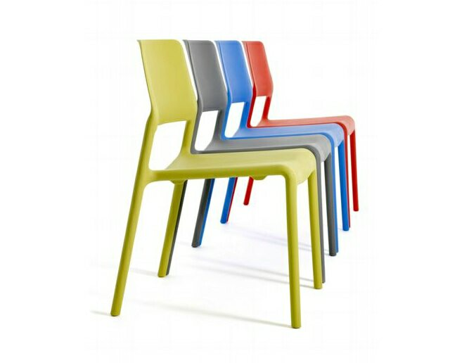
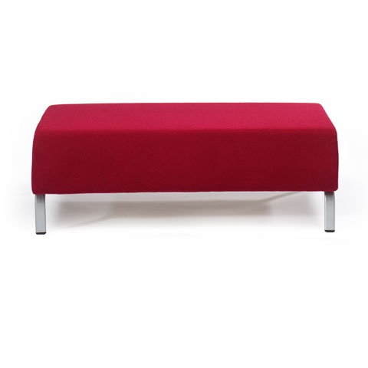
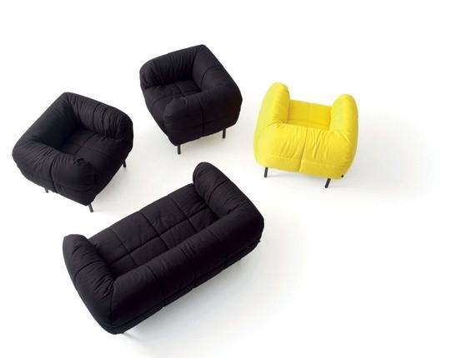
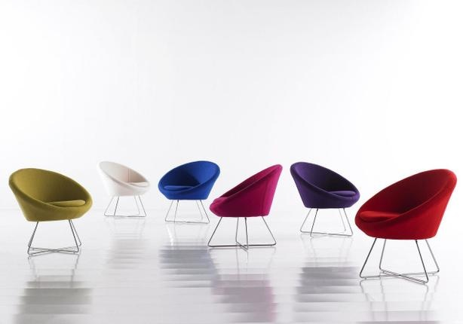
Have you considered…..
Style of furniture
Notes:
flip-top tables for flexibility
Beanbags
Bench seating
Firm chairs – are they stackable
Lounge chairs

Slide 17
Have you considered…..
Notes:
VU – grey, baby pink, baby blue, baby yellow
One of the things I want to change in designing the new standards for our spaces it to establish a colour palette (or palettes) that when you walk in the room, your first reaction is not to walk back out again. Going back to categories of learning spaces, thinking about having slightly different palettes for different types of learning spaces: didactive, collaborative, PBL, capstone… Another subtle visual reminder of the type of activities that students should be undertaking in the space.

Slide 18
Have you considered…..
Textures
Notes:
floors, walls
carpet

Slide 19
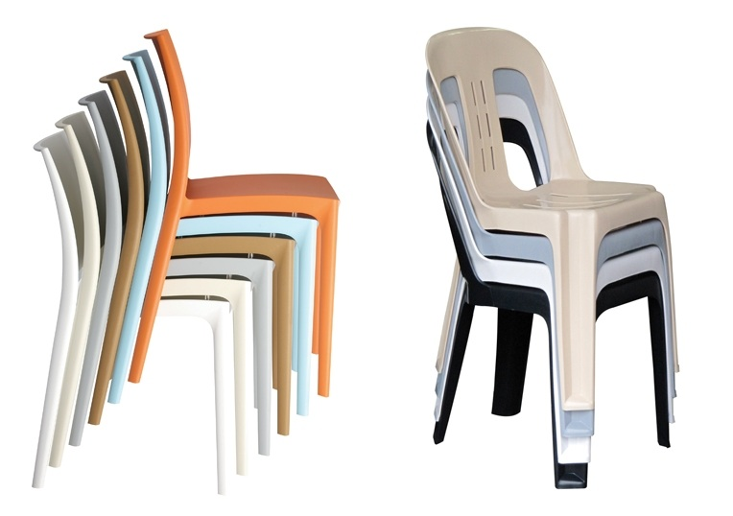
Have you considered…..
Flexibility
Zoning
Storage
Notes:
Flip-top tables
Stackable chairs
- Is there anything else you can think of that you might need to consider in designing a space for learning?

Slide 20
Notes:
Communicating
Knowledge is dispersed
Impromptu delivery
Casual
Active learning
Decision Making
Knowledge is dispersed
Information is shared
Leader sets final direction
Situation is protected
Semi-formal to formal
Passive/active learning
How did you go in your groups? Was it easy to come up with your designs … or was there some tension.

Slide 21
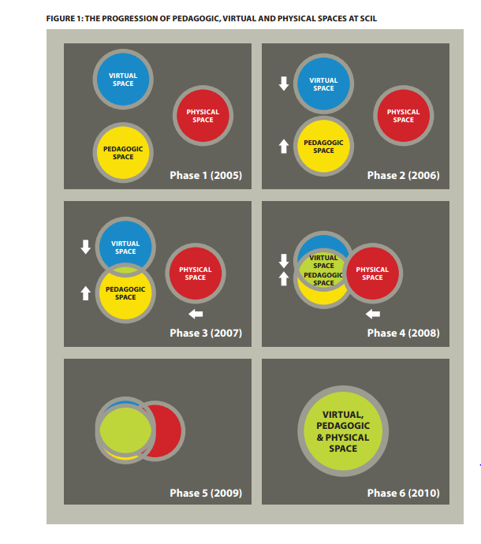
http://scil.com.au/documents/stephen-harris_virtual-pedagogical-physical-space.pdf
Notes:
So in the past 45 mins we explored a little about how curriculum and learning space are intimately linked but not considered in normal day to day thinking as such.
Where are we on the spectrum of linking them for real?

Slide 22
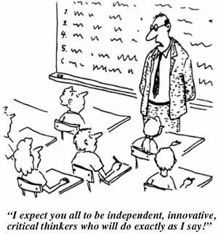
Notes:
Mixed messages
In the same way, we expect our teachers to be innovative in their use of space for learning and teaching and explore ways of increasing active learning during f2f time with students, but we as institutions give them rows of desks and a presentation area and whiteboard out the front.

Slide 23
Further information
Lisa Germany
Associate Director Blended Learning
Victoria University
lisa.germany@vu.edu.au
(03) 9919 4079

