Slide 1
THE VICTORIA UNIVERSITY BLOCK MODEL
6 lessons in cutting a Gordian knot
or
revolutions are slow, systems are robust and the curriculum is like a suitcase
Ian Solomonides
@solfella

Slide 2
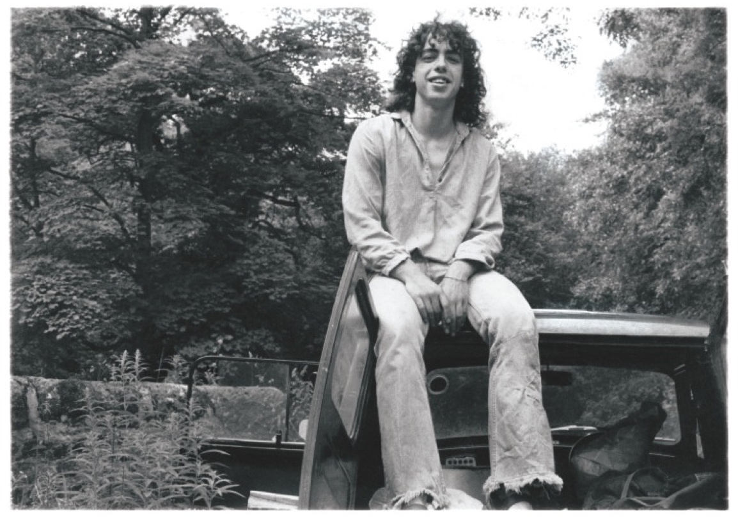
THANK YOU

Slide 4

ACODE BENCHMARKS
Institution-wide policy and governance for technology enhanced learning
Planning for institution-wide quality improvement of technology enhanced learning
Information technology systems, services and support for technology enhanced learning
The application of technology enhanced learning services
Staff professional development for the effective use of technology enhanced learning
Staff support for the use of technology enhanced learning
Student training for the effective use of technology enhanced learning
Student support for the use of technology enhanced learning

Slide 5
WHAT IS ‘THE VU BLOCK MODEL’ AND HOW DID WE GET THERE?

Slide 6

VICTORIA UNIVERSTY FIRST YEAR MODEL

Slide 7
CUTTING THE GORDIAN KNOT

Slide 8
REVOLUTIONS ARE SLOW

Slide 9
REVOLUTIONS ARE SLOW

Slide 10
SYSTEMS ARE ROBUST

Slide 11
SYSTEMS ARE ROBUST
Autonomy
Regulation
What to teach
How to teach
How to asses
The experience created for the student
Modes of delivery
etc.
To assure standards
To assure quality
To assure safety
To allocate public financial subsidies
To assure equity of access
etc.
Francisco Marmolejo
The World Bank

Slide 12
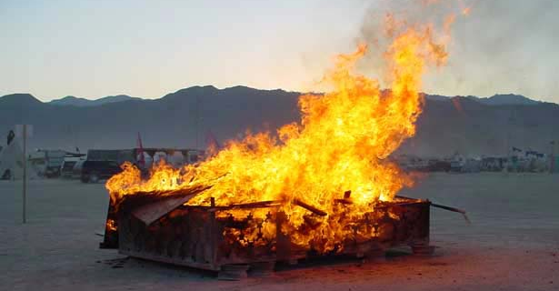
VICTORIA UNIVERSITY’S BURNING PLATFORM

Slide 13
INNOVATING THE 21ST CENTURY: IT’S TIME!

Slide 14
INNOVATING THE 21ST CENTURY: IT’S TIME!
“First we need to toss out the old industrial model of pedagogy (how learning is accomplished) and replace it with a new model called collaborative learning. Second we need an entirely new modus operandi for how the subject matter, course materials, texts, written and spoken word, and other media (the content of higher education) are created.
”We believe that if the university opens up and embraces collaborative learning and collaborative knowledge production, it has a chance of surviving and even thriving in the networked, global economy
“The Industrial Age model of education is hard to change. New paradigms cause dislocation, disruption, confusion, uncertainty. They are nearly always received with coolness or hostility. Vested interests fight change. And leaders of old paradigms are often the last to embrace the new.”

Slide 15
21C EDUCATORS SHOULD BE PROMOTING:
Learning design
Active learning
Collaborative learning
Collaborative teaching
Technology enhanced learning and teaching
Assessment/evaluation for learning
Project based instruction
Life, career, learning, innovation, information, media and technology skills
Digital literacies
STE(A)M literacies
Multi modal (f2f, online, hybrid) learning
Student engagement/high impact practices
Personalised/personal learning
Program level design and assessment

Slide 16
DELIBERATE, DESIGNED, APPROACH
Based on known impacts to learning gain
Do not predict how much students learn | Do predict how much students learn
Selectivity (predicts performance, effort etc., not learning gain or engagement) Research performance Reputation (predicts selectivity, funding, research and employability but not gain) Peer ratings of teaching (reflect reputation) Class contact hours (there is no correlation between CCH and learning gain) Student satisfaction (e.g. can be negatively correlated with effort expected) | Student effort and their sophistication as learners (time on the right things) Smaller cohort and class sizes Who does the teaching Timely and impactful feedback (must feed forward) Close contact with teachers (e.g. how much oral feedback received) Collaborative and active learning Clear and high expectations

Slide 17
TRADITIONAL FIRST YEAR MODEL
An innovation that sustains
STDUDENT EXPERIENCE: high stakes, confusing, many demands and tasks
LOCK STEPPED: passive, industrial model of education that is hard to change
STUDENT WORKLOAD: content, lectures, seminars, tutorials, high stakes assignments
TRANSITION TO UNIVERSITY: difficult, slow, impersonal

Slide 18
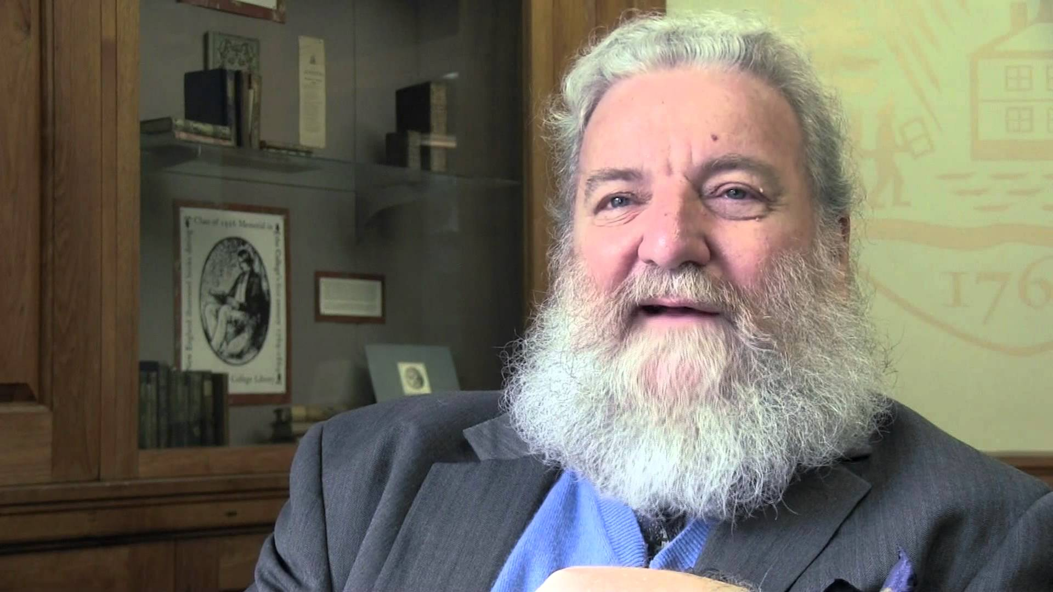
REVOLUTIONARIES ARE AMONG US

Slide 19
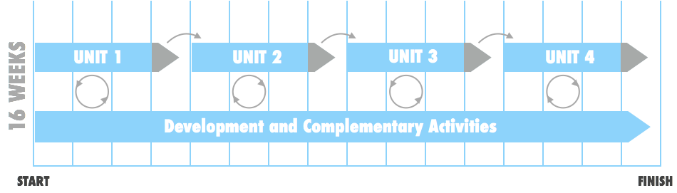
VICTORIA UNIVERSTY BLOCK MODEL
An innovation that disrupts
FOCUS on one unit at a time with IMMERSIVE and DEEP learning
CONSOLIDATED timetable enabling students and staff to MANAGE other dependencies
ASSESSMENT contained within the block; SUCCESS and MOTIVATION early on
COMPLEMENTARY ACTIVITIES to enhance KNOWLEDGE and SKILLS

Slide 20
21C SKILLS AND COMPLEMENTARY ACTIVITIES

Slide 21
PROJECT AND CHANGE MANAGEMENT

Slide 22
PROJECT MANAGEMENT WORKSTREAMS
CROSS FUNCTIONAL BUSINESS AREAS
PROGRAM TEAM
INTERDISCIPLINARY COLLEGE CLUSTERS
FUNCTIONAL WORKSTREAMS
PROGRAM MANAGEMENT
AND DELIVERY
COLLEGE FLAGSHIP WORKSTREAMS
Student Services
Naomi Dempsey
Student Administration
Louise Batchelor
Program
Director
David Day
Health, Sport and Active Living
Karen Dodd
Sustainable Industries and Liveable Cities
Rob Strathdee
VU POLYTECH
Dianne Semmens
VUI
Bronte Neyland
Senior Program Lead
Tania Barac
Reporting and Evaluation
Ann Hogan
Centre for Student Success
Jo Van Son
College of Arts and Education
Tony Watts
Change
Manager
Stacey Van Heurck
College of Health and Biomedicine
Patrick McLaughlin
Research
Donna Hannan
FYC
Andrew Smallridge
College of Business
Romana Garma
Communication Officer
TBD
Marketing & Communications
Andrea Hammond
Learning & Teaching Experience
Trish McCluskey
Flagship Project Managers
Sonja Kiernan
Jessica Town
College of Engineering and Science
Alasdair McAndrew
IT Services
Zoran Sugarevski
People & Culture
Jen Warszewski
College of Sport and Exercise Science
Eric Schwarz
Flagship Project Coordinators
Penny Jose
TBD
College of Law and Justice
Lidia Xynas
Facilities
Kevin McCarthy
Academic Standards
Deb Tyler

Slide 23




PROJECT MANAGEMENT GOVERNANCE
Informed and champion the idea across VU
Resolve issues, eliminate roadblocks, consider high level risks and mitigations
Make key program/University transformation decisions not resolved at lower levels
SEG – TS Phase 2 Steering Committee
Sponsor: DVC
L&T Transformation WG
Chair: VP L&T
Provide program team with direction and strategic guidance at check-ins or as required
Manage risk
Assist with the resolution of issues/roadblocks raised by the Project Control Board
Program Owner
VP L&T
Program Customers
VP Flagships
Program Team
Program Director
David Day
Bring workstream leads together to identify issues, risks and dependencies
Govern at the operational level making decisions as required and escalating when needed
Update the wider body on the status of effort
Project Control Board
Chair: Ian Solomonides,
Karen Dodd or Rob Strathdee
Work Stream Ldr. Reporting & Evaluation
Cross Functional Business Areas
Interdisciplinary College
Clusters
Work Stream Ldr.
Systems
Program Team
College Reps
4

Slide 24
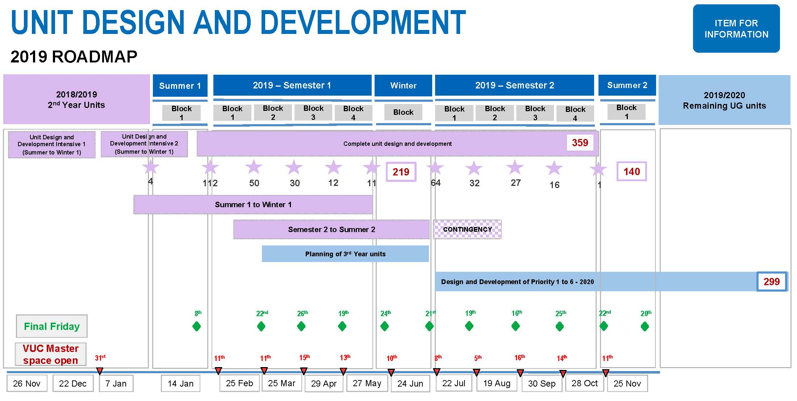
2019 ROADMAP

Slide 25
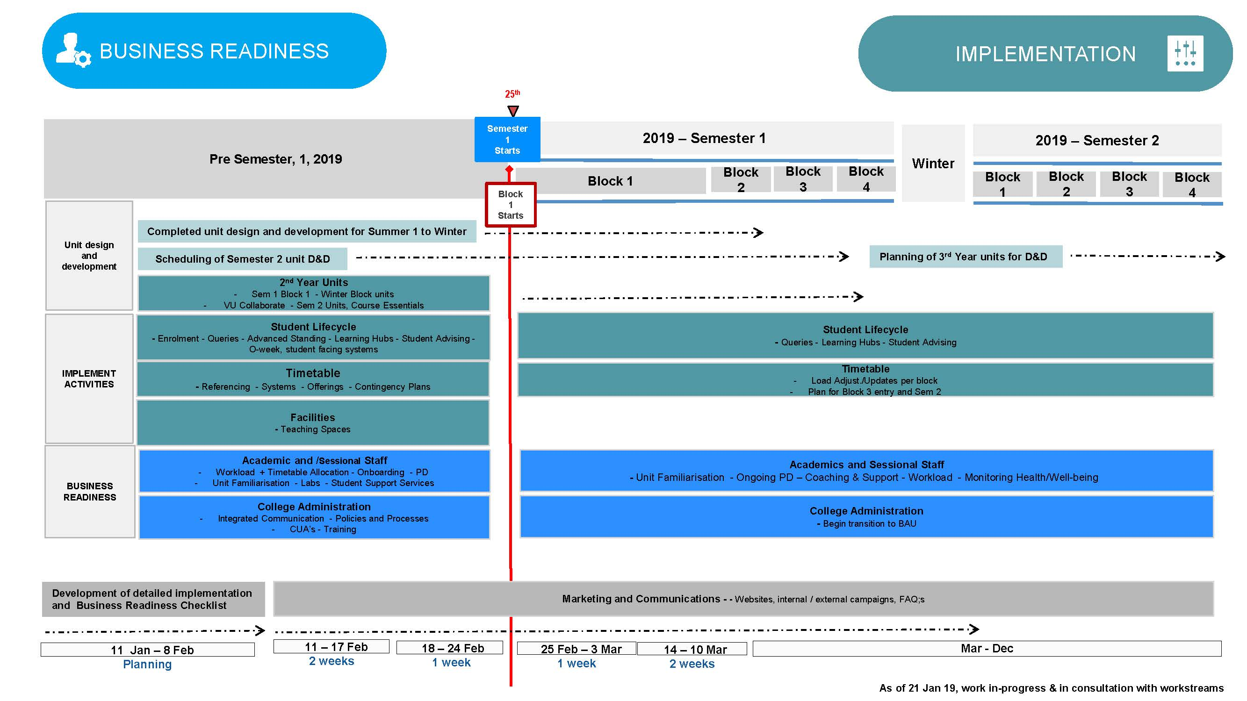
PROJECT READINESS AND IMPLEMENTATION

Slide 26
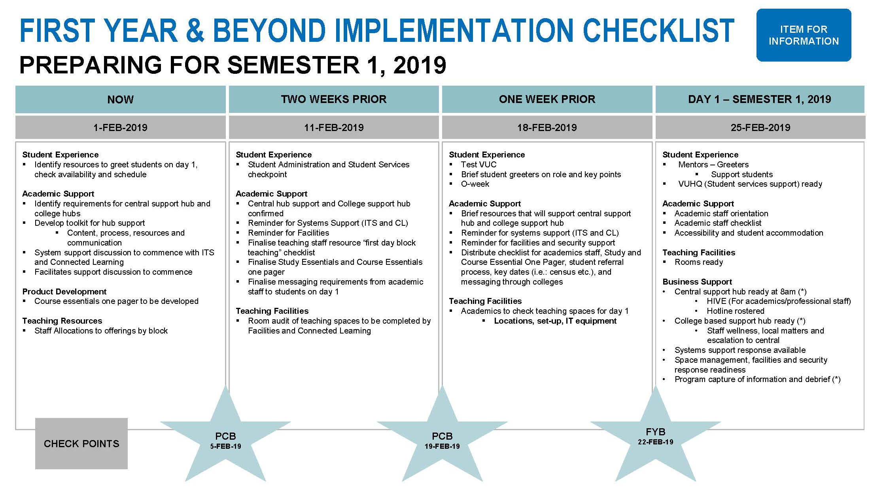
PEOJECT MANAGEMENT CHECK LIST

Slide 27
21C LEADERSHIP SHOULD BE PROMOTING:
Conceptualise the future student experience
Lead from a strong evidence base
Create the conditions that enable academics to strive for excellence in teaching
Align faculty and departmental leadership of teaching with institutional goals
Promote collaborative approaches to improvement
Reward, recognise and develop teaching
Ensure that deans and heads acknowledge and reward the teaching function of individuals and academic units
Promote the university as a successful teaching institution
Promote student involvement in academic quality processes

Slide 28
21C ADMINISTRATION SHOULD BE PROMOTING:
Single view of the student
Student – University congruence (through gatekeeping)
Personalised, timely and efficacious academic and student advising
Just in time, seamless and ‘simple’ administration for students
Personalised service channels with customised optimisation
Partnerships for decision making, conceptualisation and co-design of services
Converged and integrated services

Slide 29
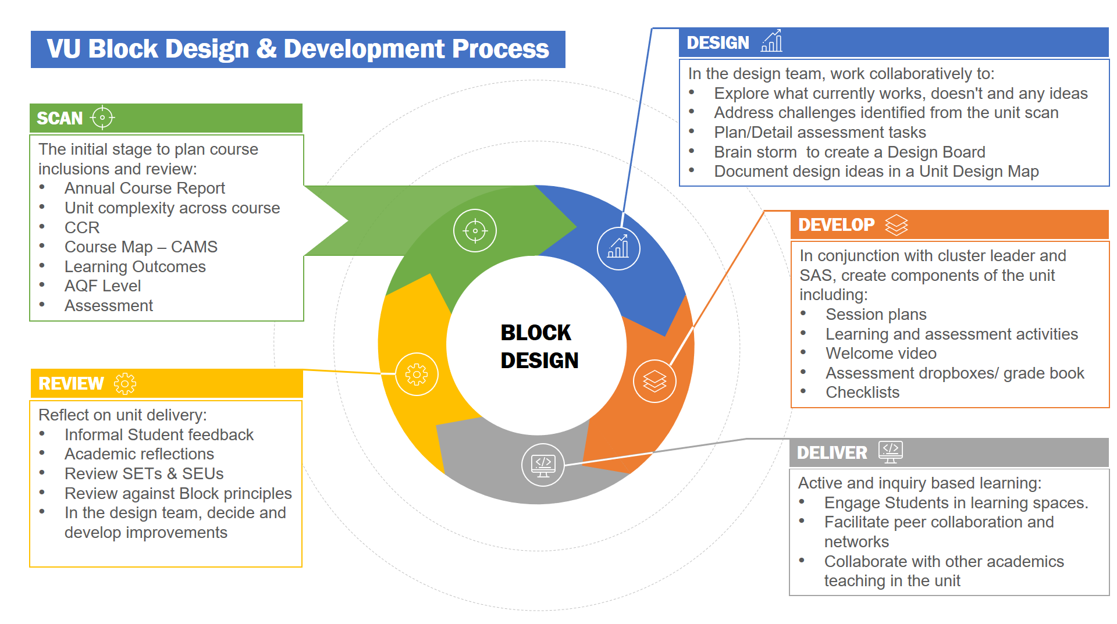
VU BLOCK DESIGN AND DFEVELOPMENT

Slide 30
SHIFTING DESIGN PERSPECTIVES
From the old to the new
Old | New
The student is the problem
Design for the majority
Learn from the majority
Mechanical solutions
Understand the impact on the organisation
One problem – one solution
Initial Ideas – why don’t we … ?
The student is the solution
Design for the extremes
Learn from the minority
Adaptive solutions
Understand the impact on organisation and the students
Deep dive problems – double loop learning
Root cause analysis and solutions

Slide 31
RESULTS FROM ONE YEAR ON THE BLOCK

Slide 32
2017 – 2018 PASS RATES

Slide 33
2017 – 2018 GRADE DISTRIBUTION

Slide 34
2017 – 2018 LOAD RETENTION
7.9%

Slide 35
2017 – 2018 PASS RATES BY SES

Slide 36
2017 – 2018 BY INDIGENOUS STATUS

Slide 37
2017 – 2018 BY NESB

Slide 38
UNIT COMPARISON BEFORE AND AFTER
Comparison of RBM 1103, Biological Science 1 applying the same terminal assessment in 2017 & 2018
 | HD | D | C | P | F
2017 | 6% | 10% | 18% | 26% | 40%
2018 | 9% | 19% | 26% | 29% | 17%

Slide 39
ENGAGEMENT IS EVERYTHING

Slide 40
WHAT HAVE WE LEARNED?

Slide 41

WHAT WE HAVE LEARNED #1

Slide 42
WHAT WE HAVE LEARNED #2
No evolution is accomplished in nature without revolution. Periods of very slow changes are succeeded by periods of violent changes. Revolutions are as necessary for evolution as the slow changes which prepare them and succeed them.
Peter Kropotkin

Slide 43
WHAT WE HAVE LEARNED #3

Slide 44
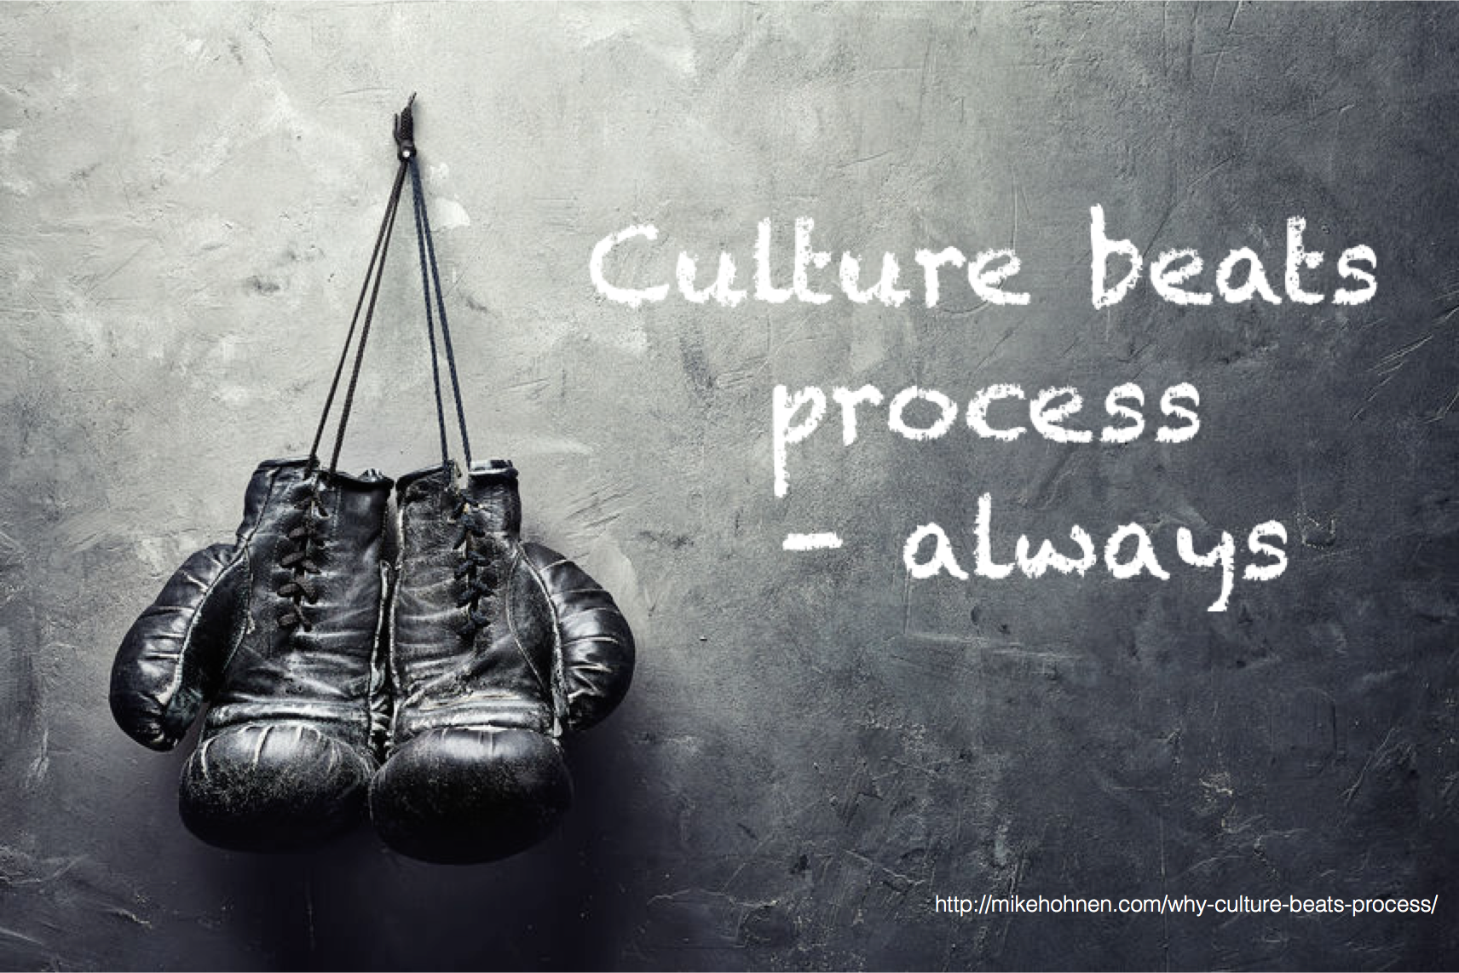
WHAT WE HAVE LEARNED #4
almost

Slide 45

WHAT WE HAVE LEARNED #5
almost

Slide 46
WHAT WE HAVE LEARNED #5
almost

Slide 47
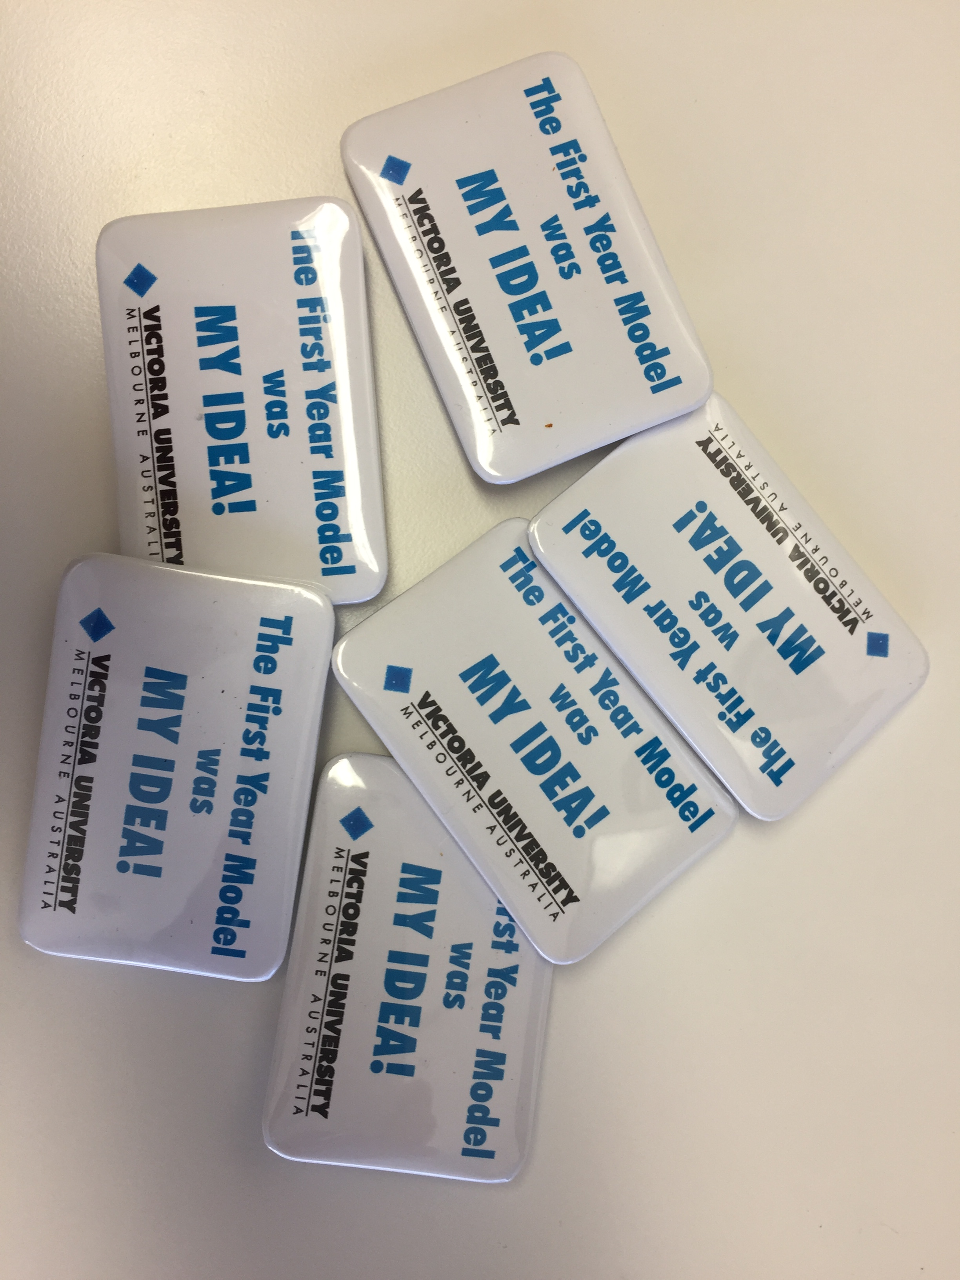
WHAT WE HAVE LEARNED #6
almost

