Slide 1

.
ACODE 78 – The University of 2030 - Laying the Foundations for Ongoing Success in Open Distance and E-Learning
Universities 4.0:
Insights into projects reshaping the digital future for higher education
Professor Marcus Bowles
Adjunct, The Centre for Workforce Futures, Macquarie University
Director, The Institute For Working Futures pty ltd
March 13, 2019

Slide 2
Contents
01
Future capabilities & work
Using technology to enhance authentic learning & assessment
Using blockchain
Diagnosing need & developing a personalised curriculum & credential stack
02
03
04

Slide 3


“
The influence of technology disruption will be felt well beyond how we learn and teach. Educational providers and governments have massively underestimated challenges the Fourth Industrial Revolution will pose in terms of reskilling the existing workforce while transforming how we educate the next generation of graduates.
“

Slide 4
1. Future Capabilities & Work
Assessing the value of higher education in terms of a graduate’s future employability

Slide 5
Automation of work
The following typologies of automation include technologies that can now automate a range of human-centred physical and cognitive activities.
06
Process
Automate routine processes such as robotic process automation (RPA) of physical, informational and transactions systems.
05
04
Physical
Deployment of robotics or AI that replicates motor human skills, navigation and mobility.
03
Sensory
perception, special assessment and judgement.
02
Cognition
Machine learning and robotic cognitive automation through replication of human patterns, reasoning, creativity, etc.
01
Natural language
Computerised systems that analyse, understand and engage with humans in a personalised form.
Social and emotional
Output, reasoning and sensing.

Slide 6
Australia within 6 years
2019 to 2025
While job loss is of great concern, the belief that 40% of all jobs will be lost due to automation by 2016, causes anxiety but is substantially inaccurate.
Using the Australian Bureau of Statistics data (6202.0 - Labour Force, Australia, October 2018) there were 12,665,800 employees in the Australian workforce in October 2018. Applying the data from Faethm for the future workforce, we have a much clearer idea of the job loss, job creation, and the skilling task Australia will face. The major debate has to focus on how we will transform the existing workforce capabilities to stay in work and assure the capabilities of all new graduates who can no longer rely on technical skills to access employment in occupations that may no longer exist.
15%
of us
16%
of us
20%
of us
1.9m workers will lose current jobs as machines replace human tasks
Over 2m workers will require major reskilling to stay in work as technology significantly augments certain jobs
2.4m workers will move to a job that doesn’t exist today
Source: Faethm data using their predictive platform, released 18 December 2018; data modelling employment in all industries, Australia November 2018 to November 2025. Numbers of workers based on ABS (2018) 6202.0 Labour Force Australia October 2018 reporting total employment of 12,665,800 workers.

Slide 7
Capabilities
Skills & Knowledge/ Competencies Core to Role (Technical)
Soft Skills Common to Professions (Non-technical)
Personal Attributes/
Behaviours
Cognitive and Mindset
Capabilities exist to emphasise and encompass more than vocational or discipline-based skill, knowledge or competencies. This approach stresses strategic, system-level outcomes. It deliberately extends competency models (behavioural or technical) to develop and assess personal dimensions such as emotions and cognitive factors (so-called ‘mindsets’ or ‘intellect’ in some taxonomies).
Capability Frameworks grow current job competence and develop a person’s future potential. This means they are built to provide a high-level insight into the skills, knowledge, personal attributes and mindsets required for the future workforce, not just a job.
Capability frameworks have to emphasise both explicit knowledge (codified and portable) that can be taught, and tacit knowledge (implicit and embedded in a context) that cannot be taught but has to be acquired through situated experience.

Slide 8
Future skills: Research-based conclusions
There has been significant research undertaken across the globe on future skills or capabilities. Much of the research has focussed on the skills humans need that cannot be easily automated or provide careers in the future workforce. The research is well grounded, rigorous and starting to concentrate on a consistent set of core requirements both for work and for navigating the disrupted global labour markets. For instance, Deakin University undertook an 18-month, multi-million dollar DeakinDigital project with IBM Watson that analysed 60,000 current and future global jobs to reach their conclusion.
Oxford Martin School (2016) | DeakinCo. (2014, 2017) | OECD Global Workforce Core Competencies (2016) | Department of Education Foundations Skills (2015) | World Economic Forum Top 10 Future Skills Australia (2018)
Sense-making Social intelligence Novel and adaptive thinking Cross-cultural competency Computational thinking New media Literacy Transdisciplinarity (work across disciplines) Design Mindset Cognitive Load Management Virtual Collaboration | Self-management Communication Teamwork Problem Solving Critical Thinking Digital Literacy Global Citizenship Innovation Professional Ethics Emotional Judgement | Analytical thinking Flexible Thinking Strategic Thinking Manage Resources Achievement Focus Diplomatic Sensitivity Teamwork & Team Leadership Organisational knowledge & alignment Negotiating and Influencing | Self-management Communication Teamwork Problem Solving Technology Learning Interactive & Enterprise Skills Planning & Organising | Creativity, originality & initiative Analytical thinking & innovation Active learning & learning strategies Technology design & programming Complex problem-solving Critical thinking & analysis Leadership and social influence Emotional intelligence Reasoning, problem-solving & ideation Resilience, stress tolerance & flexibility

Slide 9






CApable Draft Model
Example from initial research by Chartered Accountants ANZ:
Less is more. The CA model illustrates how a macro-level, trans-national workforce strategy relies on isolating the most important capabilities across four domains. This allows the framework to flex and evolve. It can maintain relevance while keeping an undiluted focus on the priority skills required to transition the existing profession or help those entering the workforce remain employable. The model will be validated and tested with stakeholders in early 2019.
Technical
Business
Tax
Financial advisory & superannuation
Audit & assurance
Insolvency
Corporate finance
Reporting
Communication
Collaboration & relationships
Problem solving & decision making
Customer focus
Digital acumen
Business and data analysis
Personal
Leadership
Ethics & integrity
Self-management & learning
Critical thinking & judgement
Adaptive mindset
Global citizenship
Future focus
Drive for results
Leading & developing others
Agility & change
Innovation & creativity
Risk & Governance

Slide 10

Engineers Australia Model
Example from EA Professional Stage 2 Competency Model:
EA has a national competency model that aligns to international standards. For graduates EA propose the future engineer will require a mix of 16 elements across four competency domains.
Obligation to Community
Value in the Workplace
Develop safe and sustainable solutions
Engage with the relevant community and stakeholders
Identify, assess and manage risks
Meet legal and regulatory requirements
Communication
Performance
Taking action
Judgement
Stage 2
Competencies
Personal Commitment
Technical Proficiency
1. Deal with ethical issues
2. Practise competently
3. Responsibility for engineering activities
Advanced engineering knowledge
Local engineering knowledge
Problem analysis
Creativity and innovation
Evaluation

Slide 11

Future Capabilities
Example from Queensland Tertiary Admissions Centre Future Capability Dictionary:
The capabilities underpinning the badging, verification and credentialing regime by partner universities spans three domains and 14 core capabilities required by future workers seeking employment. They have been isolated as part of a review of global research. They will be stress tested with clients in early 2019. The capabilities have also been mapped against higher education graduate learning outcome/ attribute frameworks.
Personal
Non-Technical
Technical
Personal Initiative and Drive
Personal Learning and Mastery
Adaptive Mindset
Cultural and Social Intelligence
Empathy
Entrepreneurial Thinking
Critical Thinking and Judgment
Ethics and Integrity
Communication
Collaboration and Relationships
Creativity and Innovation
Problem Solving
Digital Acumen
Customer Focus
Technical/ Professional Skills and Knowledge
Draft prior to final national Industry Validation January-March 2019

Slide 12

Message to ACODE members
INSIGHT ONE
Look beyond disciplines tied to current jobs to the capabilities required in the future workplace.
Demand for future skills spans all occupations, industries and locations globally.
Serving these needs can form the basis for guiding institutional efforts to create innovative, flexible and relevant courses or curriculum.
Notes:
Comment on graduate attributes, graduate learning outcomes
Flip course design and curriculum approval to insist on assessing future capabilities, not just course or unit ILOs

Slide 13
2. Using technology to enhance
authentic learning and assessment

Slide 14
Balancing learning, experience and practice
Future capabilities have three dimensions.
Future jobs need more than technical skills
The tendency in the past has been for many university and professional courses to emphasise narrow discipline-based, technical knowledge and theory over non-technical and other attributes. The non-technical aspects were often assessed as a by-product of professional and technical learning aligned to graduate outcomes.
An individual’s qualification still has strong market value. But as a signal to employers that the individual is ‘job ready’ their value is rapidly eroding.
For an employer value often lies in the potential of an individual to adapt to change and deploy their technical skills in a range of contexts.
Technical
Personal Attributes & Intelligences
Non-technical/
Transferable

Slide 15
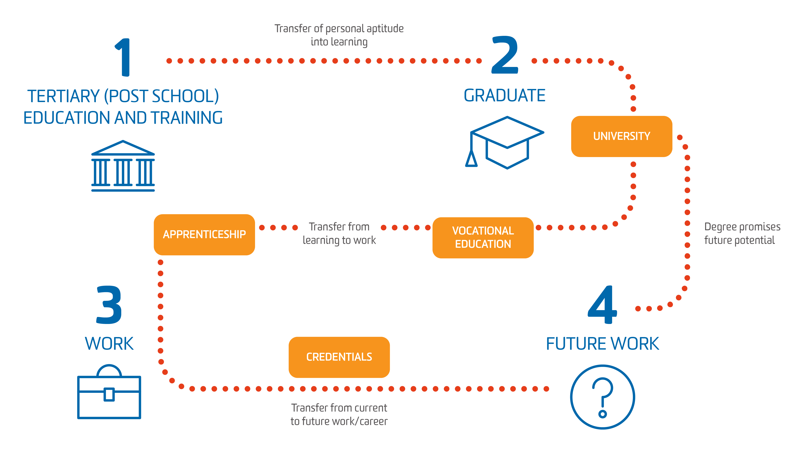
Is credentialing for learning the highest value?
Notes:
University degree = Input: Promise of employability & future potential through robust acquisition of knowledge and cognitive capability
Vocational Education = Output: Promise of occupational competency through acquisition of skills and underpinning task level knowledge
Technical Training/ Apprenticeships = Output: Confirmed technical competency and robust, applied workbased acquisition of skills
Degrees by Apprenticeship = Outcome: Confirmed employability but with robust work integrated learning or similar to assure authentic assessment
Professional Credentials = Outcome: Assurance professional expertise through applied skills, knowledge and experience

Slide 16
12%
Mindsets
63%
Soft Skills*
The motivation, cognitive awareness and drive to grow and overcome new challenges.
The personal knowledge, skills and attributes required to work in a range of contexts and with a diversity of people.
25%
Technical Skills
The discipline specific technical skills, body of knowledge and competencies that delineate professional practice.
Future work-ready profile
* Deloitte Access Economics (April 2017). Soft Skills for business success, DeakinCo., Melbourne.

Slide 17
Evidence-based, authentic assessment
Capabilities can be acquired through formal, informal, non-formal and experiential learning throughout a person’s life.
Micro-credentials issued for a capability must come from a trusted source and represent independent verification of evidence provided.
Evidence is specific to the person but must satisfy the capability standard and the relevant professional context.
Knowledge
Skills
Experience
Reflection
Credential
Digital record
Notes:
Trust in credentials – Employer and Candidate have a reliable instrument for completing an exchange.
The degree is no longer trusted in every industry. Graduates need a more refined way of differentiating themselves and their value proposition to an employer.
Employers need to be able to assess the human capital value and the ‘cultural and values’ fit of an individual. Together they inform future potential.

Slide 18
Explicit
Skills & Knowledge
The body of knowledge, theory, competencies or capabilities that allow you to perform in a specific occupation or professional role. For example being an:
Chartered Accountant
Engineer
Surgeon
Network Engineer
Teacher
Things you do that can be evidenced, written down, seen or demonstrated.
Traditional higher education tends to focus on the transfer of technical and theory-based knowledge and discipline specific skills

Slide 19
The future world of work and workers requires a recalibration of higher education to focus more on non-technical, soft skills and personal capabilities that allow us to move rapidly to new or merged work roles that largely ignore ‘industrial age’ discipline or occupational boundaries.
Tacit
Personal & Experiential
This is how you perceive yourself and others, your beliefs and ethics, and your self-awareness. They are deeply embedded in your DNA and emerge when you respond to others or a specific situation. For example:
Personal ambition and persistence
Empathy
Self-esteem
Ethical judgement
Things you know or can do that can only be learnt but not taught. It may be held within a network or by communities in a context (e.g. social capabilities), They are cognitive, mental, personality-based, or embedded in your attitude and mindset. They shape how effectively you deploy and reflect on your technical and non-technical knowledge and skills.

Slide 20
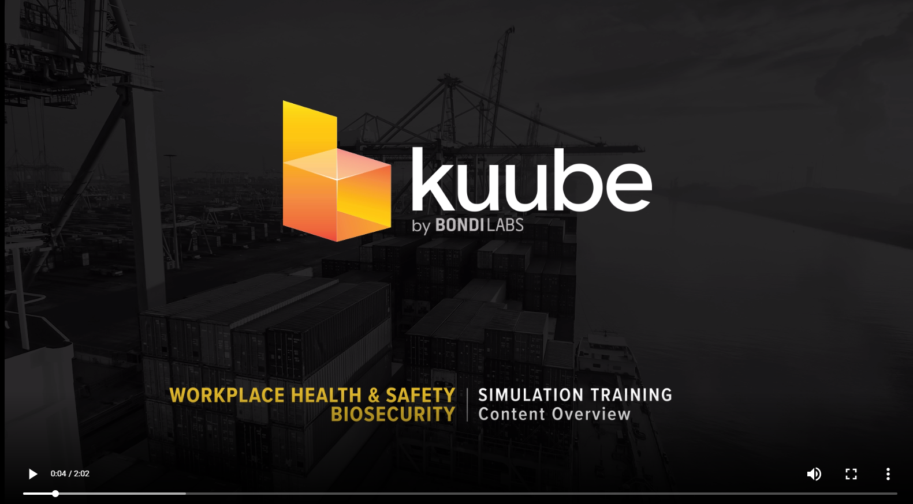
https://www.bondilabs.com

Slide 21
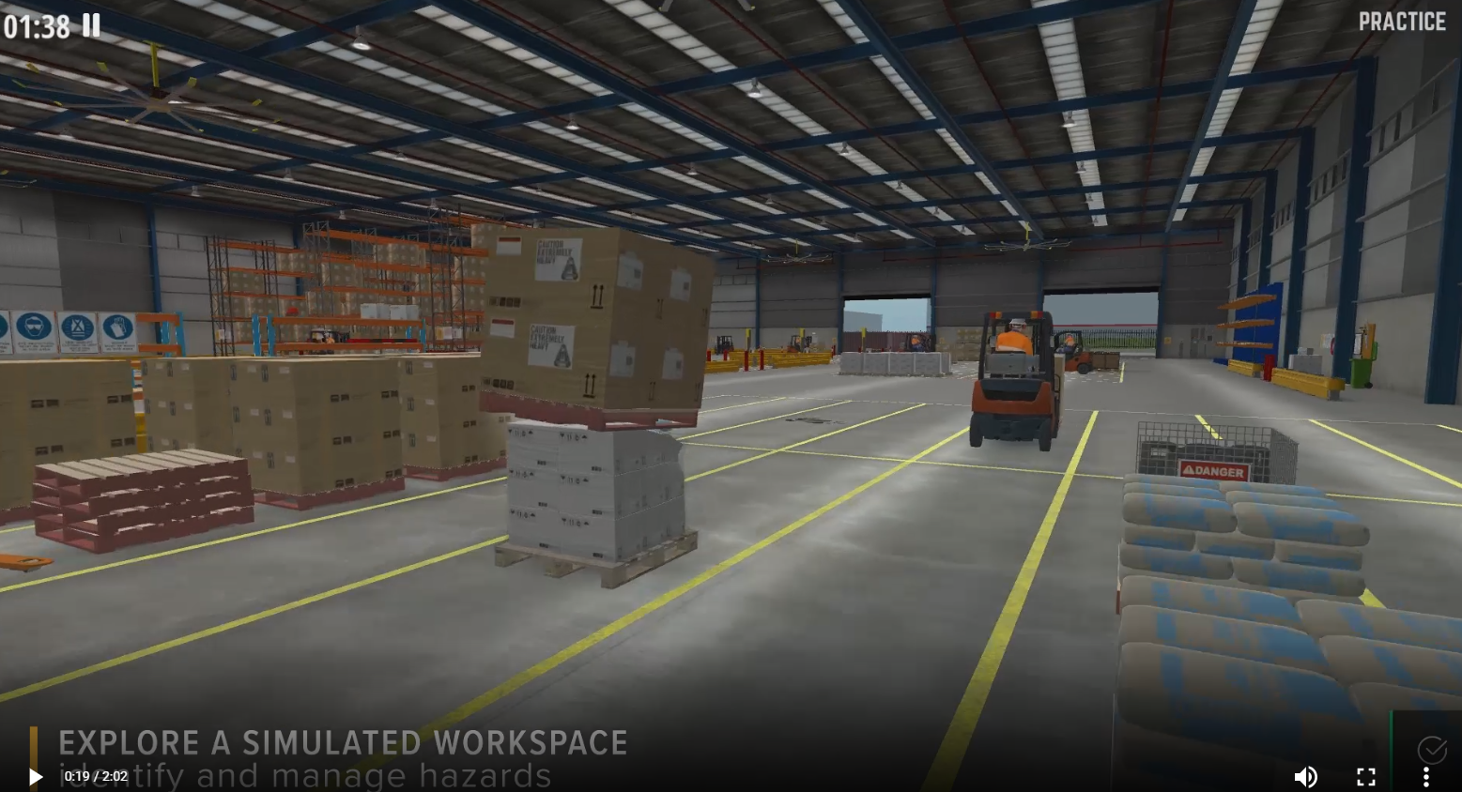
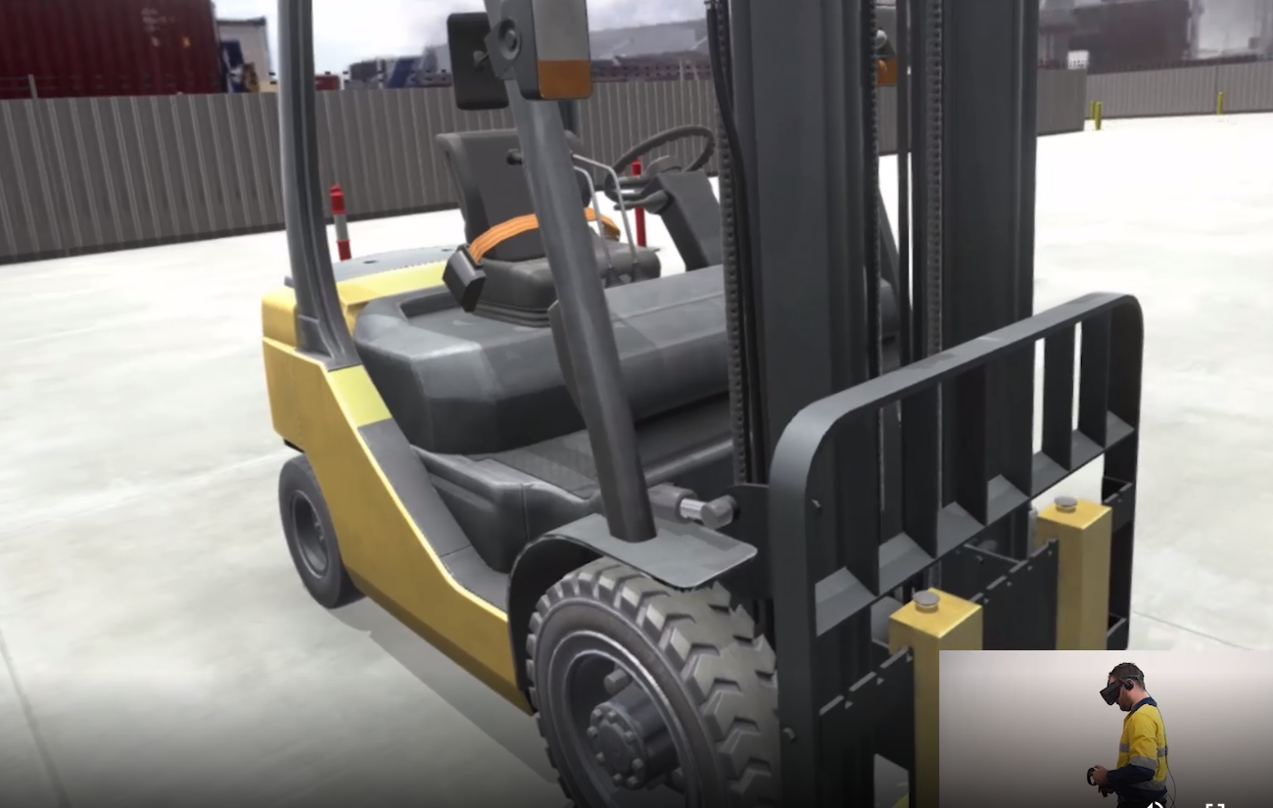
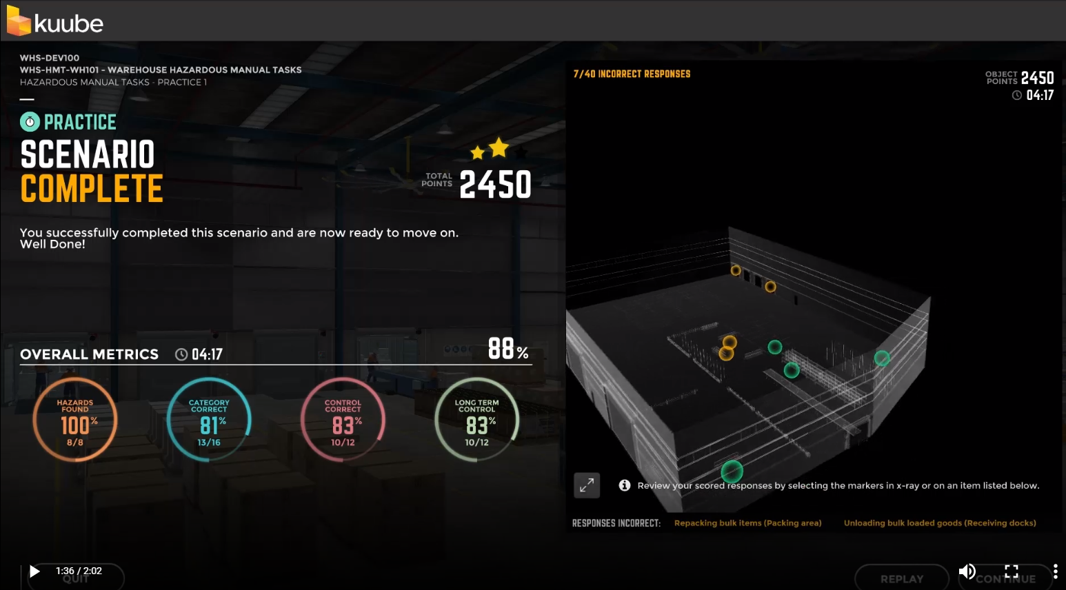
Real learning, real context, real data all in real time
This video link demonstrates some of Bondi Labs early VR training development:
https://link.bondilabs.com/VRWarehouseHazardID
This video link provides a larger overview of the product and how it captures valuable data https://s3-ap-southeast-2.amazonaws.com/bl-core/prod/public/media/video/Kuube_QuickOverview_March26_2018_02.mp4

Slide 22

Message to ACODE members
INSIGHT TWO
Like never before, technology can enhance how well we move beyond leaning outcomes to put context and authenticity into an outcomes-based approach to learning and assessment.

Slide 23
3. Using Blockchain
Verifying identity and managing a person’s lifelong learning records

Slide 24

Why Blockchain?
Data management is modular and improves user control of privacy, sharing and mobile access while enhancing central management of the information and permissions by institution (or their nominee).
Decentralised, open platform means limited overheads associated with running and maintaining blockchain infrastructure.
Shared Trust occurs as all parties in the value chain from educators through to employers can add data to the chain using same protocols and immutable data platform.
Traceability and authenticity occurs for all data as it can be audited, checked and reported over time.
Automation of processes occurs and the existing restrictions of interoperabity between institutional systems and academic records is removed.
Scalable with limited capex incurred by institution or user.
Blockchain provides a unique opportunity to better manage identity, personal records, and credentialing process in education.

Slide 25
Beyond the hype: Blockchain works
1. Verify
Person and evidence for credential.
6. Tradable
Date and records can be shared by owner and used to enhance access to further learning and work.
Blockchain
2. Block
Record is entered into blockchain.
5. Evidence-based
Proof of attainment, evidence and supporting records can be digitally linked.
3. Ledger
Personal record is updated.
4. Confirmation
Record is transparent, able to be checked, traced and distributed.

Slide 26
success factors
blockchain can improve open distance educational solutions and overcome old problems
Trusted
Wrong & Counterfeit Data
Be THE credible, trusted source of validated records for all parties.
Assures and validates data and provides traceable history of data entry.
Lifelong
Fake Identity
A ‘free’ for life, digital record using blockchain that can seamlessly integrate with other systems.
Identity confirmation and an immutable single point of trust and truth created thereafter.
Gains
To
Make
Pains
To
Defeat
Credentialed
Poor Student Experience
Provide verification based on a currency recognised by employers, vocational providers and universities.
Meets data and user expectations of digital natives and stakeholders working in global or mobile environment.
Transparent & Secure
Process Inefficiency
Provide quality assured, integrated, and secure digital service.
Removes heavy human touch and automates processing across institutions, time and locations.

Slide 27
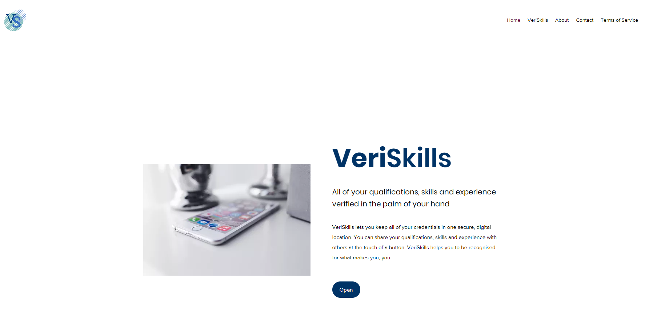
www.veriskills.com

Slide 28

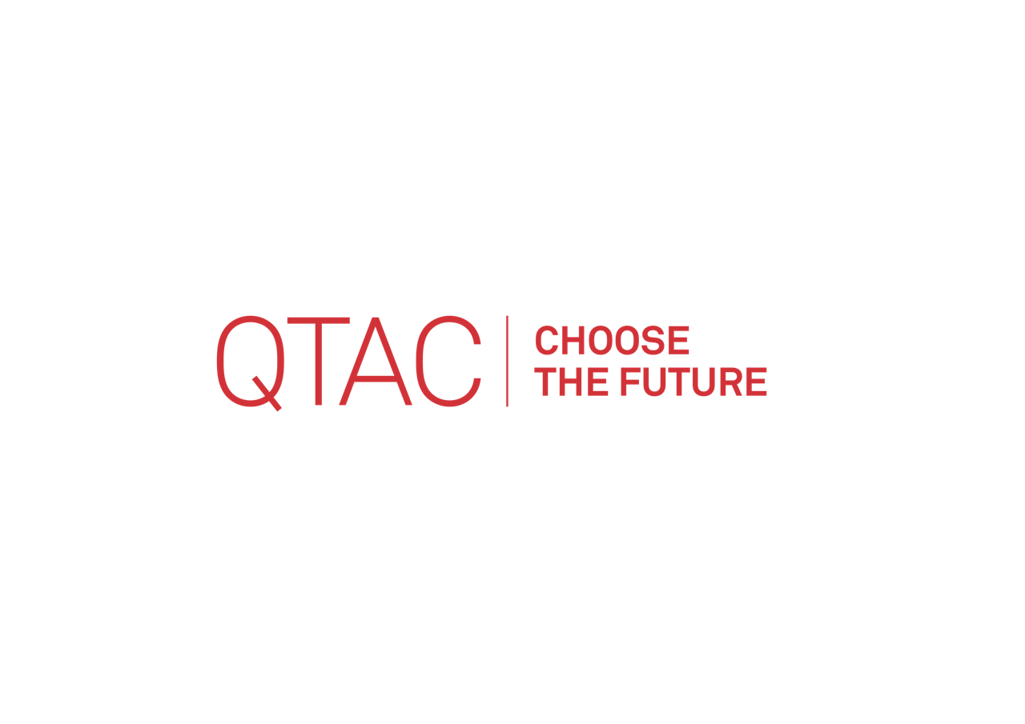
VeriSkills is powered by
40 years of verifying skills and experience for university entrance
Situated within Australia’s qualifications eco-system
Owned and operated by universities

Slide 29
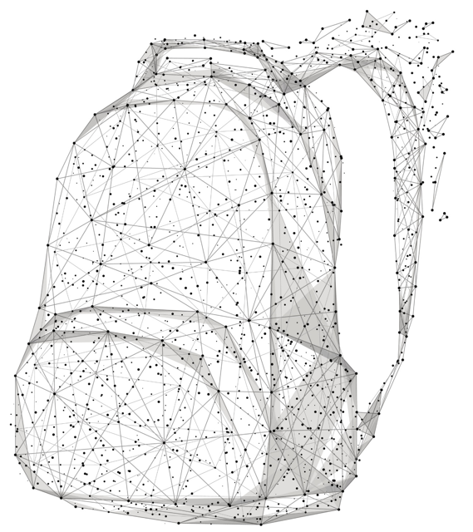
What is
VeriSkills?
VeriSkills provides a ‘digital backpack’ that will hold the validated, lifelong record of each individual’s educational credentials and abilities acquired through experience or learning.
The backpack is portable and holds records that can be accessed and shared at any time by the owner using a digital device.
This innovation allows individuals to personally manage the collation, storage, validation and sharing of their lifelong records. Furthermore it will remove inefficiencies and helps students without an ATAR score to plan a path which will ensure they secure not only the right tertiary provider and course, but also a sustainable career.

Slide 30


We all need a portable, digital, verified record of what we can do
Skills
Qualifications
Experience

Slide 31










Verify and share what you can do
Citizenship
Identity
Qualifications
Memberships
School results
Certifications
Assessment of Future Capabilities and Skills
Employment
Training
Credentials

Slide 32






How VeriSkills Works
Customer/ Student downloads free VeriSkills App and creates an Account
The Customer lists their qualifications, skills or experience
Third-party verified qualifications and experience (including microcredentials), are represented through digital badges.
Verification fees apply for skills assessment.
The Customer share their digital badges through social media
The Customer securely shares badges and metadata with trusted recipients

Slide 33

Message to ACODE members
INSIGHT THREE
To build a 21 Century solution educators have to disrupt what exists and use technology and processes where students, employers and the community can benefit in profound ways.
OR
For a university CIO: CAPEX investments in educational technology and platforms cannot be made diligently without consideration of the value generated by open and free options.

Slide 34
4. Diagnosing needs and developing
a personalised curriculum and
credential stack

Slide 35

The divide: from learning to employment
Qualifications no longer a reliable currency for recruiting people to new forms of work
University disciplines do not match emerging areas of work
Automation and disruption have radically altered jobs and employment
Businesses failing to keep pace with disruptive innovations
Graduates have skills not being recognised and valued
3.5 billion digital natives born 1983 to 2016
Gig economy and self-employment increases
Career moves become horizontal movement than vertical
Technical skills have shelf life of <2.5 years
Soft skills enduring longer and more valuable
Governments, educators, labour market and employment bodies using industrial age data classification, analysis and reporting mechanisms

Slide 36
how can micro-credentials help?
Personalised, relevant and highly contextualised and controlled by the student.
Allow credentials to be stacked to optimise planning of career path and study for qualifications (macro-credentials).
Accelerate the time to completion and reduce the cost by eliminating university study where the student has existing, validated prior capability and experience.
Increase the offer to individuals traditionally avoiding higher education pathways.

Slide 37
Credential Types
Macro-Credential is the qualification
Increasingly micro-credentials are being used to certify or verify that an individual has completed a specific or component of learning within a course.
The component may result from a bundling or unbundling of formal learning. For instance, offering a topic, subject, unit of study, module, or competency within a formally recognised course, that may represent:
  Skill sets
  Program resulting from bundled/ unbundled parts of a qualification that fall short of satisfying all the requirements for graduation
  Short courses or Executive Programs (in professional and continuing education, vocational education and training (VET) or executive courses)
  Vendor Qualifications
  Enabling and Foundation courses
  Massive Open Online Courses (MOOCs)
Notes:
Comment on micro, meso, nano credentials terms and usage
Nano-degree
Nano-credential
Micro-degree

Slide 38















Credentials: Emerging landscape and typologies
Same name, different meaning.
The terms digital badges and micro-credentials have often been used interchangeably. As a result not all microcredentials or digital badges are comparable or of a consistent quality.
Micro-credentials can be a digital badge, but not all digital badges are micro-credentials. While most microcredentials encompass learning, not all badges nor credentials have a direct relationship to a qualification. Some encompass learning but only if applied experience is also included.
Credential for Completion
Credential for Learning
Credential for Practice
Used as a validated indicator of accomplishment, skills demonstration, quality or advanced personal achievement. Typically used by vendors, as hallmarks by educators or by global online or open educational providers.
Aligned to accredited learning outcome or approved part of a course. The badge maybe issued by an accredited provider or form part of an accredited course. It could be provided by trusted institution to recognise or register an individual. The credit back to the qualification can be uncertain.
Aligned to independent standards or competency framework. The credential is proof of a person’s capability, skill or achievement tied to a level of proficiency. It has a known relationship to a qualification and can be backed by an accredited provider.
Vendor/ CPD Learning Formal Learning Work/ Employability
INPUTS OUTPUT OUTCOMES
Notes:
Note moves from self accreditation to academic and professional to an emerging hybrid mix
Quick chat on hallmarks – Confusion between attainment of GLOs (DU) and employability outcomes. Mixed signals to employers who feel MC and digital badge do the same thing. More holistic, more under remit of course coordinator and Director to recognise outstanding achievement outside grades or academic marks.

Slide 39
Job Neighbourhoods
Examining corridors to employment and sustainable careers
Job Neighbourhoods show jobs clusters related not only by what workers do, but the capabilities required to perform work tasks and activities. It supplements the concept of occupations and job families.
You should choose jobs with capabilities that allow movement (Job Corridors) into other jobs in the neighbourhood. Ideally, this movement should be to jobs with sustainable employment growth.
In the example provided for the Accounting field, the Accountant Business Services: Tax looks to be a good job given current employment. But the indicative 10 year employment growth projections are not great. Employment for a Financial Manager is comparatively lower today, and the Management accountant: Project confidence and assurance is much lower. But these latter jobs have much better long term growth projections.
This indicative study of a regional Job Neighbourhood for information and communication technology professionals can inform educational providers about priorities, and existing workers and students where they may wish to gain capabilities and then specialise to enhance future employment.
Numbers Employed May 2018
Accountant: Business Services - Tax
Employment Growth
Financial manager
Employment Growth
Management accountant: Project confidence and assurance
Employment Growth
Projected Job Growth May 2018-2025

Slide 40

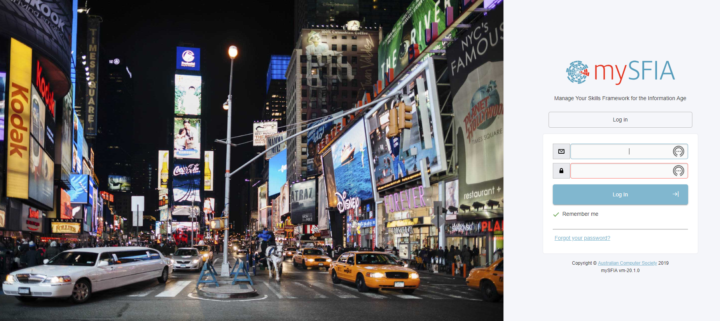
https://corp.mysfia.com.au/

Slide 41

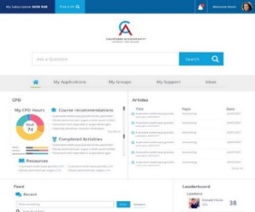


Profiling Tool
Assure conceptual model fits plans for an online self-assessment tool
CA Members
Member Journey
Profile and accurately report and track capability acquisition throughout the member’s journey.
Track, report and recognise member’s journey. Connect members to each other.
Professional Development
Development Plan
Personalised plan helping sort, prioritise and map CA education and services to specific needs.
Isolate capability and competency gaps and target CA X or CPD solutions.
Career Planning
PERSONAL
profile
Micro-credentials
Isolate individual career ‘corridors’ or transition from redundant occupations to new opportunities.
Ability to ‘cash in’ learning or experience to evidence capability and gain CA recognition.
Employers
Data Analytics
Support workforce planning, skills audits and development of learning and talent plans.
Rich data and insights able to inform personal, company and CA ANZ or global GAA planning.
CA ANZ
CApability
Dictionary
My CA

Slide 42


Credential Stacks: Transforming call centre staff
From customer service staff using technology to customer success advocates
Once capabilities are identified for the required future work, a set of priority, highly employable capabilities emerge. This forms a personalised learning plan.
Instead of undertaking a full qualification (a macro-credential) that may give little indication of work performance or readiness, a person can complete the most important and employable capabilities. These can be recognised through micro-credentials (part of a degree) where the person is independently validated by a third party (e.g. professional association, university, admissions centre, assessment centre such as DeakinCo) as presenting evidence of authentic, applied expertise to the required international standard of professional performance.
Moreover, the individual will be verified as possessing capabilities that indicate they have the potential to work across other current or emerging areas of professional practice or job neighbourhoods.
01
Specialist
Data analytics
02
Common
Customer experience
03
Core
Emotional Judgement
04
Core
Problem solving

Slide 43

Message to ACODE members
INSIGHT FOUR
Mass versus Personalised education:
Using MOOCs or digital platforms to push short and executive courses tied to parts of an existing qualification without regard for future workforce demand seems ill considered.
As work transforms and disciplines converge, so new educational market opportunities will emerge. It is in these spaces universities can specialise and become a critical strategic partner in a national or regional responses to industry transformation.

Slide 44


Professor Marcus Bowles
Adjunct, Centre for Workforce Futures, Macquarie University
Director, The Institute for Working Futures pty ltd
Direct
M +61 412 439 009
mbowles@workingfutures.com.au
marcus.bowles@mq.edu.au
The Institute for Working Futures
pty. ltd. abn: 22 054 466 769

