Slide 1

What can students’ digital experiences today teach us about the university of the future?
Helen Beetham, ACODE 78, University of Tasmania, March 2019

Slide 2





About the insights survey
Survey instrument developed over three years by Jisc
2018 ANZ survey had over 21k responses from 12 unis
(10 in Australia and 2 in New Zealand)
23 core questions under 4 themes
        You and your digital tech
        Digital at your university
        Digital on your course
        Your attitudes to digital
UK survey of 43 unis used as a comparison group

Slide 3

The survey is just one element in an engagement process
Start the conversation: What is the ‘digital’ university?
What could it be? What is it like to work and study here?
Engage stakeholders – especially teaching staff and students
Involve stakeholders in designing and delivering the survey
Involve stakeholders in interpreting and responding to the findings
Follow up with focus groups and learning journeys
Develop collaborative projects to make a difference

Slide 4
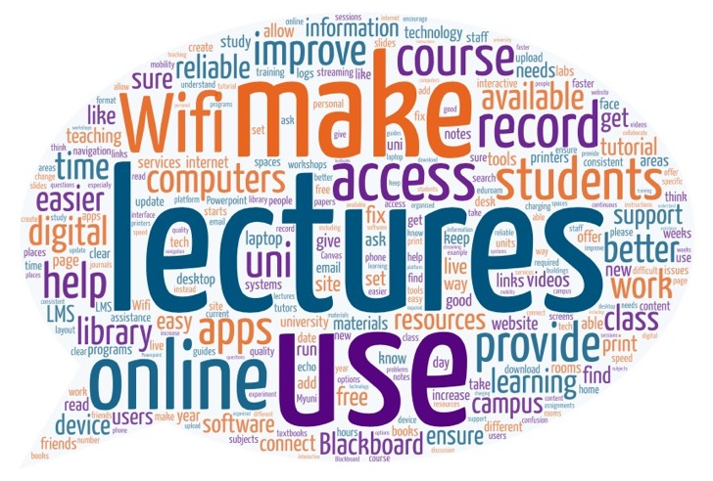

Limits of student feedback
Focused on the here and now
Transactional rather than transformational
‘Teach skills we need for the future as well as now’
‘Employability digital fundamentals’
‘Use different apps to improve our skills.’
Computer rooms are “crowded”, “noisy”, “booked out”, “filthy”, “full of desk hogs” and “a street market”!

Slide 5

Limits of student feedback
Limited perspective, ‘conservative’ learning habits
Teaching staff are more likely to be dissatisfied and to
aspire to more extended/sophisticated uses (UK findings)
% of students and teaching staff saying that digital technologies should be used more, about the same, or less in teaching

Slide 6


Students are focused on their
digital skills…
74% of students agreed that digital skills would be important in their future career.
Only 44% agreed that their course prepared them for the digital workplace.
Only three in ten students agreed that they were told what digital skills they would need before starting their course, or that that they were given the chance to be involved in decisions about digital services.
With MVA, this one factor - ‘my digital skills’ - explained 23% of all variance.

Slide 7

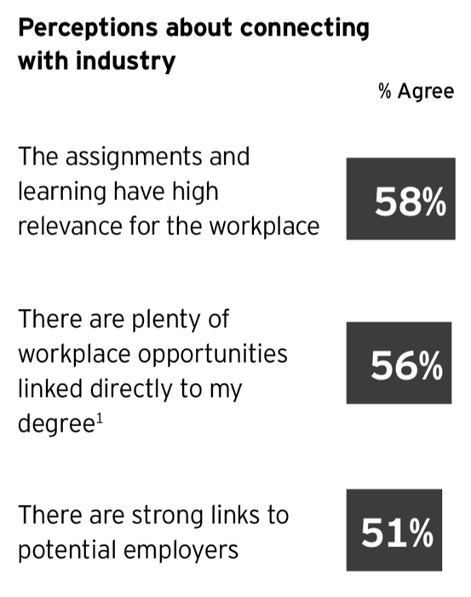
Comparing with EY report

Slide 8


Student attitudes to digital
About three in four students agreed that they are more independent in their learning when digital technologies are used. Similar numbers agreed that digital allows them to fit learning into their life more easily.
A majority of students agreed that they understand and enjoy learning more when digital technologies are used.
But students were on average 'neutral' about whether digital technologies make them feel more connected with other learners or with their lecturers/tutors.
About three in ten students agreed that they are more distracted when digital technologies are used, and a similar number agreed that they are less likely to attend class.

Slide 9
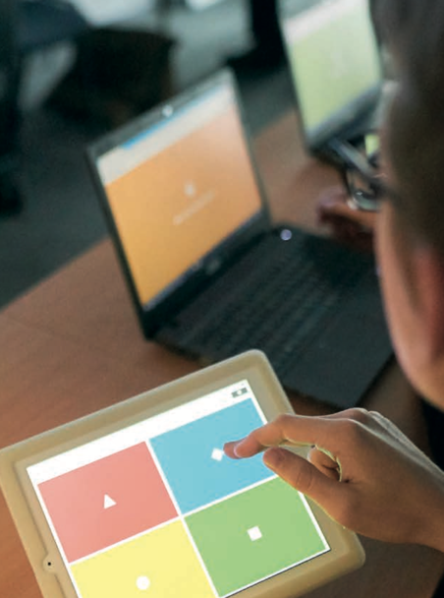
Student attitudes to digital: free text data
Independence and organisation
Independence, flexibility and being able to organise their study time are benefits that students rely on, especially distance students
Value for money
Students expect value for money, and can feel ‘cheated’ if they see interactions with teaching staff being ‘replaced’ by online work.
Digitally disadvantaged or disenchanted
Some students have poor digital access or skills, find it hard to
transfer skills to learning or struggle with distraction,
Others are cynical/disenchanted about digital in their learning.
The attendance paradox
Recorded lectures and online activities support a more equitable experience but there is a risk of undermining the special quality of the face-to-face lecture.
Invest in the technologies students value
Subject-specialist applications such as data analysis and digital design; up-to-date tools for the digital workplace.

Slide 10
“Don’t put everything online”
A large proportion of comments suggested that ‘too much’ learning was now online:
Loss of human presence and interaction
“I find lectures in person much more engaging/easy to follow.”; “Some students like me learn better with face-to-face interaction.”
Teaching quality
“More face-to-face classes and less dumping information on the LMS.”; “Don’t let our lecturers use the phrase ‘blended learning’ as an excuse to leave the classroom.”
‘Blended is best’
“You need both digital and face-to-face for the best university experience.”; “Keep giving written essays as a core assessment. Digital should allow flexibility in assessment.”
Value for money
“We are paying for interactive classes and teachers to talk to.... online classes are a waste of our money.”
Attendance and participation
“I have witnessed decreased student participation due to over-reliance on digital tech.”
“Don't encourage learners to always refer to [recordings] – the rooms will soon be empty”

Slide 11
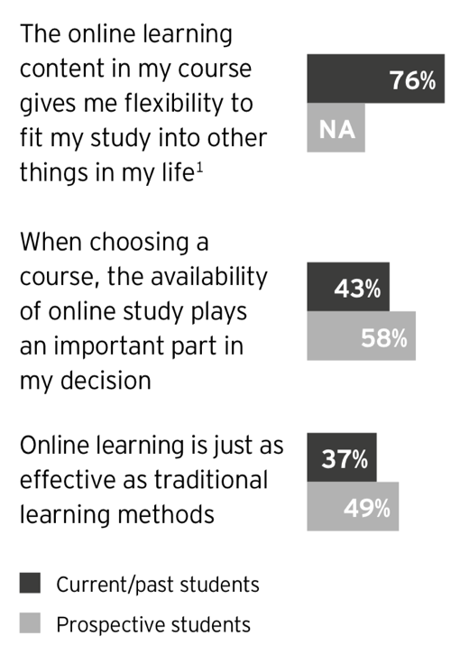
Comparing with EY report

Slide 12

Key differences, ANZ and UK students
ANZ students carried out all but one of the independent digital learning activities more often than UK students
ANZ students carried out all but one of the course-related digital learning activities more often than UK students
ANZ students significantly more likely to agree with POSITIVE statements about their LMS experience
but
ANZ students were more likely to agree with NEGATIVE statements about their digital learning experience overall
ANZ students were much more likely to say they might not attend class if digital is used
ANZ students were significantly LESS likely to want digital technologies used more in their learning

Slide 13
Conclusions for today:
- Students are uncertain and anxious about the future
- We need to think beyond ‘skills’ to digital mindset, attitude, resilience
- Critical is a valuable mindset!
- Critical attitudes to digital can easily become disenchantment
- Capabilities and future orientation develop in courses of study…
- … but also when we work with students to find digital solutions

Slide 14
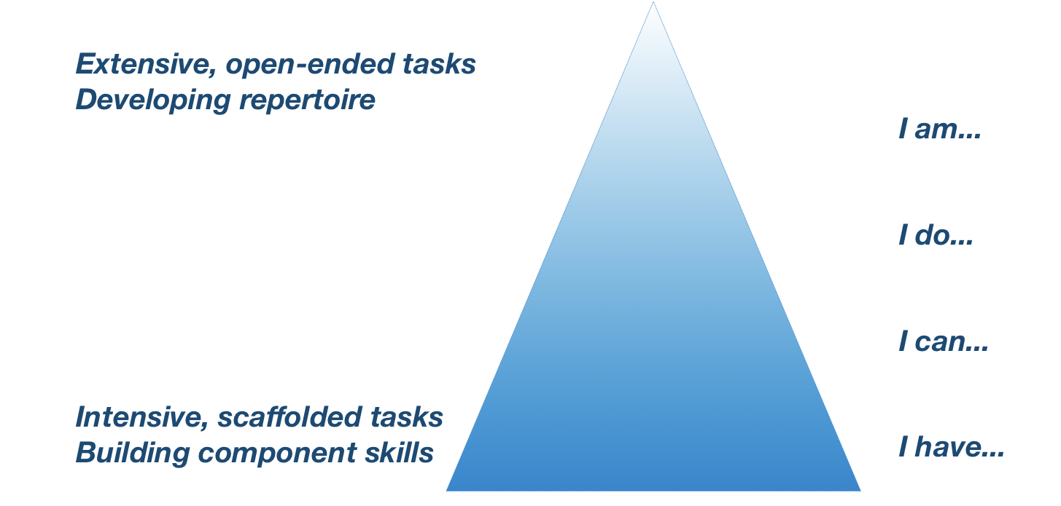
Developing digital capabilities
(Beetham and Sharpe 2000)
identity
attributes
situated practices
functional skills
access

Slide 15
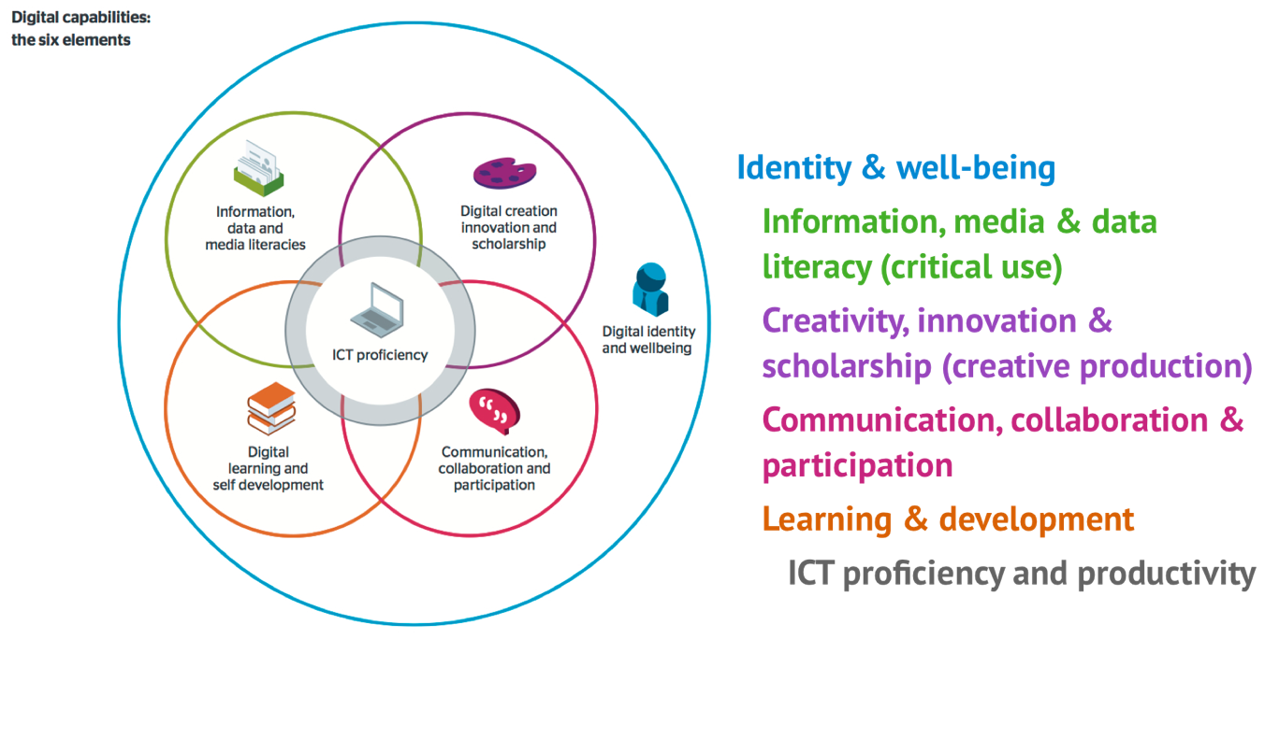
Developing digital capabilities
(with Jisc 2014-18)
Notes:
In courses of study…

Slide 16
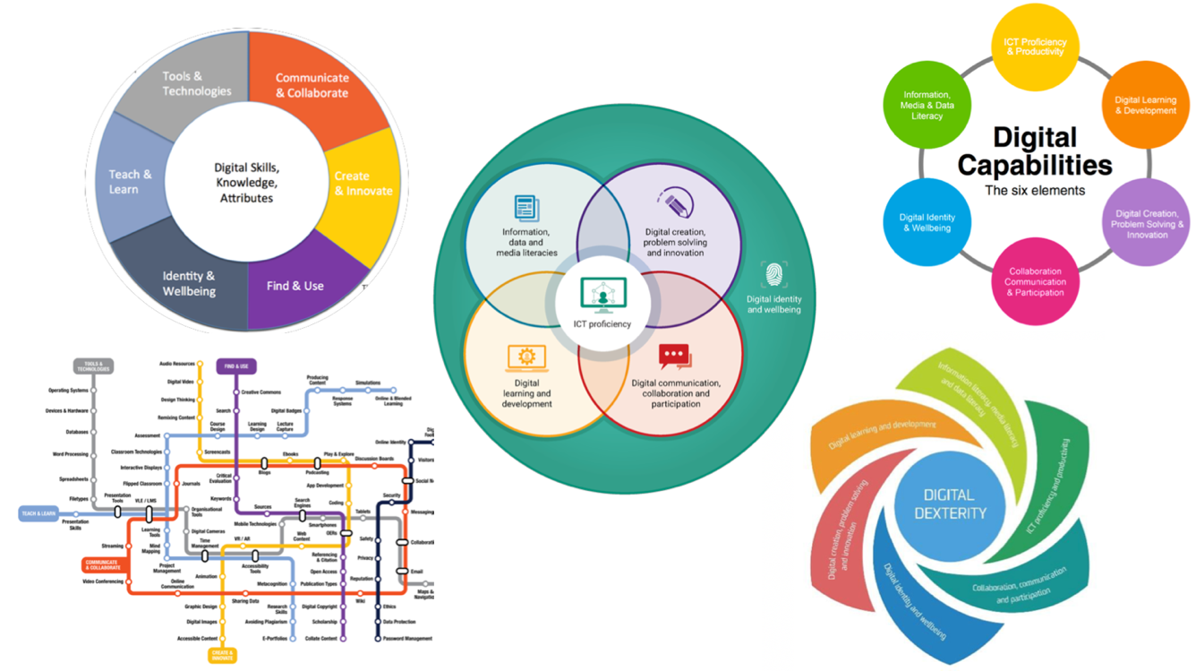
Developing digital capabilities – many versions

Slide 17
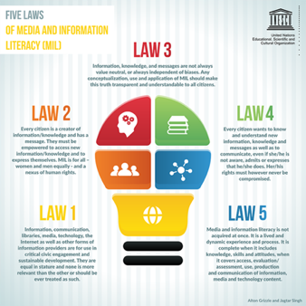
Developing digital capabilities – a global agenda
A human right (EU, UNESCO ‘5 laws’, recent ACHR conference)
An aspect of citizenship and civic participation (Council of Europe, British Columbia, Office of the e-Safety Commissioner, schools programmes)
A requirement for economic engagement (Australia’s Tech Future, EY report)
An international measure of educational outcomes
(OECD’s PSTRE measure)
A marketplace (MS, Lynda.com,
google, Adobe, Mozilla…)
…

Slide 18
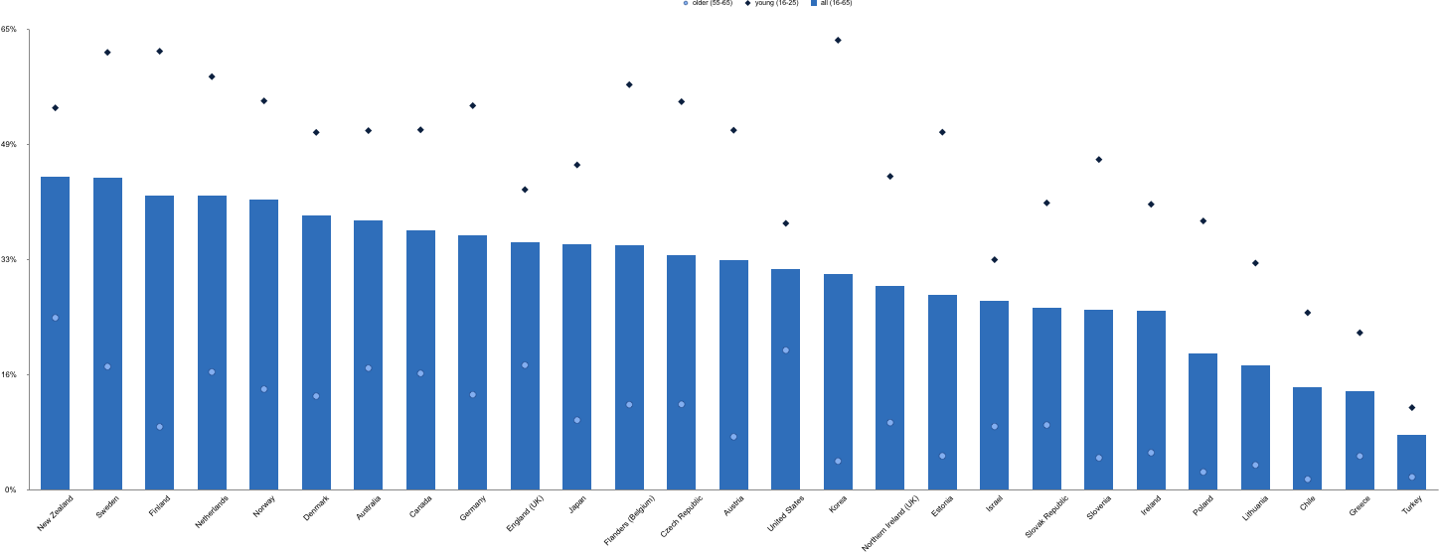
Developing digital capabilities – a global agenda
An international measure of educational outcomes
OECD survey of adult skills (PIAAC 2017): % of adults scoring 2 or 3 on the ‘problem solving in a technology rich environment’ measure (Aus / NZ highlighted)

Slide 19
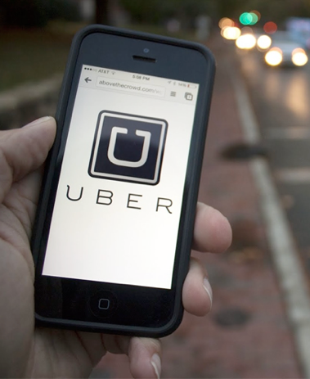


The stakes are high…
      Automation and off-shoring
      Precarity of (human) employment
      Loss of trust in professions
      Demand for continuous reskilling
      Algorithmic labour

Slide 20
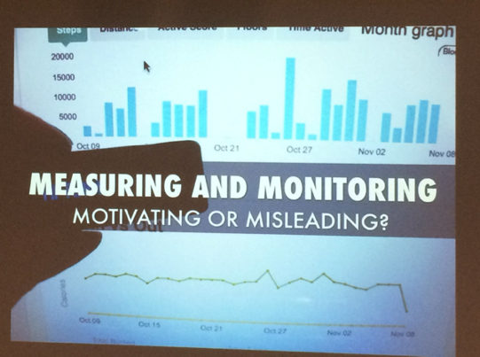


The stakes are high…
      Texture of personal and social life
      Threats to democracy and democratic institutions
      Surveillance and privacy
      Generational shifts/conflicts
      New kinds of inequality
      …

Slide 21

Futures thinking can’t be left to futurologists
‘Beyond Current Horizons’ (UK Govt 2009)

Slide 22
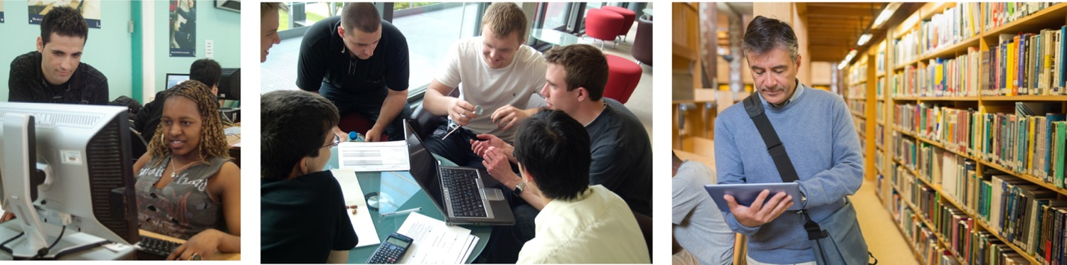
Some of the solutions may be here:
      Discipline-based resources (new methods, sub- and inter-disciplines)
      Digital capabilities agenda – including critical responses
      Developing students as engaged citizens of their university

Slide 23
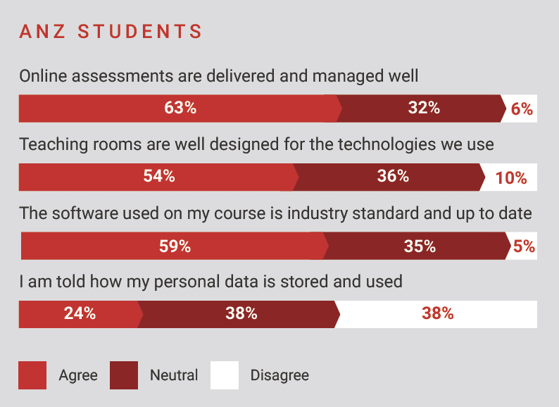
Developing students’ data literacy

Slide 24
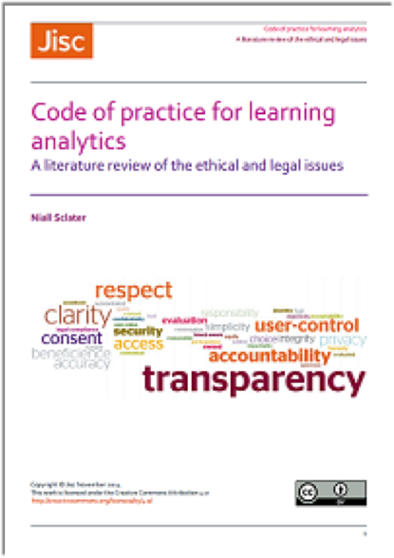
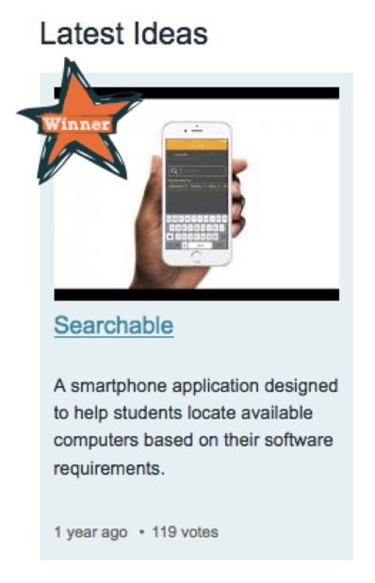
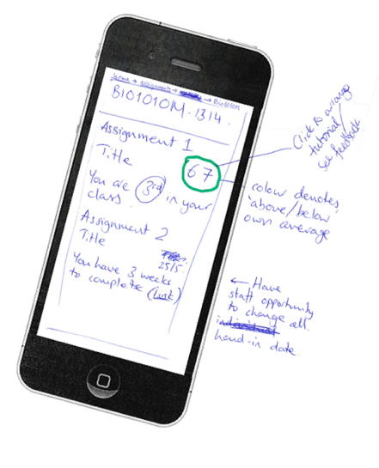
Developing students’ data literacy

Slide 25
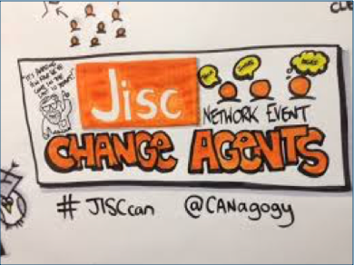
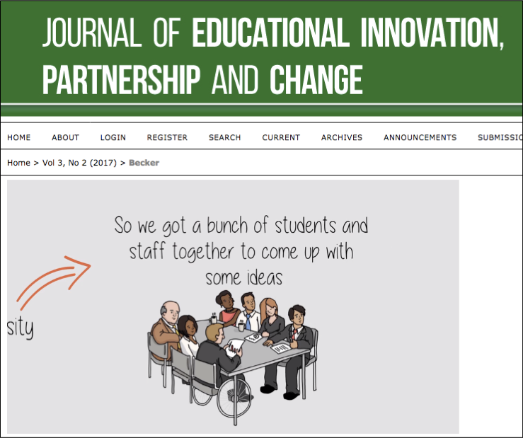
Students as change agents
“Be open to student input regarding the new programs and apps that are being used”
“Give students a say in how they want to learn and use devices”
“Let students create the improvements, as they know what they want.”

Slide 26
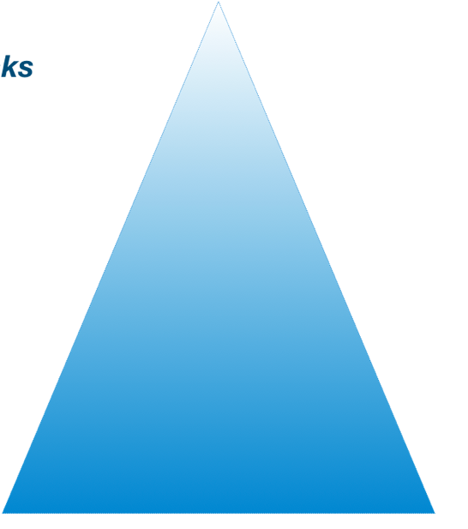
Developing digital capabilities
engaged digital citizens
identity
attributes
specialists and creatives
situated practices
critical thinkers and problem solvers
functional skills
informed consumers
proficient general users
access

Slide 27
Developing digital capabilities
Critical computer literacy involves learning … to perceive computer culture as a contested terrain… to interrogate the political economy, cultural bias and environmental effects of computer-related technologies.
Critical media literacy not only teaches students to learn from media, to resist media manipulation and to use media materials in constructive ways, it is also concerned with developing skills that will help create good citizens and make them more motivated and competent participants in social life.
engaged digital citizens
specialists and creatives
critical thinkers and problem solvers
informed consumers
proficient general users
Richard Kahn & Douglas Kellner (2005) Reconstructing Technoliteracy

Slide 28
What can students’ digital experiences today teach us about the university of the future?

Slide 29
What digital experiences can we offer students today that will equip them for uncertain futures?
Questions, contributions, provocations…

