Slide 1
Contract cheating in Higher Education Findings from a Survey of Australian Students and Staff
Project Co-Leaders
Associate Professor Tracey Bretag and
Dr Rowena Harper
This Strategic Priority Project (SP16-5283) is supported by the Australian Government Department of Education and Training

Slide 2
Project team
Lead institution
University of South Australia (Project co-leaders: Tracey Bretag & Rowena Harper)
Partner institutions
Griffith University (Karen van Haeringen)
University of NSW (Cath Ellis)
University of Sydney (Pearl Rozenberg)
Swansea University, UK (Phil Newton)
Data analyst
Michael Burton (University of Western Australia)
Project Manager
Sonia Saddiqui (University of South Australia)

Slide 3
Overview
Background to project
Research questions and approach
Student survey findings
Staff survey findings
Assessment design findings

Slide 4
Commercialisation, marketization and competition
Massification, internationalisation, and diversification
Corruption in wider society
Digital disruption, changing social norms/values
Employability focus, learning seen as ‘transaction’
Pressure to perform: metrics, measurement
Precarious job markets, casualisation

Slide 5
2015-2017 context
MyMaster
scandal
Exam
Impersonation
(SBS ‘Pens for Hire’)
Low admission
standards
ICAC investigates
HE corruption
2015
2016
2017
Fake testamur,
transcript
mills
Fraudulent
recruitment
practices
in VET
‘Airtasker’
scandal
TEQSA requests
academic integrity
info from all providers
‘Ghost’
students

Slide 6
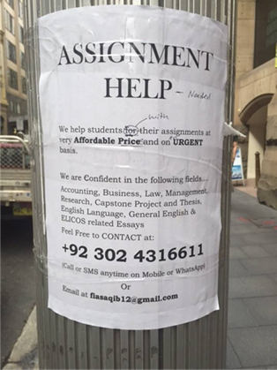
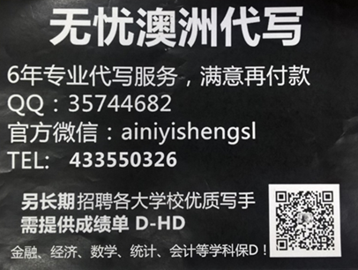
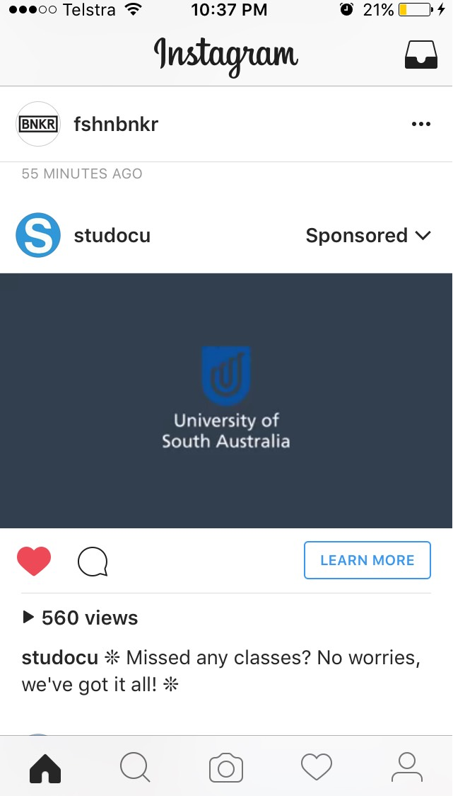
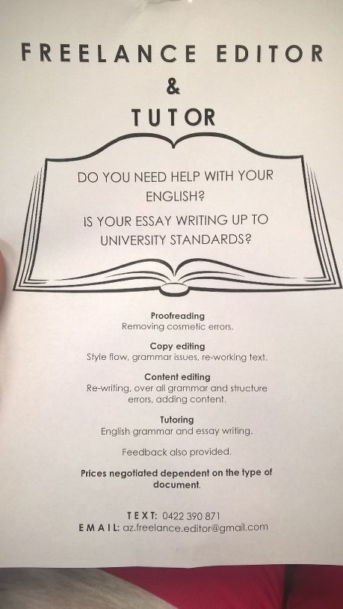

Slide 7
Contract cheating
“Contract cheating occurs when a student submits work that has been completed for them by a third party, irrespective of the third party’s relationship with the student, and whether they are paid or unpaid.”
(Harper & Bretag et al, under review)
Third party:
friend or family
fellow student or staff member
commercial service

Slide 8
Research questions
How prevalent is contract cheating in Australian higher education?
What are student and staff attitudes towards and experiences with contract cheating?
What are the individual, contextual and institutional factors that are correlated with contract cheating?
What kinds of assessments are associated with contract cheating?

Slide 9
Research design
Parallel staff and student surveys
8 Universities
4 Non-University Higher Education Providers (NUHEPs)
Large dataset of procurement requests posted to multiple cheat sites
Show the types of assessment commonly contracted out to third parties
Data from two universities’ longitudinal academic integrity databases
Show the assessment items in which purchased assignments have been detected

Slide 10
Seven outsourcing behaviours
Buying, selling or trading notes | Providing a completed assignment (for any reason) | Obtaining a completed assignment (to submit as one’s own) | Providing exam assistance | Receiving exam assistance | Taking an exam for another | Arranging for another to take one’s exam
Sharing behaviours
Cheating behaviours

Slide 11
Student survey
An analysis of key findings
Notes:
10 mins total

Slide 12
Respondents
N = 14,086
Eight universities from six states – NSW, VIC, QLD, TAS, SA, WA
57% Female, 41% Male
29% 17-20 years old, 37% 21-25, 12% 26-30, 12% over 30
69% Undergraduates, 21% Postgraduate Coursework, 9% Postgraduate Research
85% Domestic, 15% International
65% Internal students, 26% Blended mode, 9% External (online only)
79% English speaking, 21% Language Other than English (LOTE)
50% Group of Eight, 50% non-Group of Eight

Slide 13
Prevalence of outsourcing behaviours
Sharing | Bought, sold or traded notes | 15.3%
 | Provided completed assignment (for any reason) | 27.2%
Cheating | Obtained assignment (to submit) | 2.2%
 | Provided exam assistance | 3.1%
 | Received exam assistance | 2.4%
 | Took exam for another | 0.5%
 | Arranged for another to take exam | 0.2%
‘Cheating’ group
6% of students (n=814)

Slide 14
Nature of cheating behaviours
 |  | Obtained assignment (to submit) | Provided exam assistance | Received exam assistance | Taken exam for other | Arranged for other to take exam
% of Cheating Group who reported engaging in each behaviour |  | 37% | 53.2% | 41% | 7.9% | 4.2%
% who submitted as own work |  | 68.5% | - | - | - | -
Provider/ receiver | Student or former student | 60.2% | 66.7% | 78.9% | 40% | 50%
 | Friend or family member | 51.2% | 69.6% | 52.8% | 71.6% | 56.3%
 | File-sharing website | 4.2% | - | - | - | -
 | Professional service | 10.4% | 1.5% | 5.3% | 6.7% | 18.8%
 | Partner or girl/boy friend | 9% | 6.1% | 7.5% | 16.7% | 15.6%
Money exchanged | Yes | 13.3% | 3.4% | 2.8% | 16.7% | 10%

Slide 15
Sharing behaviours
 |  | Bought, sold or traded notes |  | Provided assignment (for any reason)
 |  | Cheating Group | Non-Cheating Group | Cheating Group | Non-Cheating Group
% of each group who reported engaging in behaviour |  | 28.1% | 14.5% | 52.1% | 25.6%
Provider/ receiver | Student or former student | 74.2% | 73% | 74.3% | 69%
 | Friend or family member | 46.3% | 51.6% | 68.4% | 67.4%
 | File-sharing website | 31% | 21.3% | 2.8% | 1.1%
 | Professional service | 25.8% | 11.5% | 16.1% | 9.2%
 | Partner or girl/boy friend | 14% | 8.4% | 19.6% | 14.9%
Money exchanged | Yes | - | - | 6.4% | 1.6%

Slide 16
The Cheating Group
 | All respondents (n = 14,086) | Cheating group (n = 814) |  | All respondents (n = 14,086) | Cheating group (n = 814)
Gender |  |  | Type of institution
Female | 57.4% | 44.0% | Group of 8 (Go8) | 50.0% | 55.2%
Male | 41.1% | 54.2% | Non-Go8 | 50.0% | 44.8%
Discipline |  |  | Mode of study
Health Sciences | 20.7% | 15.6% | Internal | 64.9% | 68.6%
Business and Commerce | 17.0% | 17.2% | Blended | 25.8% | 27.1%
Engineering | 13.1% | 24.6% | External (online only) | 9.3% | 4.3%
Language spoken at home |  |  | Domicile
English | 78.8% | 59.8% | Domestic | 84.7% | 67.0%
Language other than English | 21.2% | 40.2% | International | 15.3% | 33.0%

Slide 17
Attitudes towards outsourcing

Slide 18
Perceptions of T&L environment
I have opportunities to approach my lecturers and tutors for assistance
My lecturers and tutors ensure I understand what is required in assignments
There are lots of opportunities to cheat in my subjects
My lecturers and tutors have explained my institution’s academic integrity policy, and the consequences for breaching it
My lecturers and tutors spend class time teaching me how to reference
My lecturers and tutors spend class time talking about ‘contract cheating’
My lecturers and tutors spend class time teaching me how to engage in scholarship in my discipline
My lecturers and tutors consistently monitor and penalise academic integrity breaches in line with my institution’s policy
My lecturers and tutors are consistent with each other in grading
I receive sufficient feedback to ensure that I learn from the work I do

Slide 19
Perceptions of T&L environment

Slide 20
Key findings
Prevalence and nature of contract cheating
Relatively few students (6%) have engaged in contract cheating
Lots of students are sharing… and sharing is twice as common among students who have cheated
Despite the widespread availability of file-sharing websites and commercial cheating services, students still primarily engage in outsourcing with people they know: students, friends, and family

Slide 21
Key findings
Individual, contextual and institutional factors correlated with contract cheating:
Dissatisfaction with the teaching and learning items
Perceptions that there were lots of opportunities to cheat
Speaking a language other than English at home (for arranging for someone to assist with or complete an exam)
Domestic student status (both exam impersonation behaviours)

Slide 22
Staff survey
An analysis of key findings
Notes:
10 mins total

Slide 23
Respondents
N = 1,147
Eight universities from six states – NSW, VIC, QLD, TAS, SA, WA
59% female, 39% male
90% speak English at home, 36% born overseas
Primary work location: 83% metropolitan campus, 9% rural/regional, 8% home
Employment type: 49% continuing, 30% casual/sessional, 21% Fixed-term contract
Years employed in HE: 33.7% (1-5), 23.6% (6-10), 16.1% (11-15)
Employment level:
Level A 12%, Level B 22%, Level C 19%, Level D 8%, Level E 6%
Non-academic 16%, Not sure 17.5%

Slide 25
Outsourced assignments
68% of staff have suspected assignments of being outsourced
Of those, 40% have suspected this more than 5 times
Educator’s knowledge of student was the most common signal
Knowledge of academic ability 71%, Knowledge of language ability 62%
High text match via software 49%
Only 56% of staff refer such cases to AI decision maker
Approximately 8% of staff ignore them
The remaining 36% handle it themselves, from giving warnings through to giving zero

Slide 26
Outsourced assignments
For those who do not refer such cases to AI decision makers, why?
32% Impossible to prove
14% Too time consuming
12% Not supported by senior management to pursue these matters
For those who do refer cases
33% are not typically informed about what happens
35% report their cases are substantiated 90-100% of the time
This counters perceptions that contract cheating is impossible to prove…
BUT staff must be informed of this to increase referral rates

Slide 27
Outsourced assignments
What is the typical penalty? [staff could select a combination of items]
30% Warning/counselling
27% Zero for assignment
21% Reduced mark for assignment
3% Suspension
2% Exclusion
Penalties seem far more lenient than those recommended in the literature

Slide 28
Exam assistance
Only 7% of staff said exam assistance had occurred in their courses
Of those, most (61%) had seen it 1-2 times
However, 9% had seen it more than 10 times
23% were not informed of the outcome
36% Zero for the exam
46% Warning/counselling
11% Resit the exam
4% Exclusion

Slide 29
Exam impersonation
5% of staff said exam impersonation had occurred in their courses
Of those, most (77%) had seen it 1-2 times
However, 13% had seen it more than 10 times
35% were not informed of the outcome
23% Zero for the exam
23% Warning/counselling
16% Zero for the subject
16% Suspension
12% Exclusion

Slide 30
Recording of breaches
As part of the ‘typical’ response for each breach type, how many staff reported that an official database record is created?
Outsourced assessment: 18%
Exam assistance: 13%
Exam impersonation: 16%

Slide 31
Perceived prevalence

Slide 32
Level of concern

Slide 33
Organisational factors

Slide 34
Engagement in contract cheating
In their role as staff, had respondents ever provided materials to a student that allowed them to gain an unfair advantage?
Only 0.5% (n=4/783) said yes
one was paid money
two had been detected, with the most serious penalty being non-renewal of contract
As students, had respondents ever engaged in behaviour that would be classified as third-party cheating?
10% said yes

Slide 35
Key findings
Staff experiences with contract cheating
Almost 70% of teaching staff have suspected outsourced assignments at least once
Knowing the student is an important signal
Although most referred cases are substantiated and penalised, many staff do not pursue suspected breaches
misperceptions it is ‘impossible to prove’
not informed about outcomes
concerns about penalties

Slide 36
Key findings
Staff and student attitudes towards contract cheating
Staff consider contract cheating to be a serious matter
Although students tend to believe cheating is ‘wrong’, most are not concerned that students are engaging in it
Staff and students alike are ambivalent about note-sharing

Slide 37
Key findings
Individual, contextual and institutional factors correlated with contract cheating
Departmental and institutional academic integrity policies and practices are perceived to help minimise contract cheating
Practical conditions of teaching (workload, contact time, class sizes) are perceived barriers to minimising contract cheating
The performance review and reward environment is not perceived to incentivise minimisation of contract cheating

Slide 38
Teaching & Assessment Design
An analysis of key findings
Notes:
10 mins total

Slide 39
Perceptions of T&L environment

Slide 40
Assessment design
Students asked:
Rate the likelihood that a student “would consider getting someone else to complete this kind of assignment for them”
Staff asked:
“How often do you implement the following curriculum and assessment features in your teaching role?”

Slide 42
Conclusions
Assessment design alone cannot eradicate contract cheating
We need to look holistically at the teaching and learning environment, and the way it is enabled and constrained by organisational conditions
Cheating can be minimised by:
encouraging students to get more concerned about this problem
recognising the particular needs of LOTE students
improving the teaching and learning environment
reducing opportunities to cheat through course and assessment design
supporting educators to know their students
ensuring processes of breach detection, reporting, substantiation, penalisation and communication

Slide 43
Stay in touch
Website:
www.cheatingandassessment.edu.au/resources (register for updates)
Project Co-leaders:
tracey.Bretag@unisa.edu.au
rowena.harper@unisa.edu.au
Project Manager
sonia.Saddiqui@unisa.edu.au

Slide 44
Acknowledgements
The project team would like to thank Dr Saadia Mahmud for her assistance with preliminary data analysis, and Associate Professor Michael Burton for assistance with detailed statistical analysis.
This project is funded by the Australian Government
Department of Education and Training.

Slide 45
Procurements notices and detected breaches
A preliminary analysis of key findings
Notes:
2 mins total

Slide 46
Research question and design
Does authentic assessment design ‘solve’ contract cheating?
Procurement notices
Harvested orders from 85 feeds from 1 Oct to 30 Nov, 2016 (N= 111,958)
Randomised selection of 250 orders taken
Coded using authenticity schema, and FOE code (4 or 6 digit) ascribed
Inter-coder and intra-coder reliability validation
Of the 250 orders, 29 unable to be coded: n=221

Slide 47
Research question and design
Does authentic assessment design ‘solve’ contract cheating?
Institutional breach data
Reported and substantiated procured assignment breaches from two universities
Gathered from semester 2 2013 to semester 2 2016
All available cases coded using authenticity schema, and FOE code (4 or 6 digit) ascribed
Inter-coder and intra-coder reliability validation
Approximately 60 cases initially examined (a further 200 undergoing analysis)

Slide 48
Research findings
Authentic assessment design does not eliminate contract cheating
There is evidence that assessment tasks designed with no, some or all factors of authenticity are routinely procured by students, and detected by universities’ internal processes
Engineering appears to be under represented in cases of purchasing bespoke assignments

Slide 49
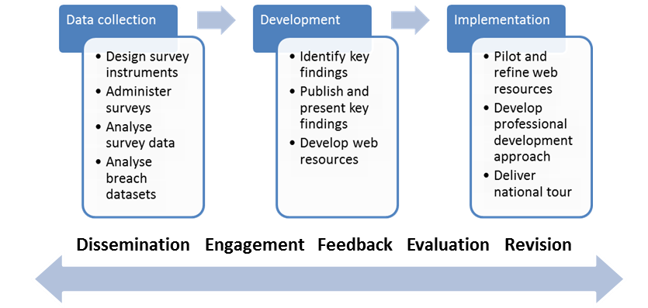
Next steps

