Slide 1
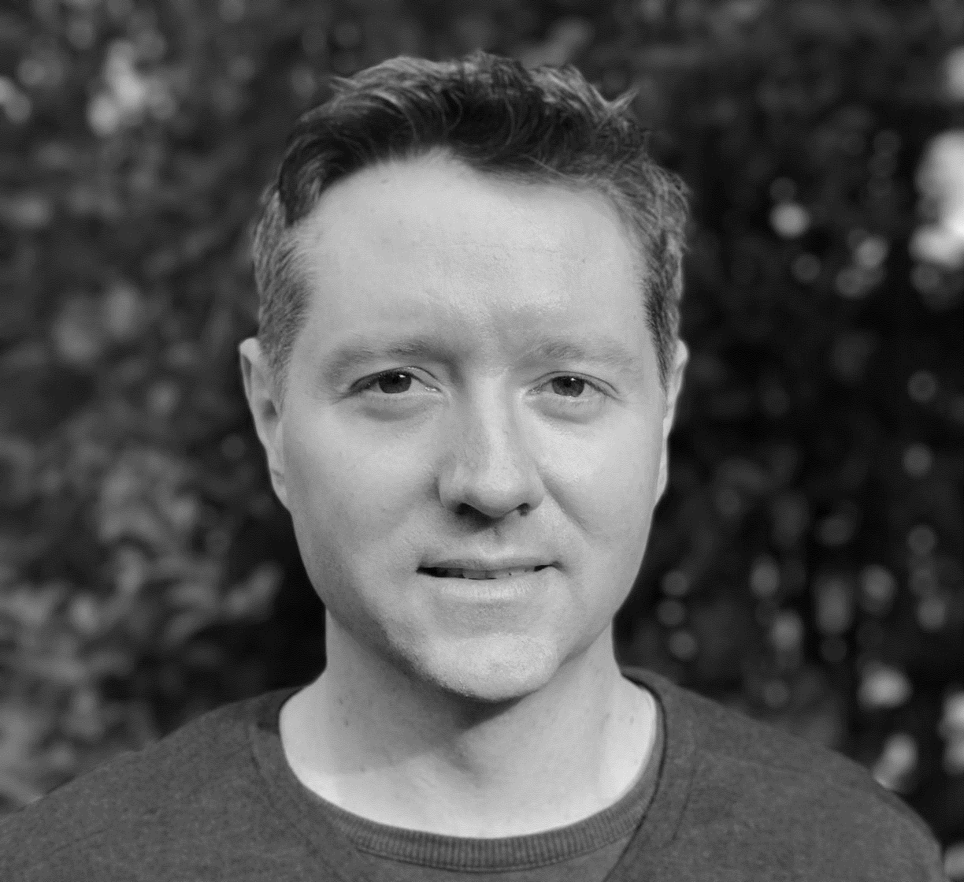
Who am I?
Thomas is a seasoned technology professional with over 18 years working in higher education institutions at QUT, UQ and Griffith University. During this time Thomas worked in a number of roles including the General Manager of AusCERT at UQ, Deputy Chief Digital Officer and CISO at Griffith and was acting Chief Digital Officer at Griffith for 18 months including the first four months of the pandemic and saw Thomas play a leading role in the COVID-19 organisational response and subsequent transformation.
Thomas has significant experience in supporting the academic and student communities in the teaching and learning, research, student experience and university operations space. Thomas also has commercial experience working in London for Cisco Systems and as the General Manager, Cyber Security products and technology at Telstra where he was awarded Information Security Professional of the year 2017, by the Australian Information Security Association.
Thomas is currently the Higher Education Industry Executive for Microsoft ANZ.
THOMAS KING
Higher Education Industry Executive
Microsoft ANZ

