Slide 1
Welcome to JCU Opportunities and Challenges in Higher Education – ACODE Workshop
A/Prof Maree DinanThompson

Slide 2
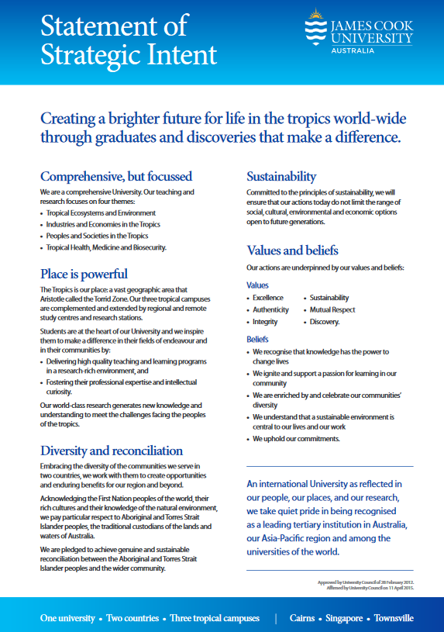
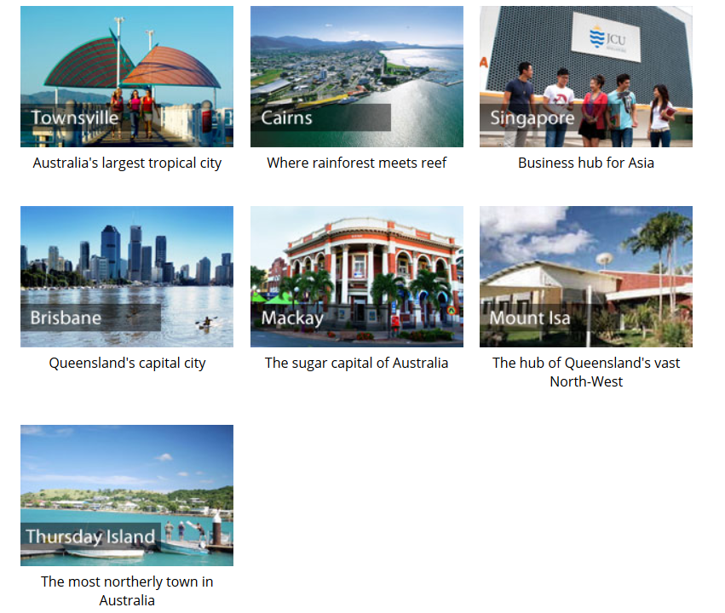
About JCU
One of the world's leading institutions focusing on the tropics, Australia's James Cook University is surrounded by the spectacular ecosystems of the rainforests of the Wet tropics, the dry savannahs, and the iconic Great Barrier Reef. Our unique location enables students from Australia and overseas to study in a diverse physical environment unparalleled by any university in the world.
11500 students in Townsville
4000 students in Cairns

Slide 3
Learning, Teaching & Student Engagement
The Directorate supports strategic activities in learning, teaching and student engagement, including:
Staff induction and ongoing professional learning (PDF, 121 KB)
Learning technologies
Curriculum and assessment design
Pathways and student transitions
Academic language, learning and numeracy, and
Services to ensure equity and student well being.
The Directorate delivers a number of University-wide projects and programs that support academic staff, including delivery of the Graduate Certificate of Education (Academic Practice) and support for teaching and learning grant and award applicants.
The Directorate sits within the Division of Academic and Student Life. While Directorate staff are located on the Townsville and Cairns campuses, they also provide support for staff and students in study centres at Thursday Island, Mount Isa and Mackay, and for external students.

Slide 4
Overview
Whole-of-institution approach to learning and teaching and student experience!

Slide 5
Blended Learning & Innovation
Priority Project – blended learning
Mediasite
Learning analytics
Digital Transformations strategy
BB Ultra
MOP – Minimum Online Presence
Improved baseline of blended learning – student interactivity

