Slide 1
Workshop Outline
Time (Activity) | Title
15 mins (Lecture) | XR Technologies in Practice
20 mins (Audience Breakout) | What are the greatest needs and opportunities in higher education that XR technologies can help fulfill?
10 mins (Review) | Emerging Themes from the Audience Padlet

Slide 2
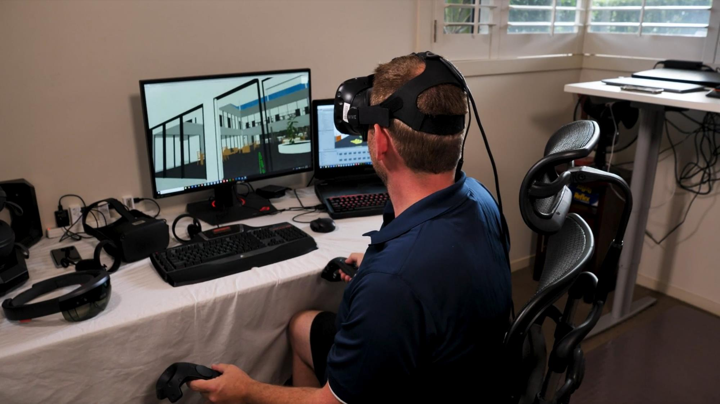
XR technologies in practice
Associate Professor James Birt (PhD)
Bond University, Australia

Slide 3
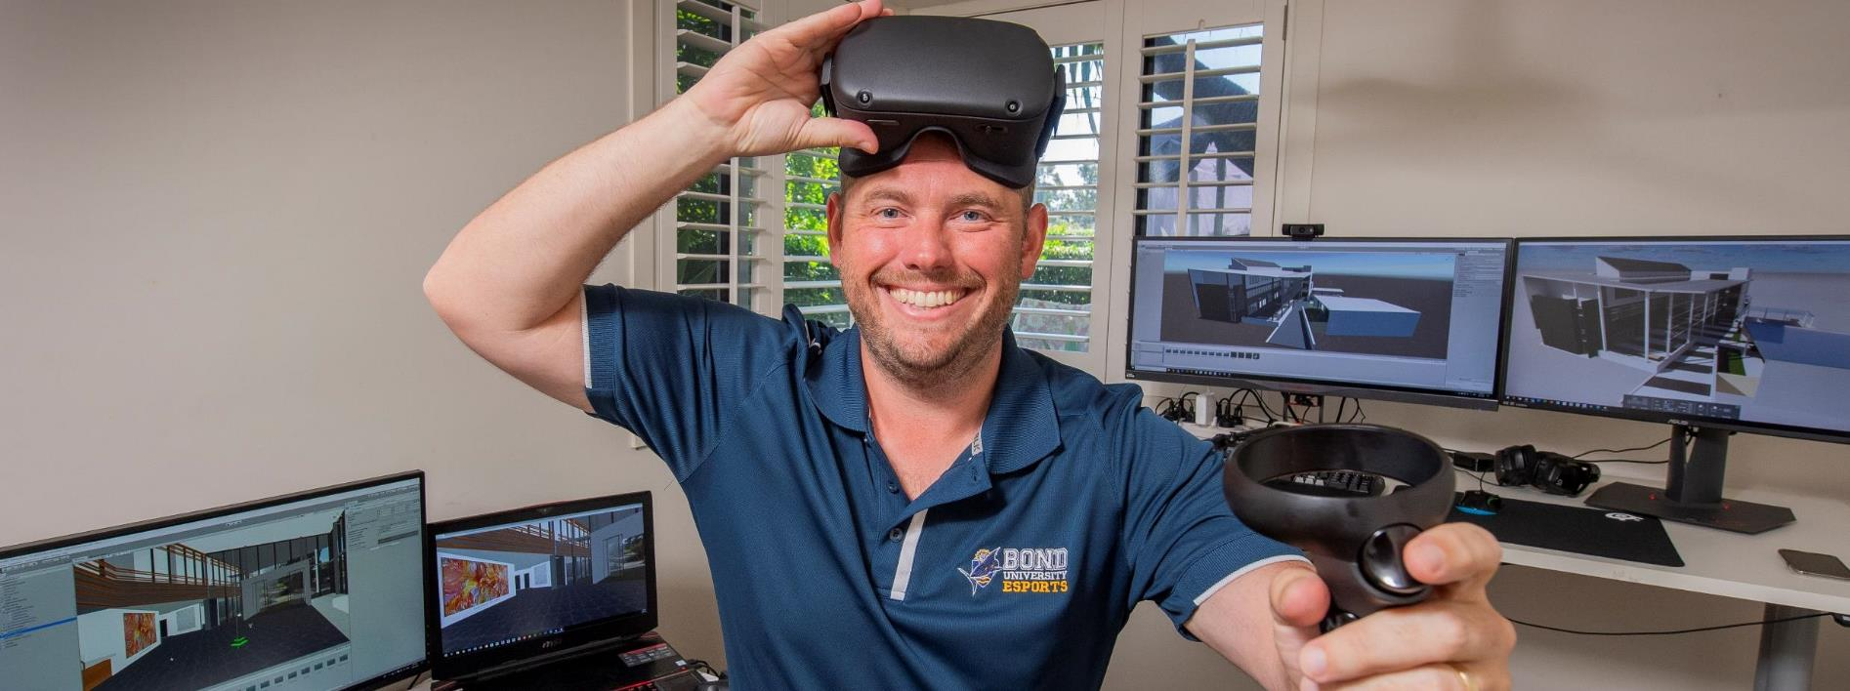
Defines my industry and academic career as an Associate Professor in Emerging Technology and Computer Games in the Faculty of Society and Design at Bond University
20 Years of Innovative Practice

Slide 4
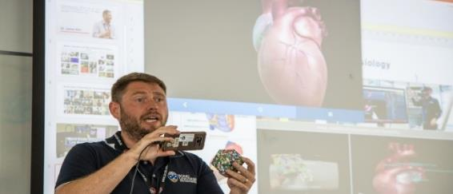
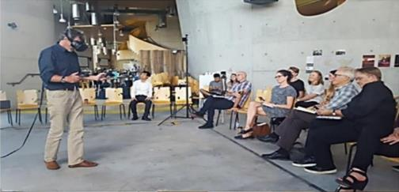
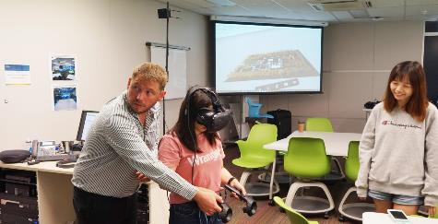
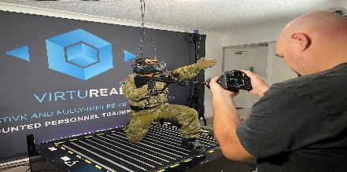
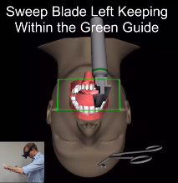
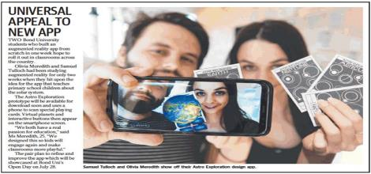
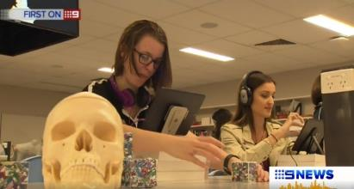
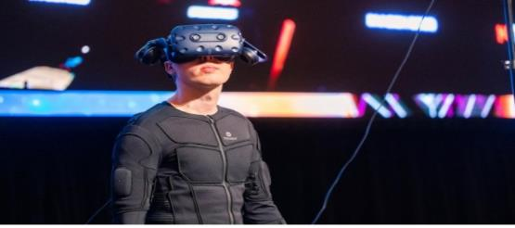
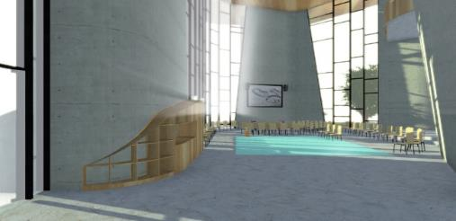
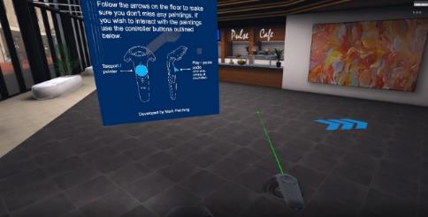
The Mixed Reality Research Lab Founded 2014; 71 papers; 6 national awards; 100+ Talks; Supports Education, Industry and Societal translation of XR

Slide 5
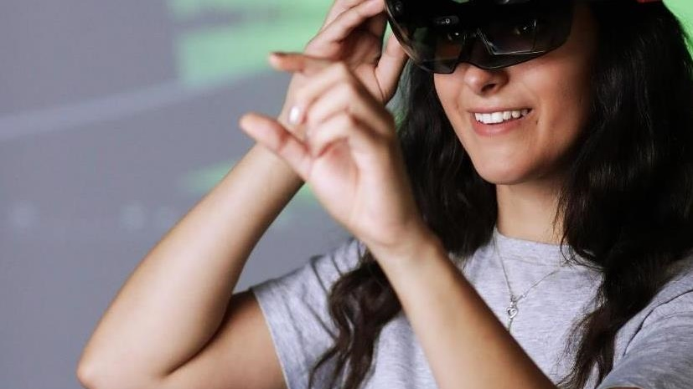
Why Technology?

Slide 6
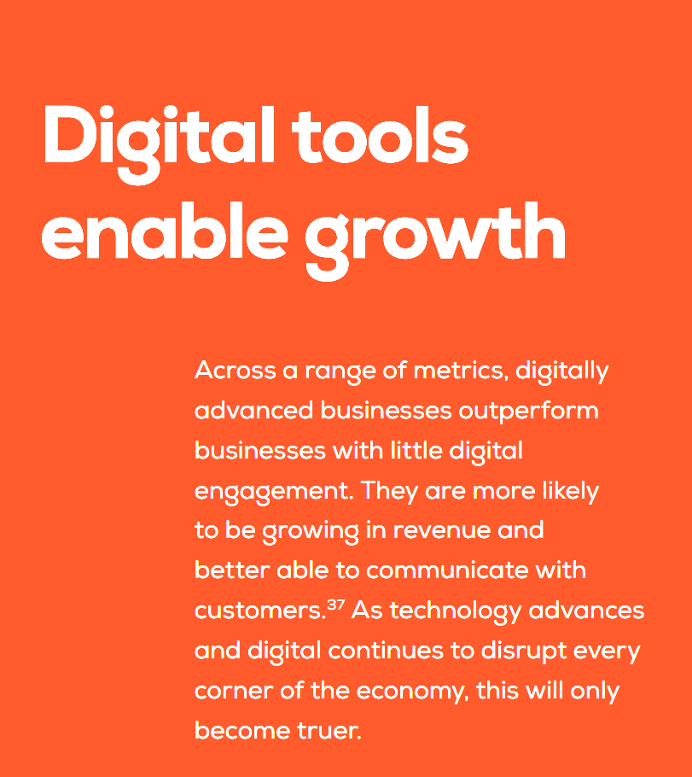
³⁷ Deloitte Access Economics (2017), Connected Small Business 2017: Report for Google.

Slide 7
Enhance your existing services

Slide 8
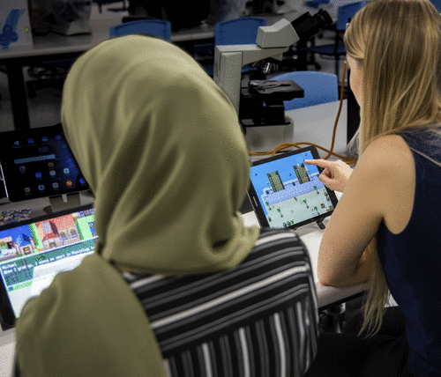
Bring playfulness to learning

Slide 9
Support critical training

Slide 10
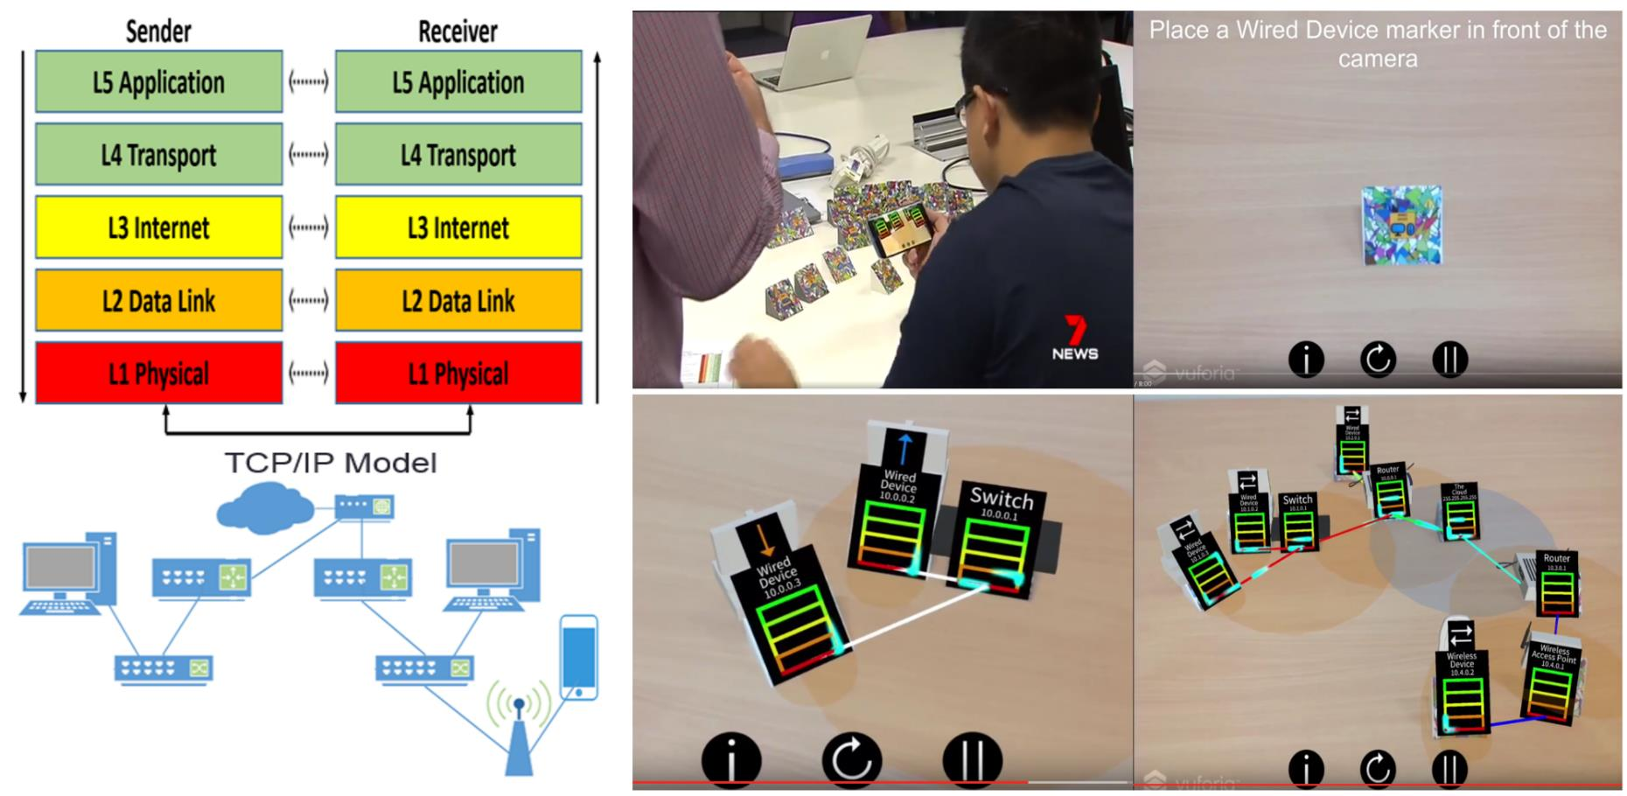
Teach abstract concepts

Slide 11
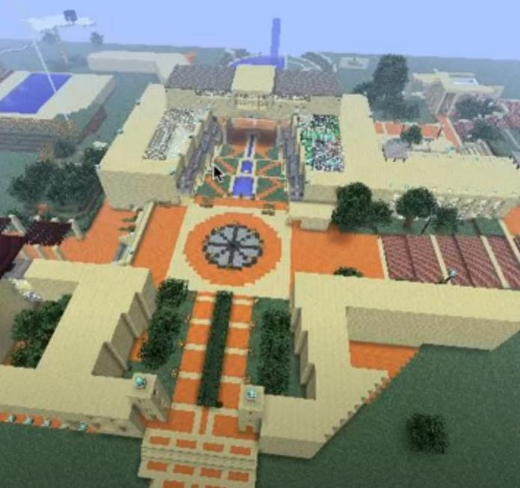
Allow remote education

Slide 12
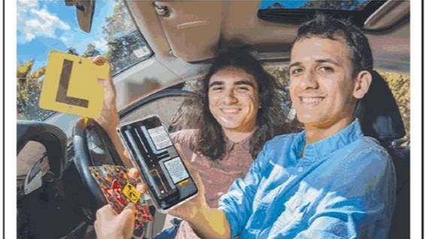
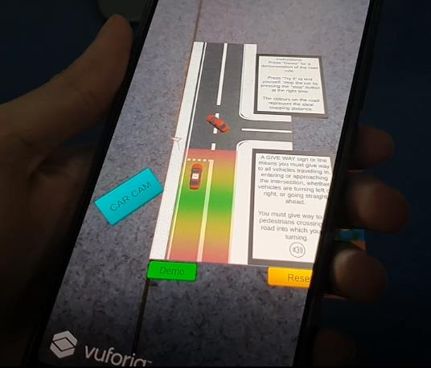
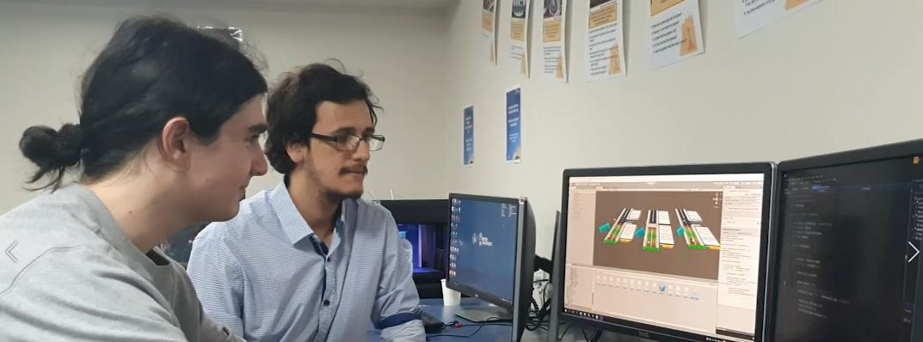
Connection with learner audiences

Slide 13
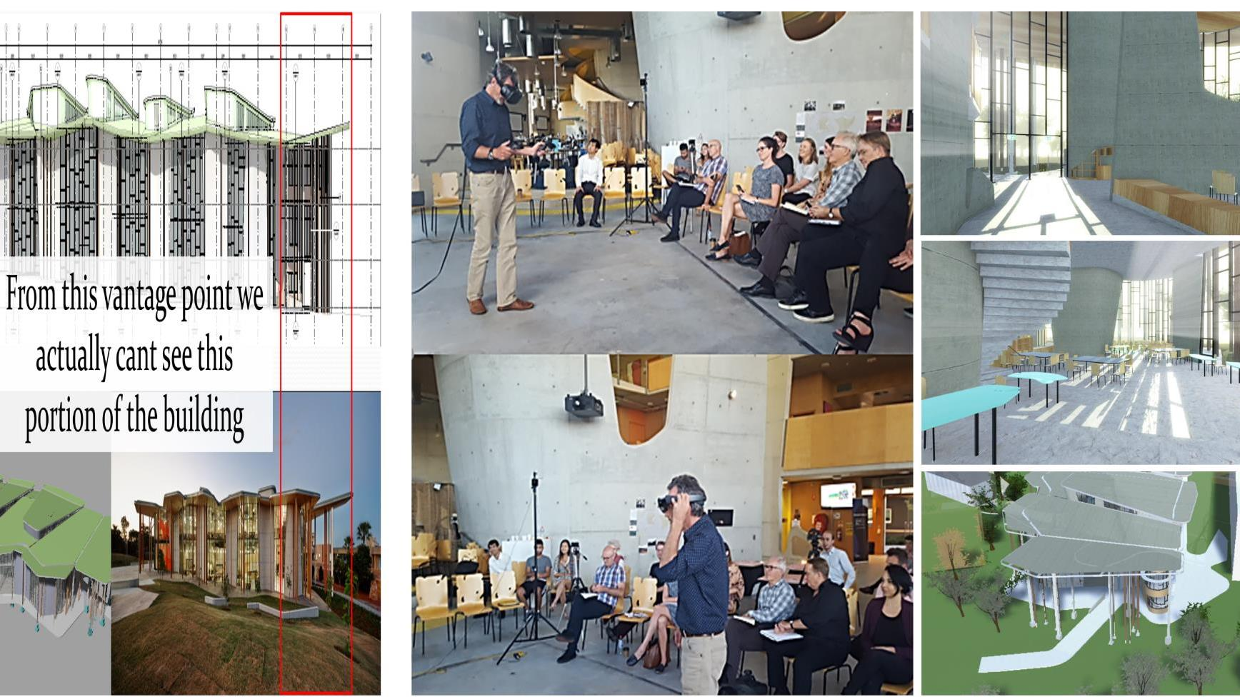
Support human affordances

Slide 14
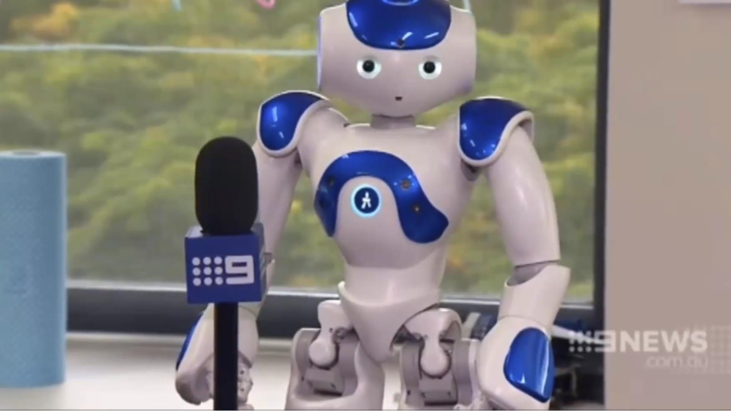
Can be used as a gimmick …

Slide 15
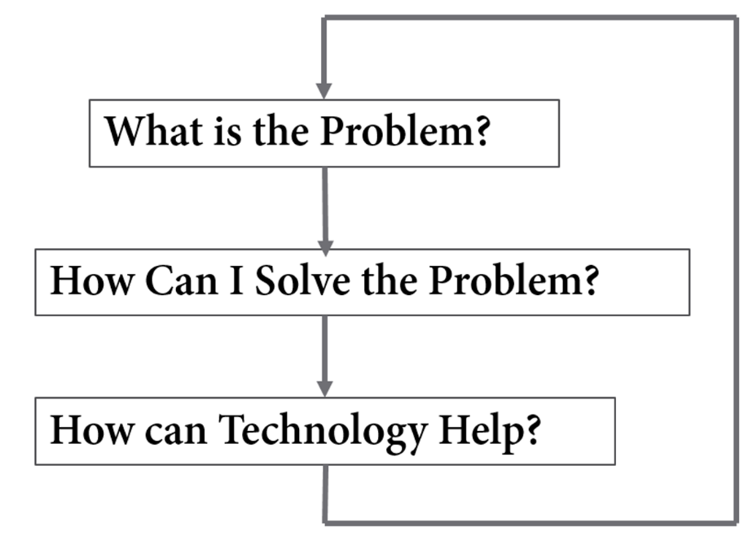
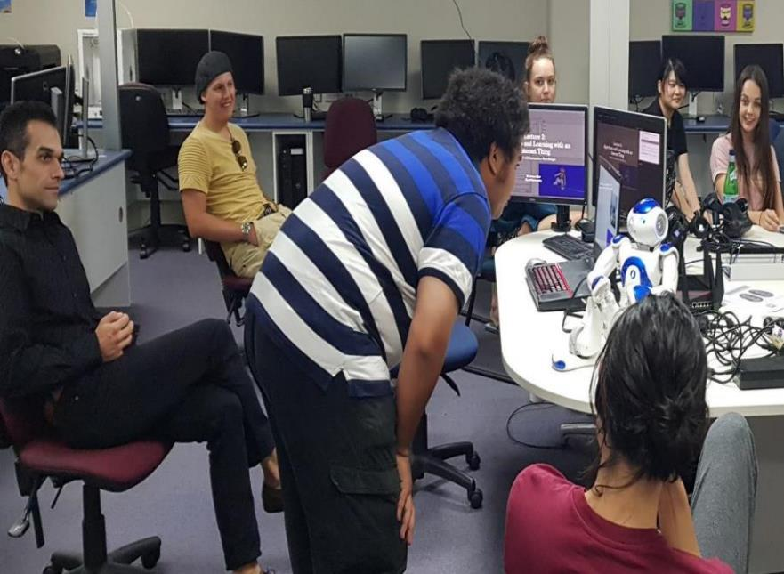
Think before you act and revise your methods …

Slide 16
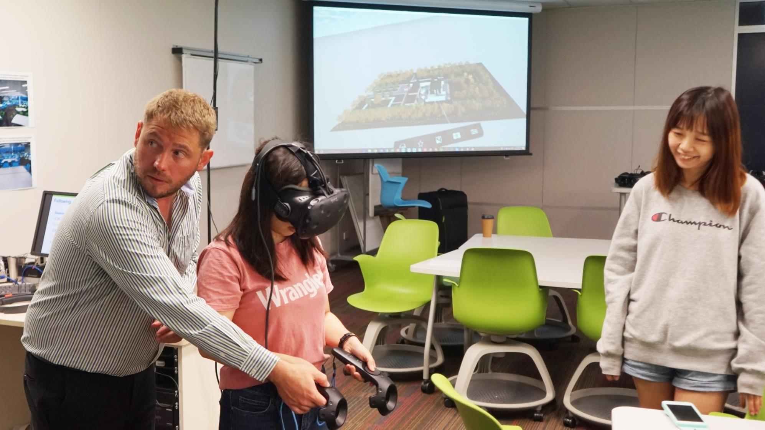
How to Begin?

Slide 17
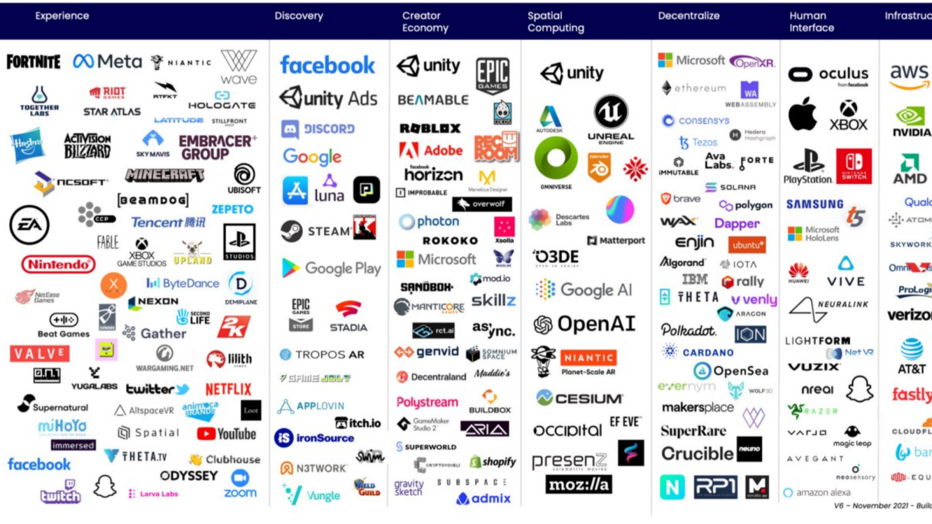
Understand the Emerging Technology Landscape

Slide 18
Digital Growth is not equal for all …

Slide 19
Large Enterprise
Medium Enterprise
Gartner Emerging Technology Roadmap 2020-2022

Slide 20
Know the XR technologies

Slide 21
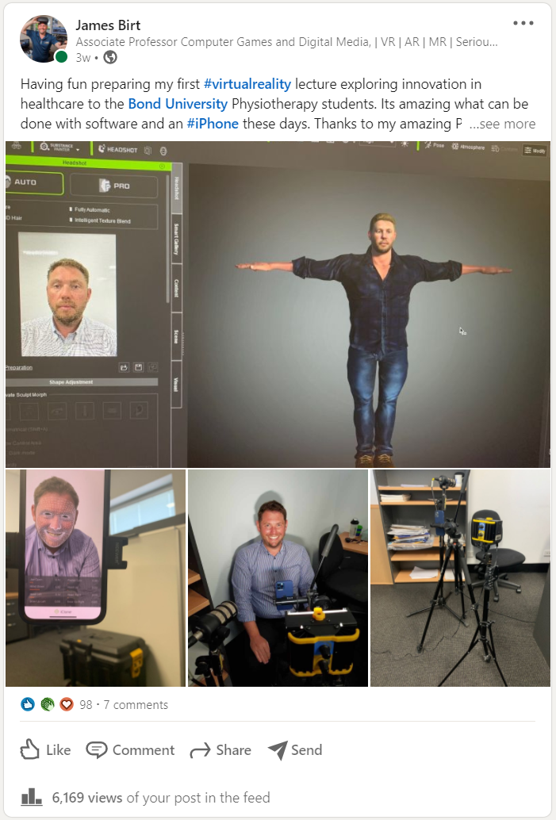
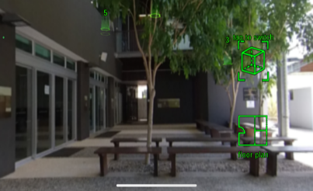
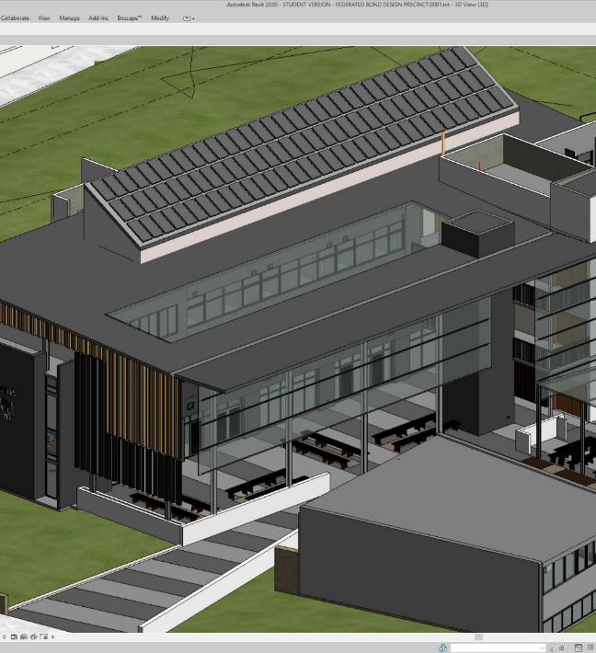
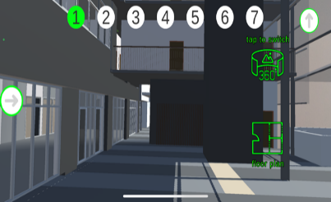
Digital Twins

Slide 22
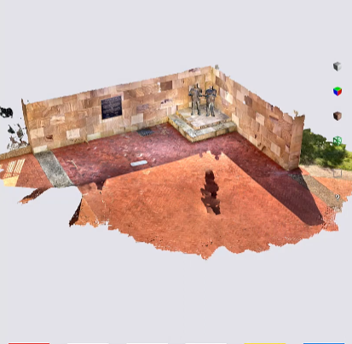
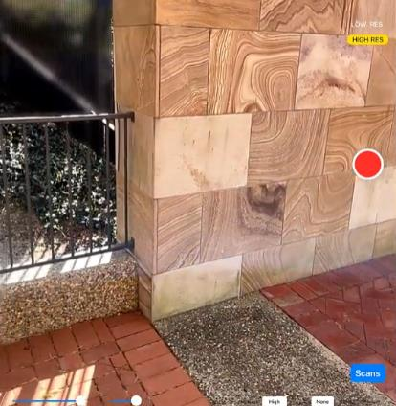
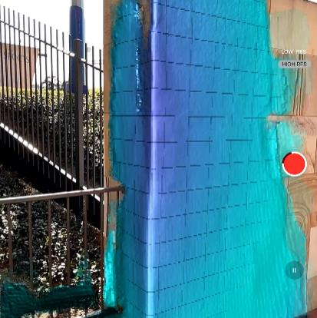
Light Detection & Ranging LiDAR
Allows for 3D Scanning at unlimited scales. LiDAR is ideal for digital duplication (digital twinning) of objects and environments when digital models and CAD formats are otherwise unavailable, very complex and/or cost-prohibitive to acquire or reproduce.

Slide 23
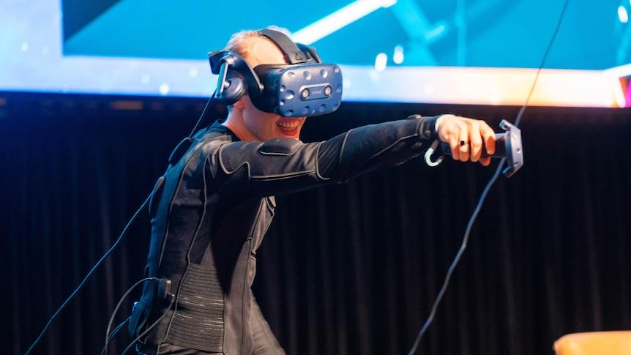
Haptics

Slide 24
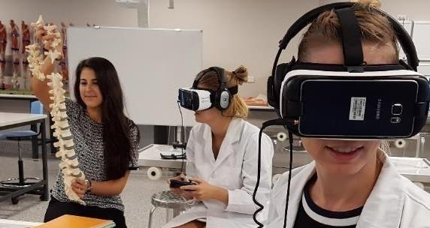
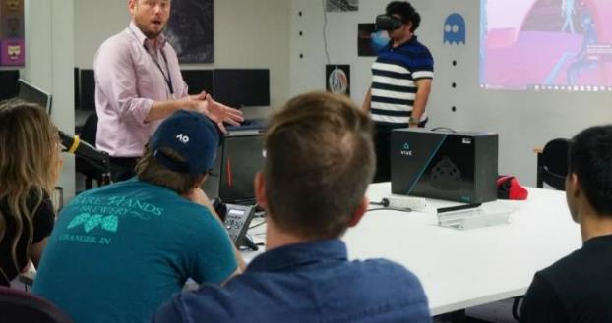
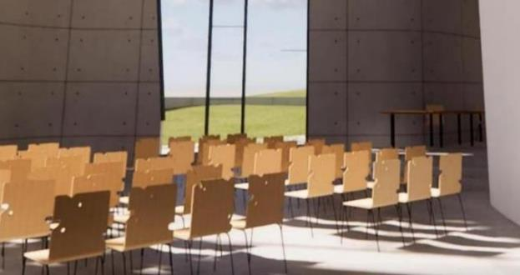
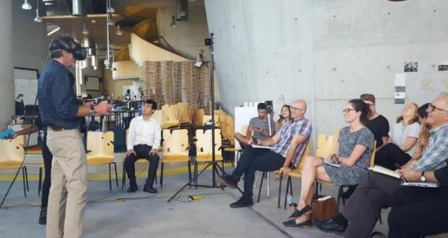
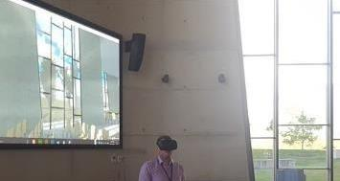
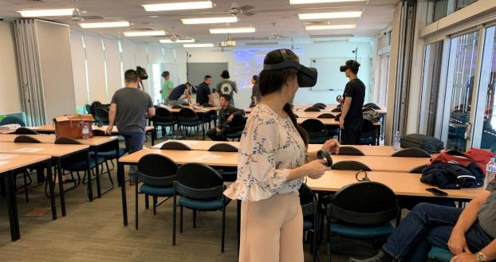
Virtual Reality

Slide 25
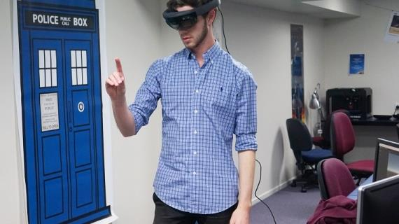
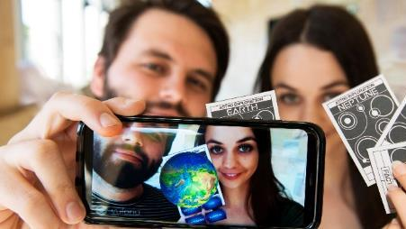
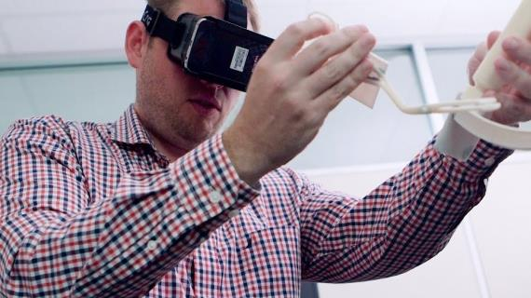
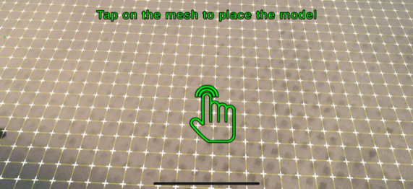
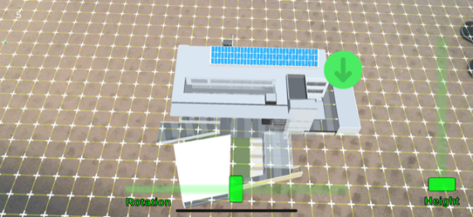
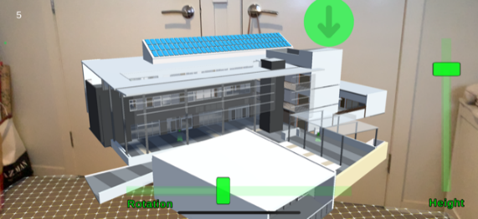
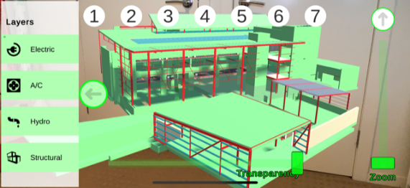
Augmented Reality

Slide 26
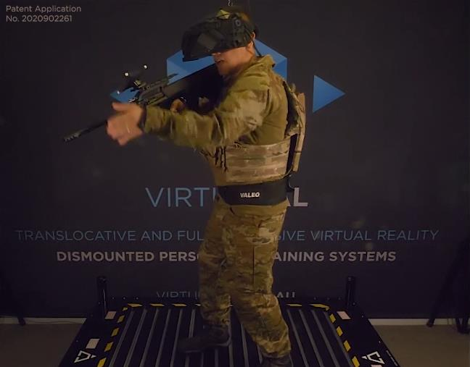
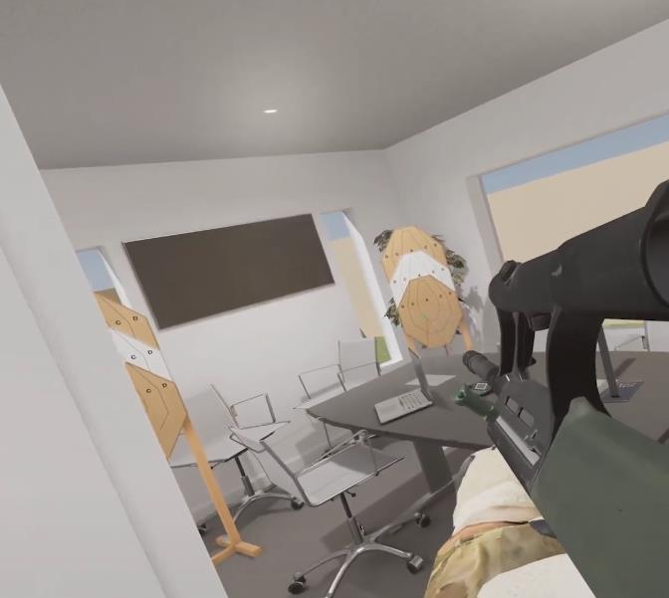
Mixed Reality

Slide 27
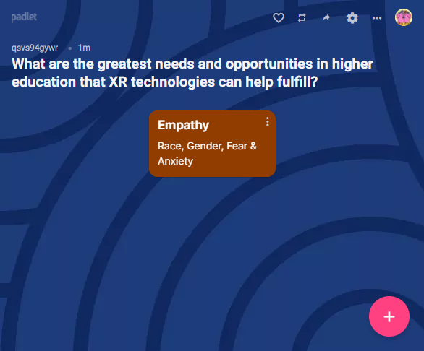
Audience Participation: What are the greatest needs and opportunities in higher education that XR technologies can help fulfill? - https://bit.ly/3wGYOst

