Slide 1
Open Badges in Higher Education: looking to the future
Dr. Doug Belshaw, Dynamic Skillset Ltd.
https://goo.gl/etvz30

Slide 2
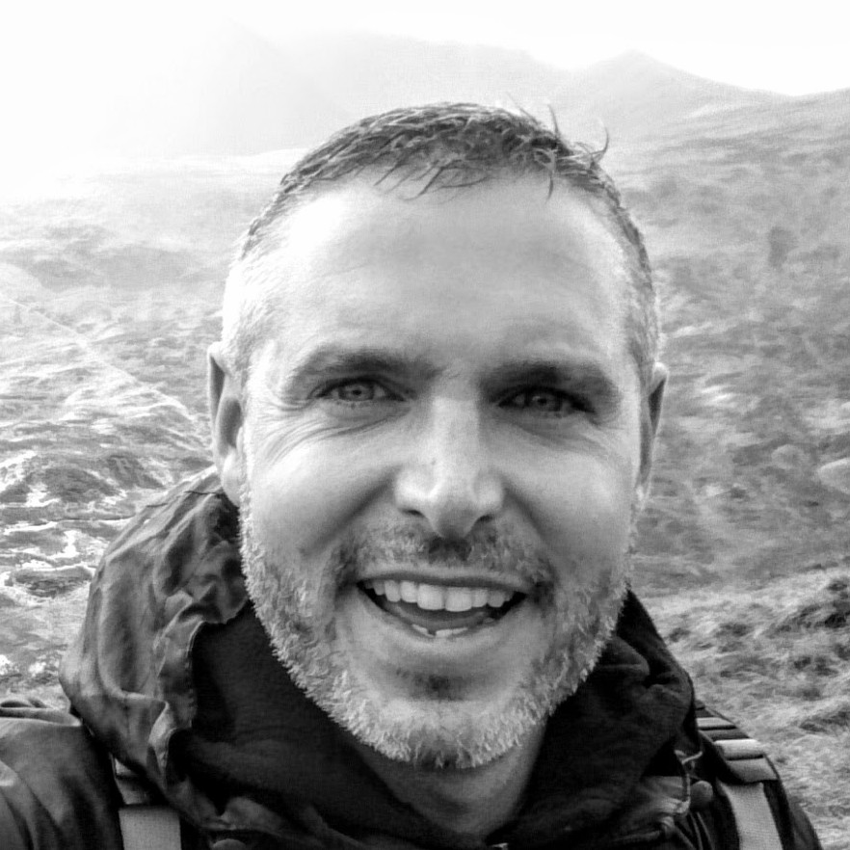
Who are you?
Dr. Doug Belshaw
@dajbelshaw
Teacher → Senior Leader → Jisc → Mozilla → Consultant
& co-op co-founder

Slide 3
#ACODE73
Don’t tweet at him, tweet @dajbelshaw!

Slide 4
New to Open Badges?
BADGE BOOTCAMP is a free, self-paced email course to get you up to speed quickly!
http://weareopen.coop/badgebootcamp

Slide 5
Overview
Ensuring we’re on the same page
Examples of current practice
Enhancing and extending through constellations of badges
Encouragement to get started
Ending (+ Q&A)

Slide 6
Who's behind the Open Badges specification?

Slide 8
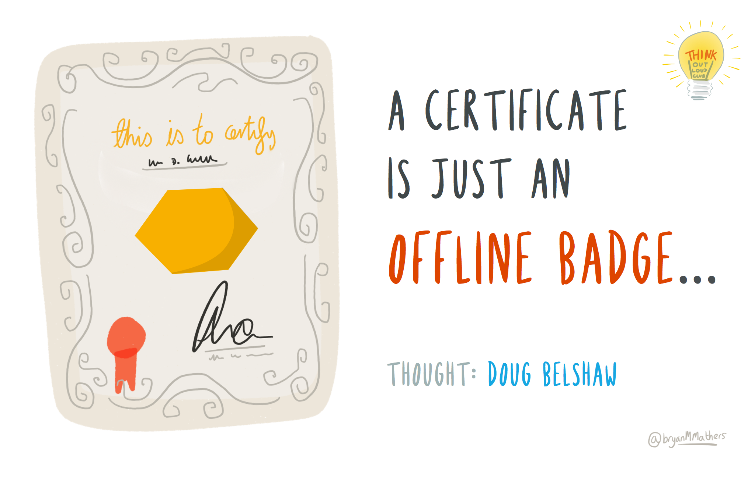

Slide 9
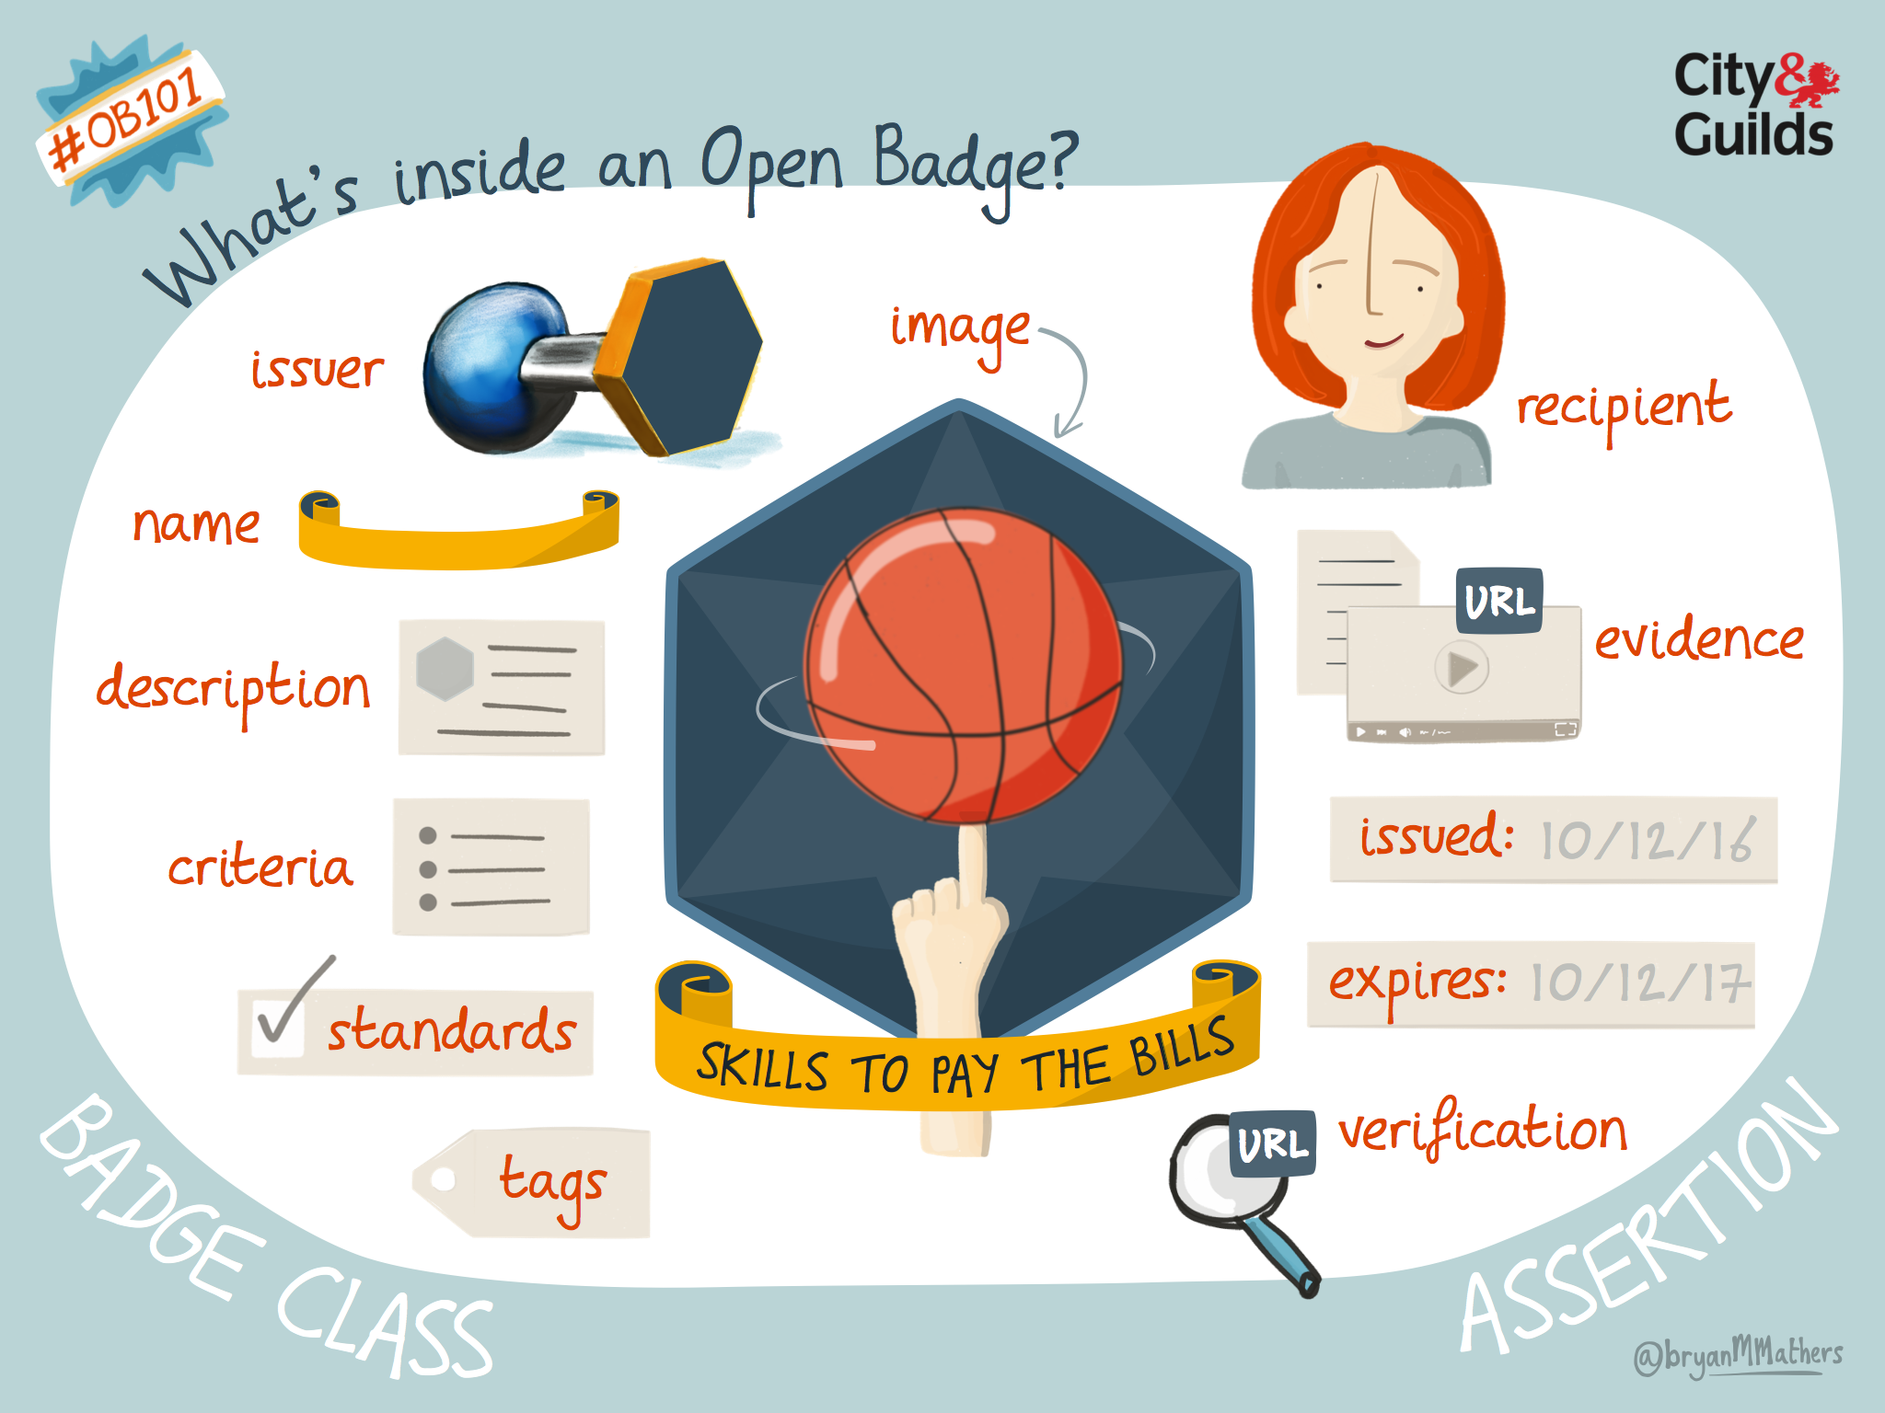

Slide 10
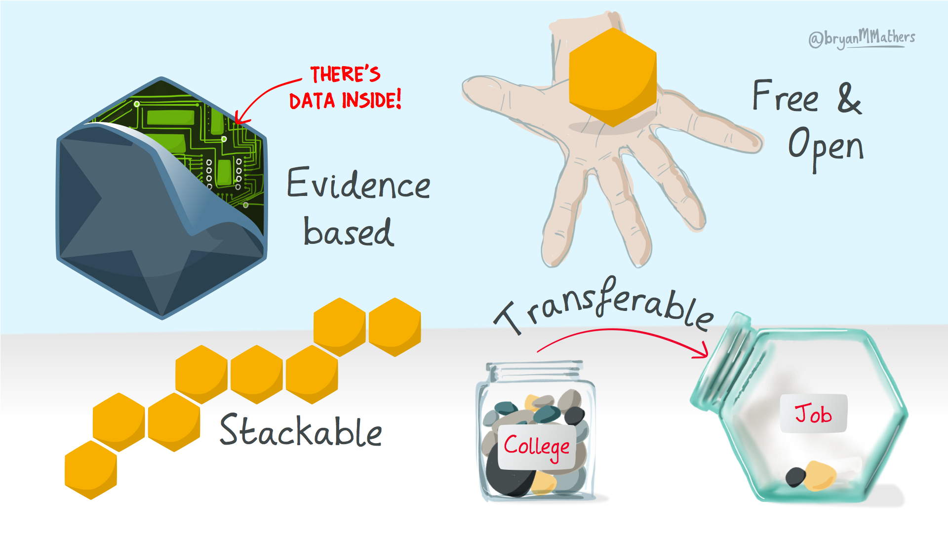

Slide 11
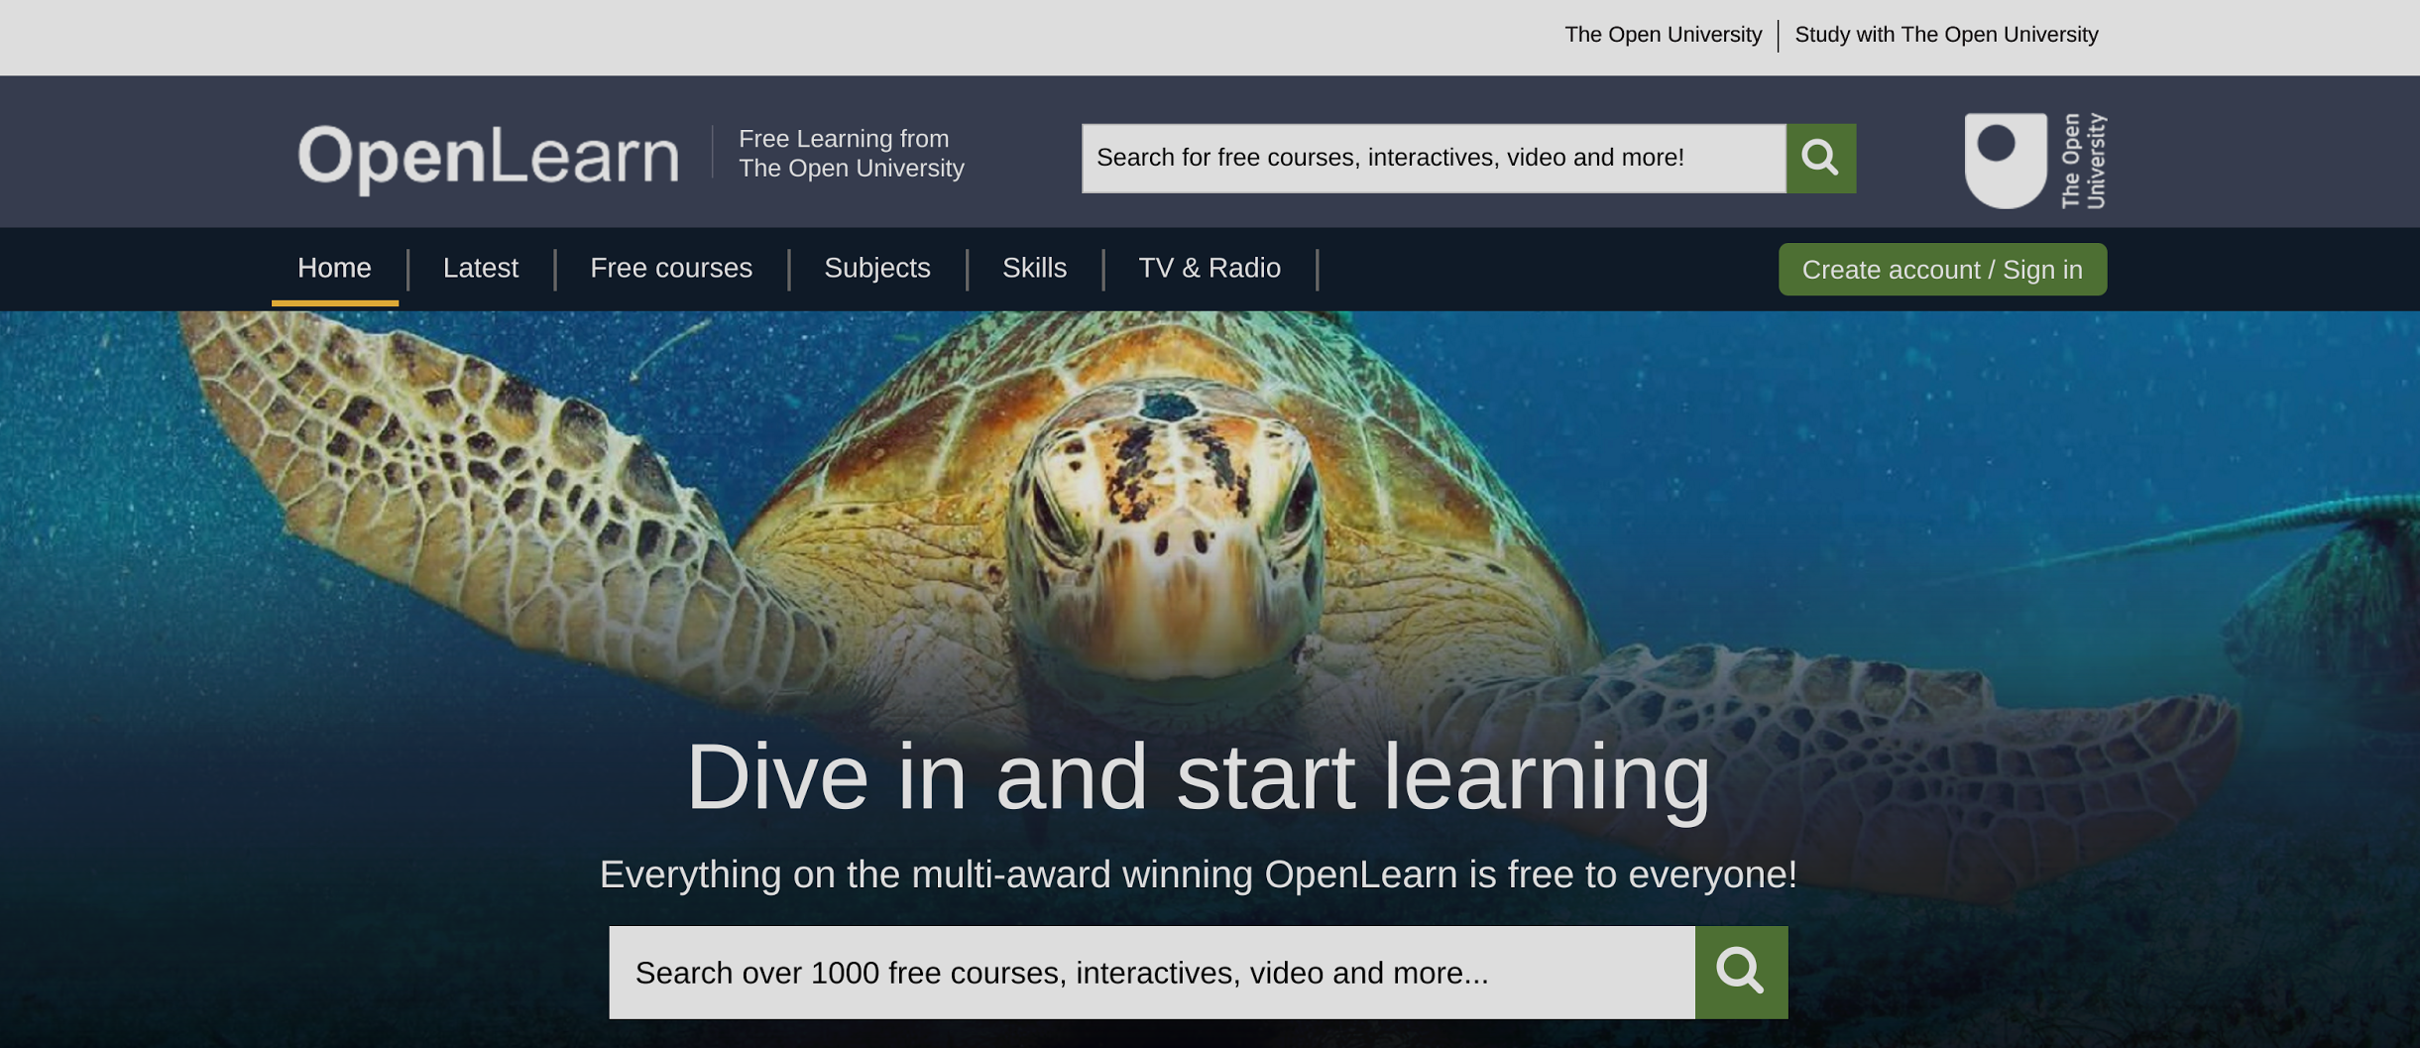
open.edu/openlearn

Slide 12
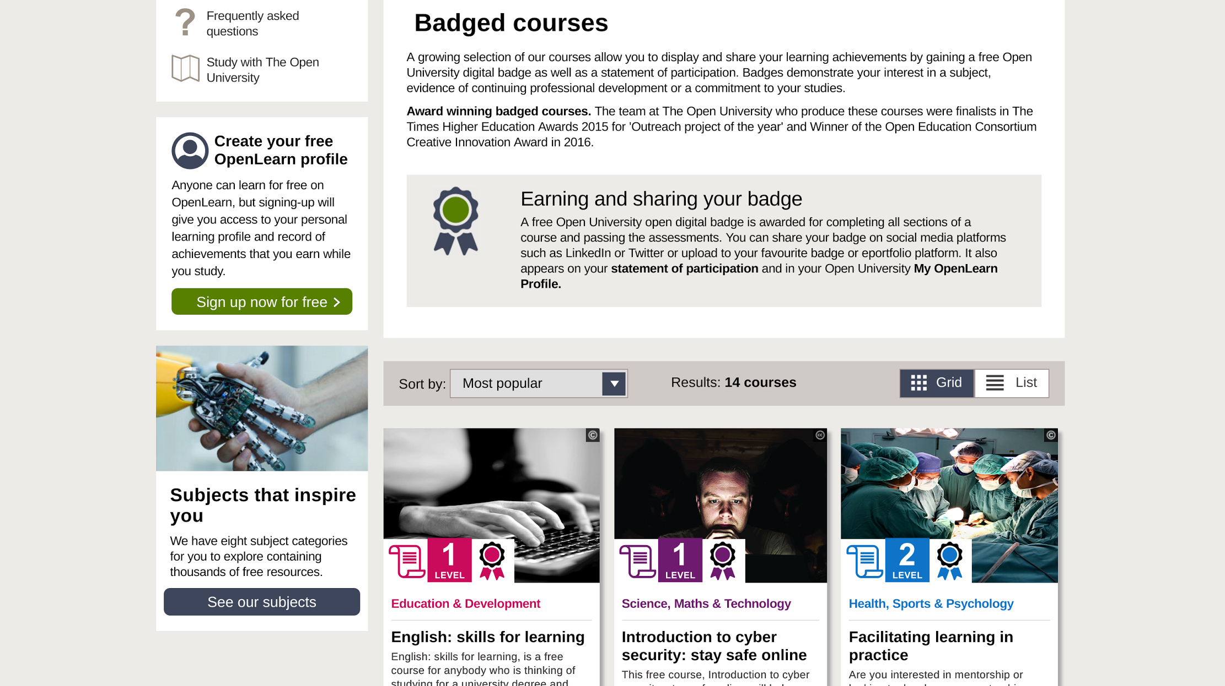

Slide 13
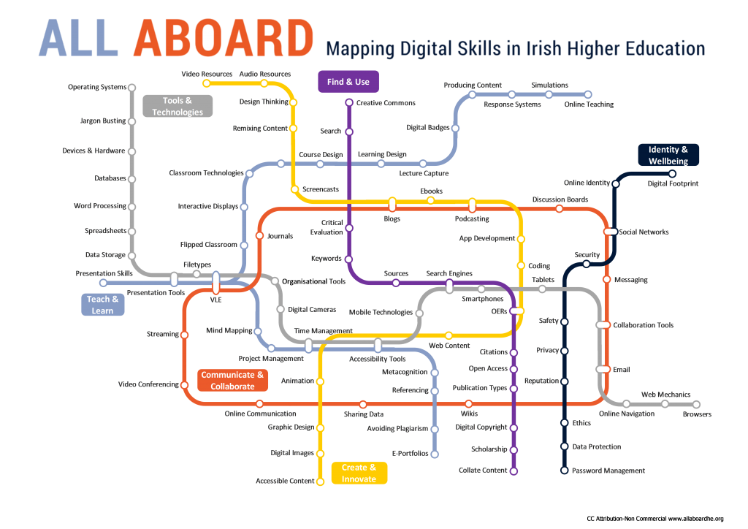
CC BY-NC www.allaboardhe.org

Slide 14
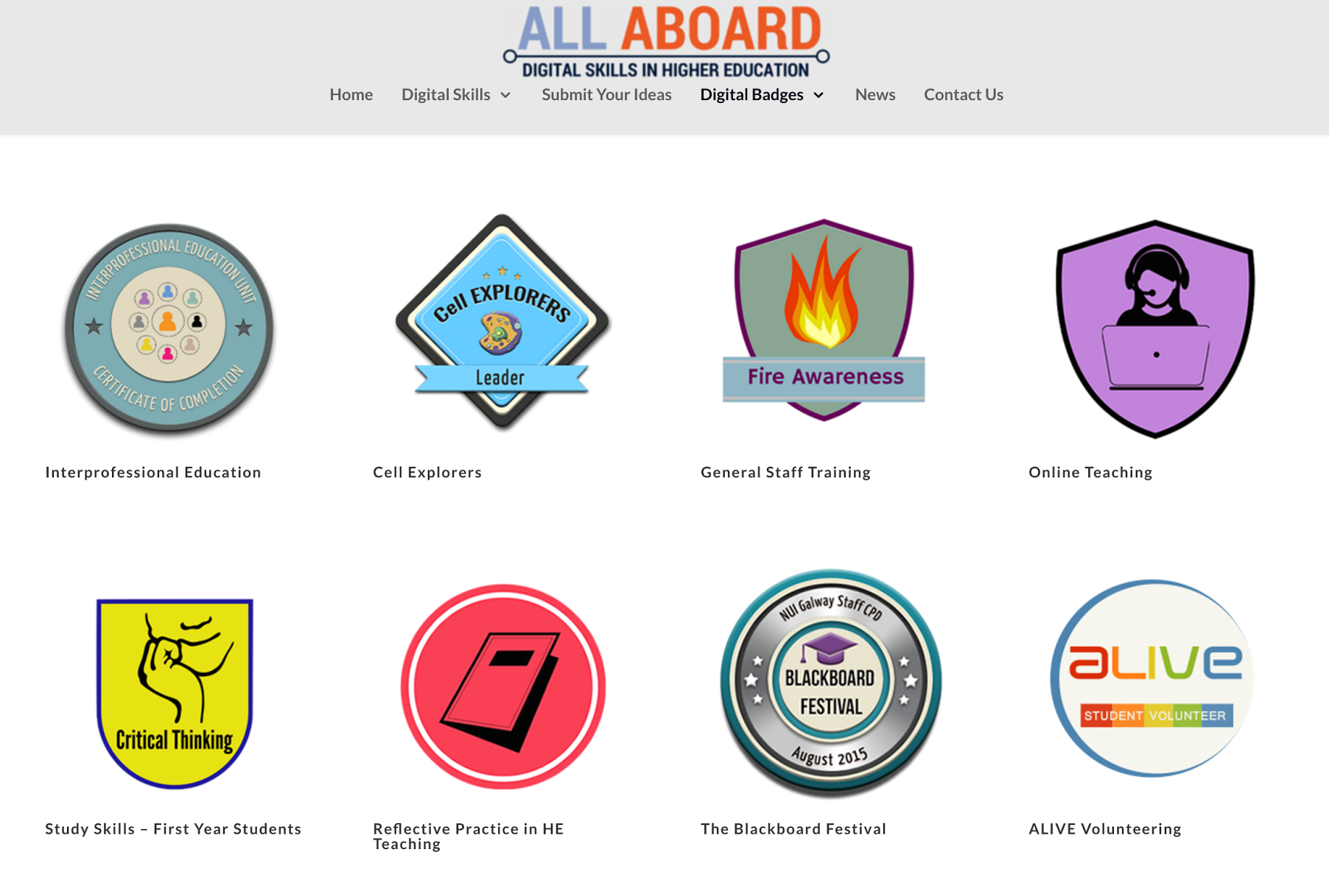

Slide 15
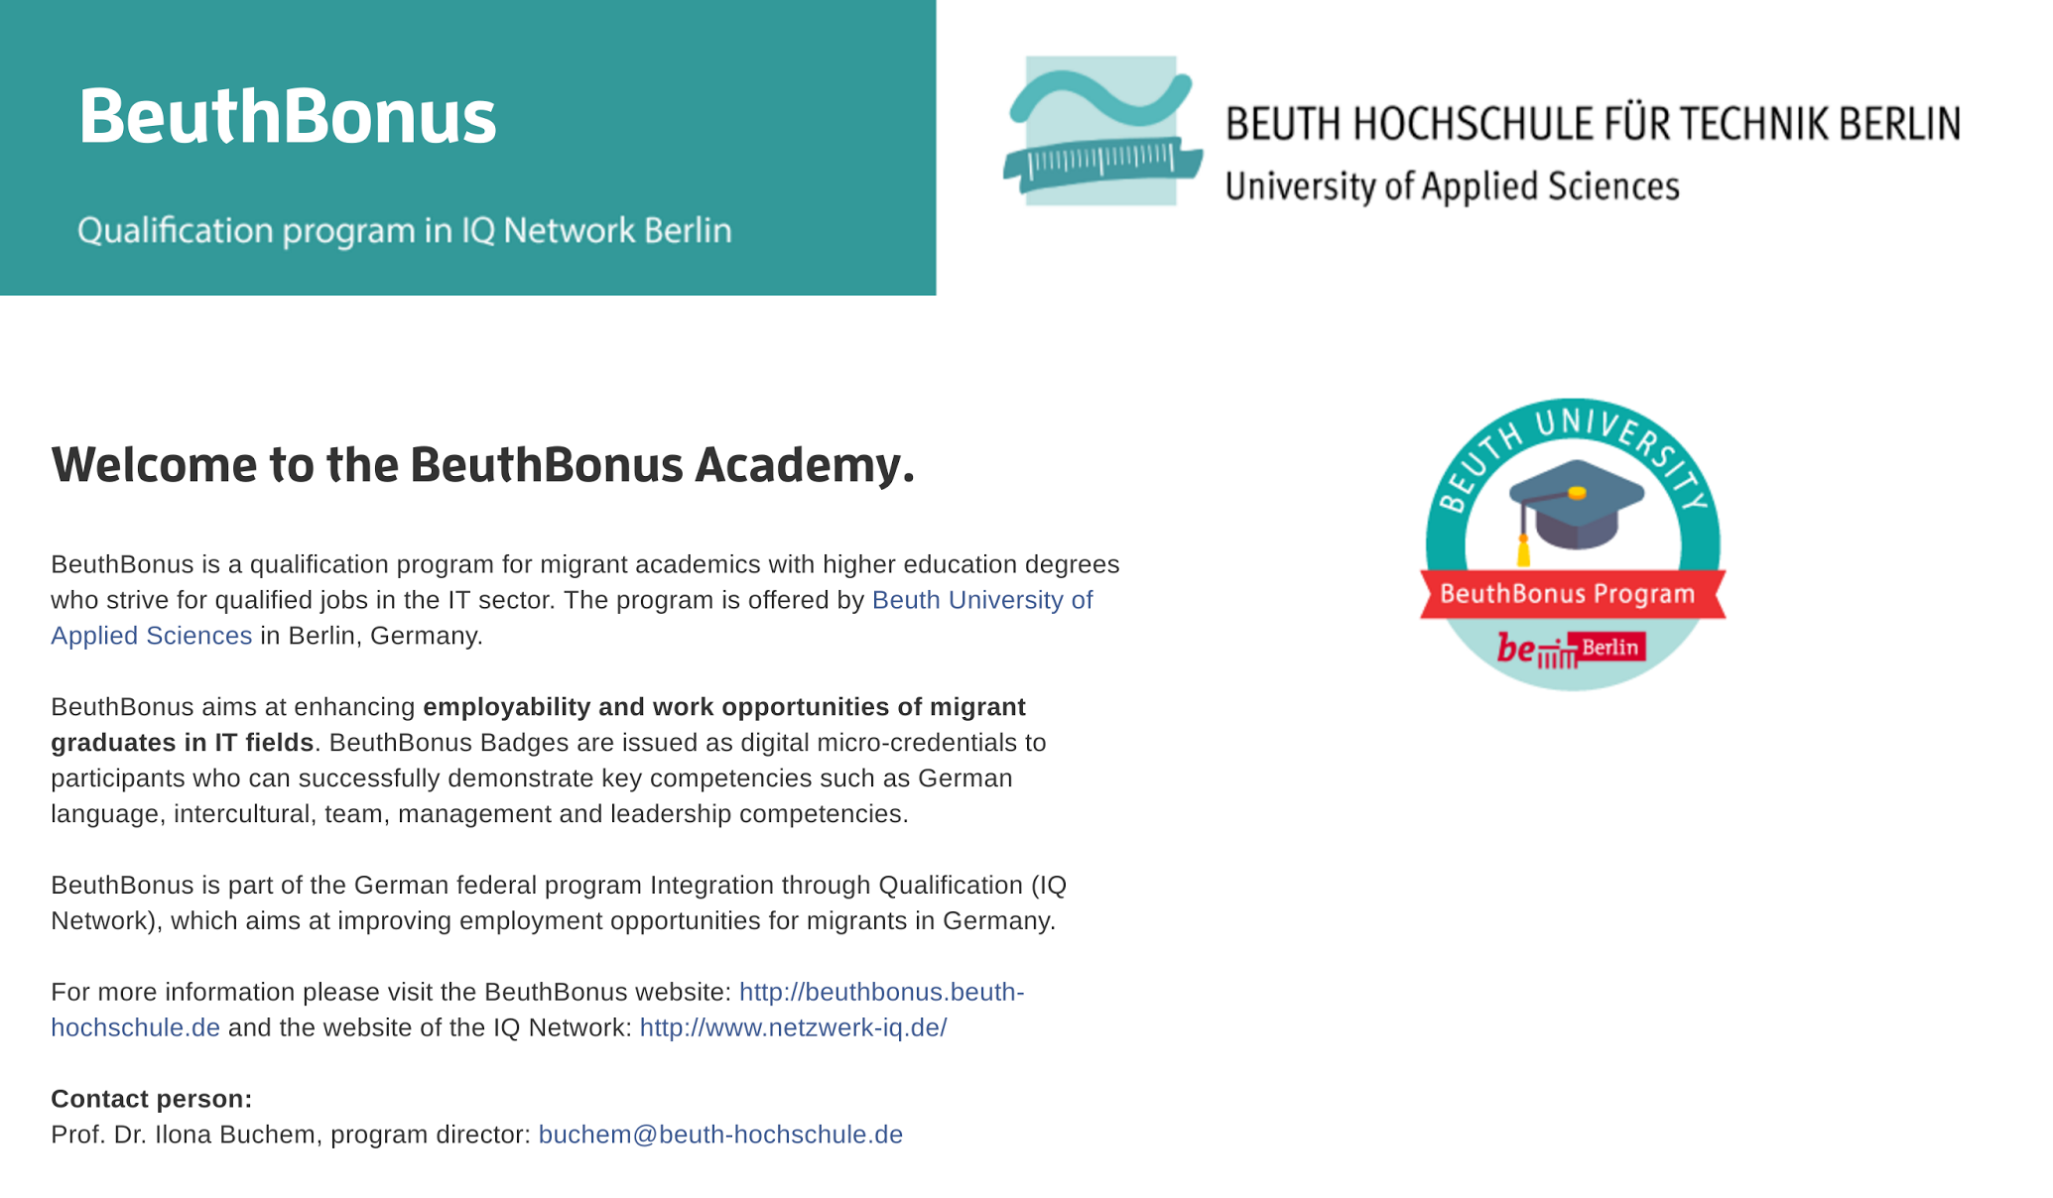
CC BY-SA beuthbadges.wordpress.com

Slide 16
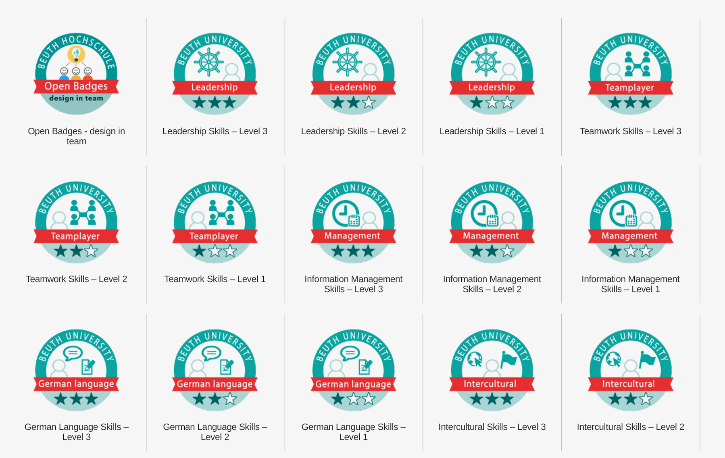

Slide 17
COMMUNICATION
+
+
+
=
Written Comms
Verbal Comms
Numeracy
Digital Literacy
Communication
COLLABORATION
+
+
+
=
Positive Attitude
Teamwork
Meet Deadlines
Emotional IQ
Collaboration
CRITICAL THINKING
+
+
+
=
SUSSEX DOWNS COLLEGE EMPLOYABILITY
PASSPORT
Initiative
Creative
Decision Making
Problem Solving
Critical Thinking
WORK READINESS
+
+
+
=
Reliable
Adaptable
Professional
Ambition
Work Readiness
Sussex Downs College Employability Passport

Slide 18
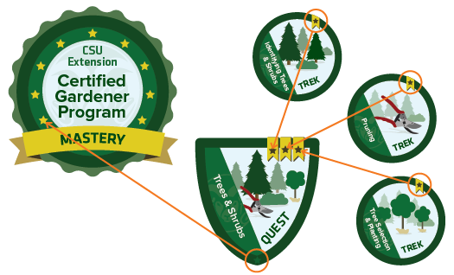
Colorado State University
http://www.online.colostate.edu/badges/certified-gardener

Slide 19
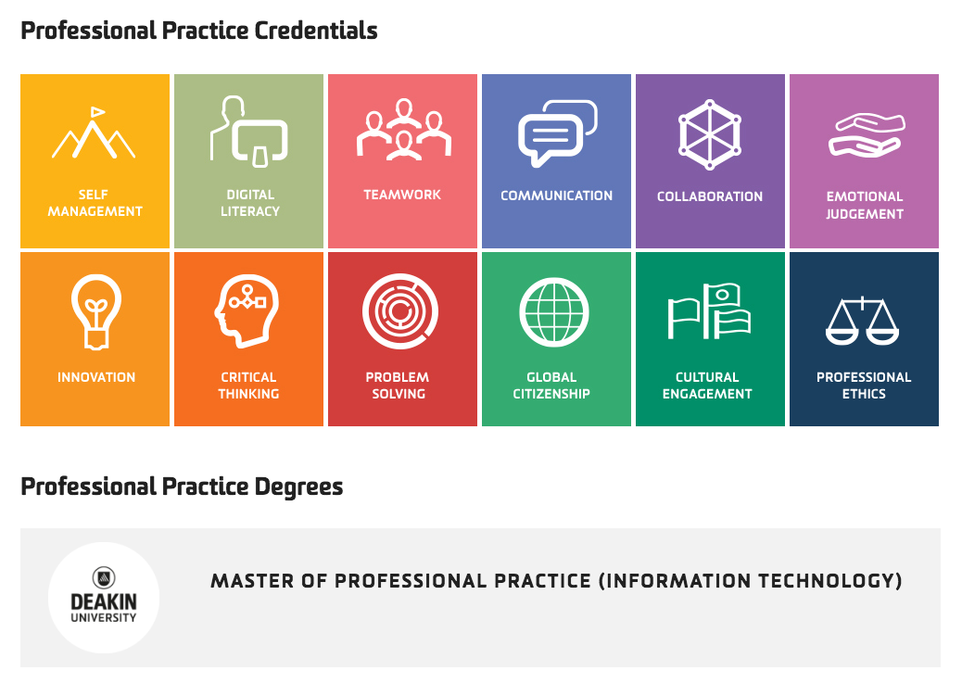

Slide 20
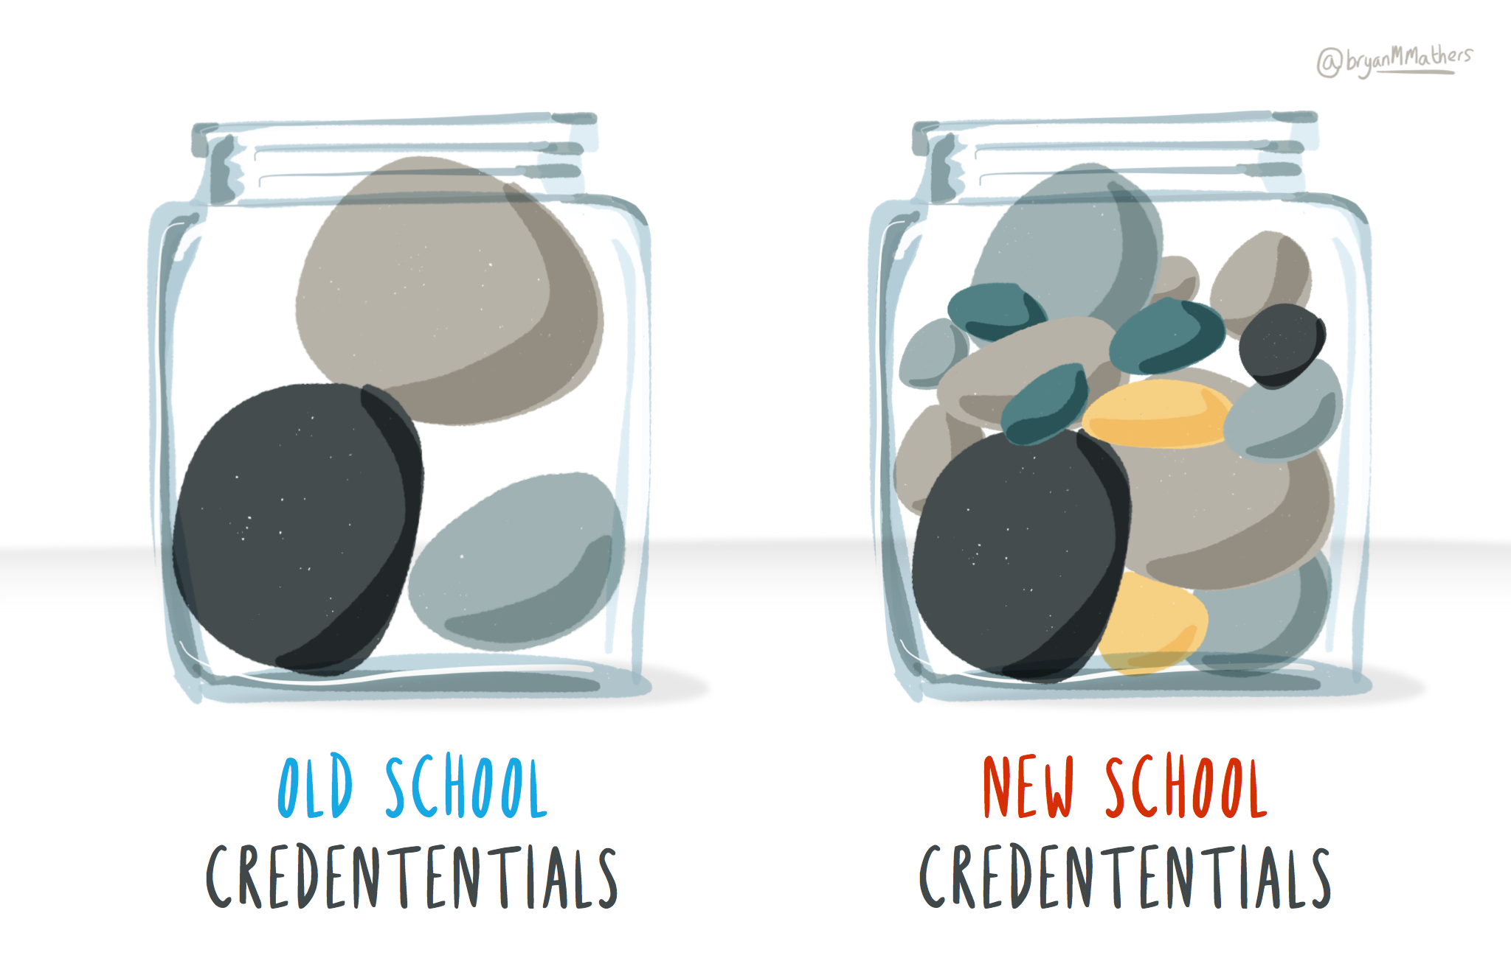

Slide 24
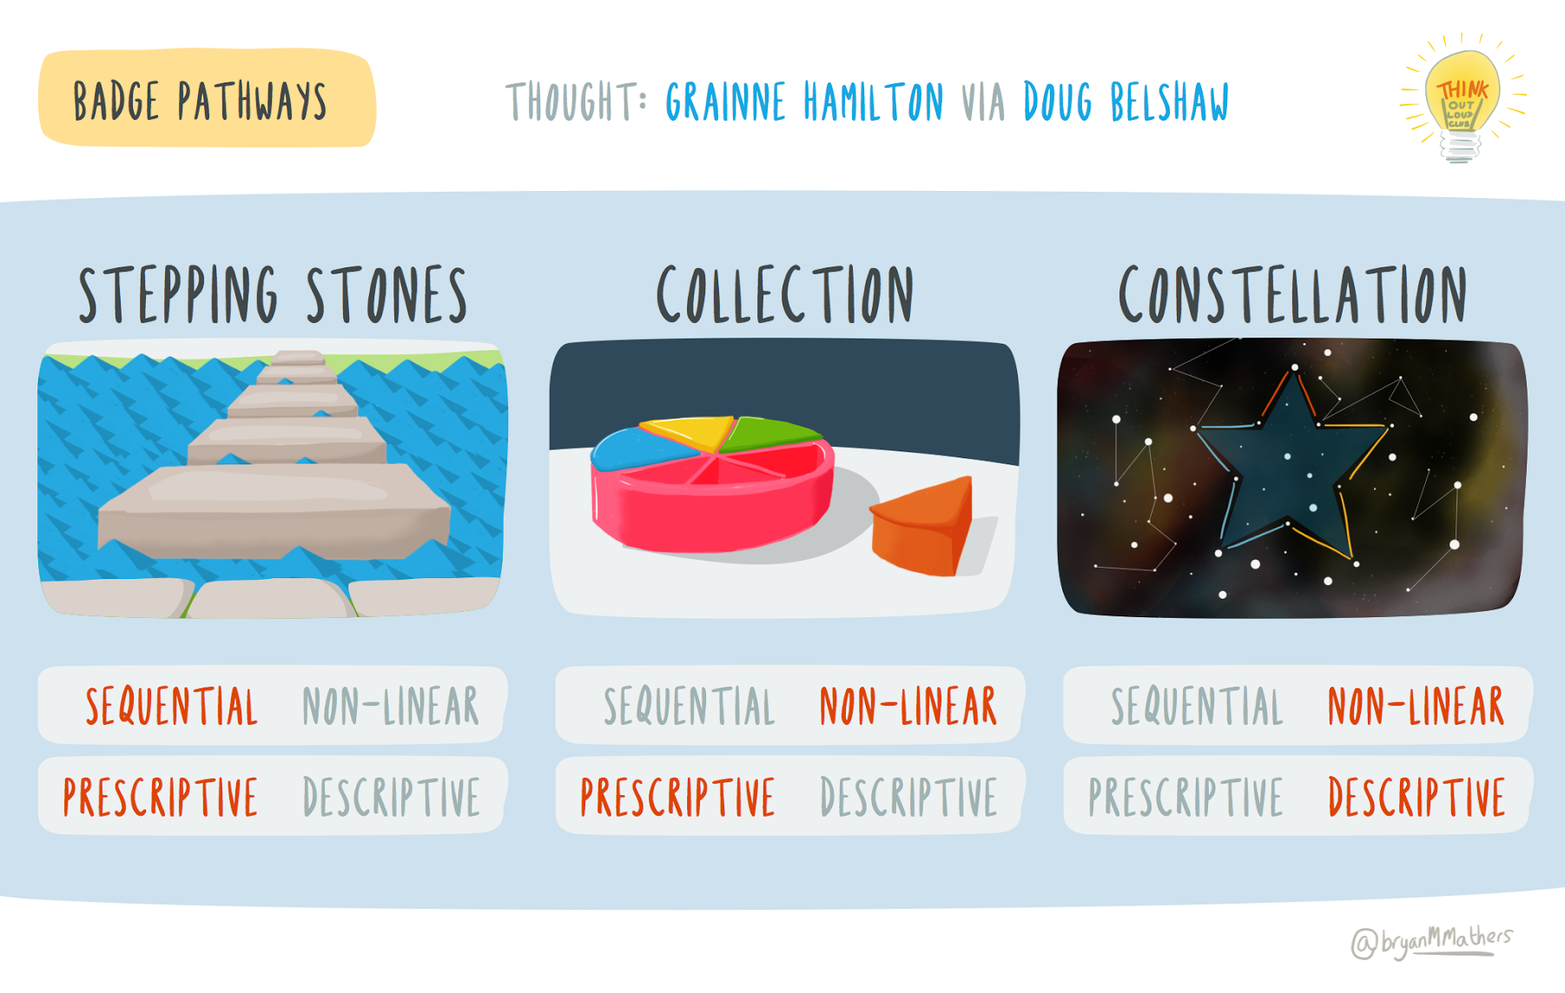

Slide 25
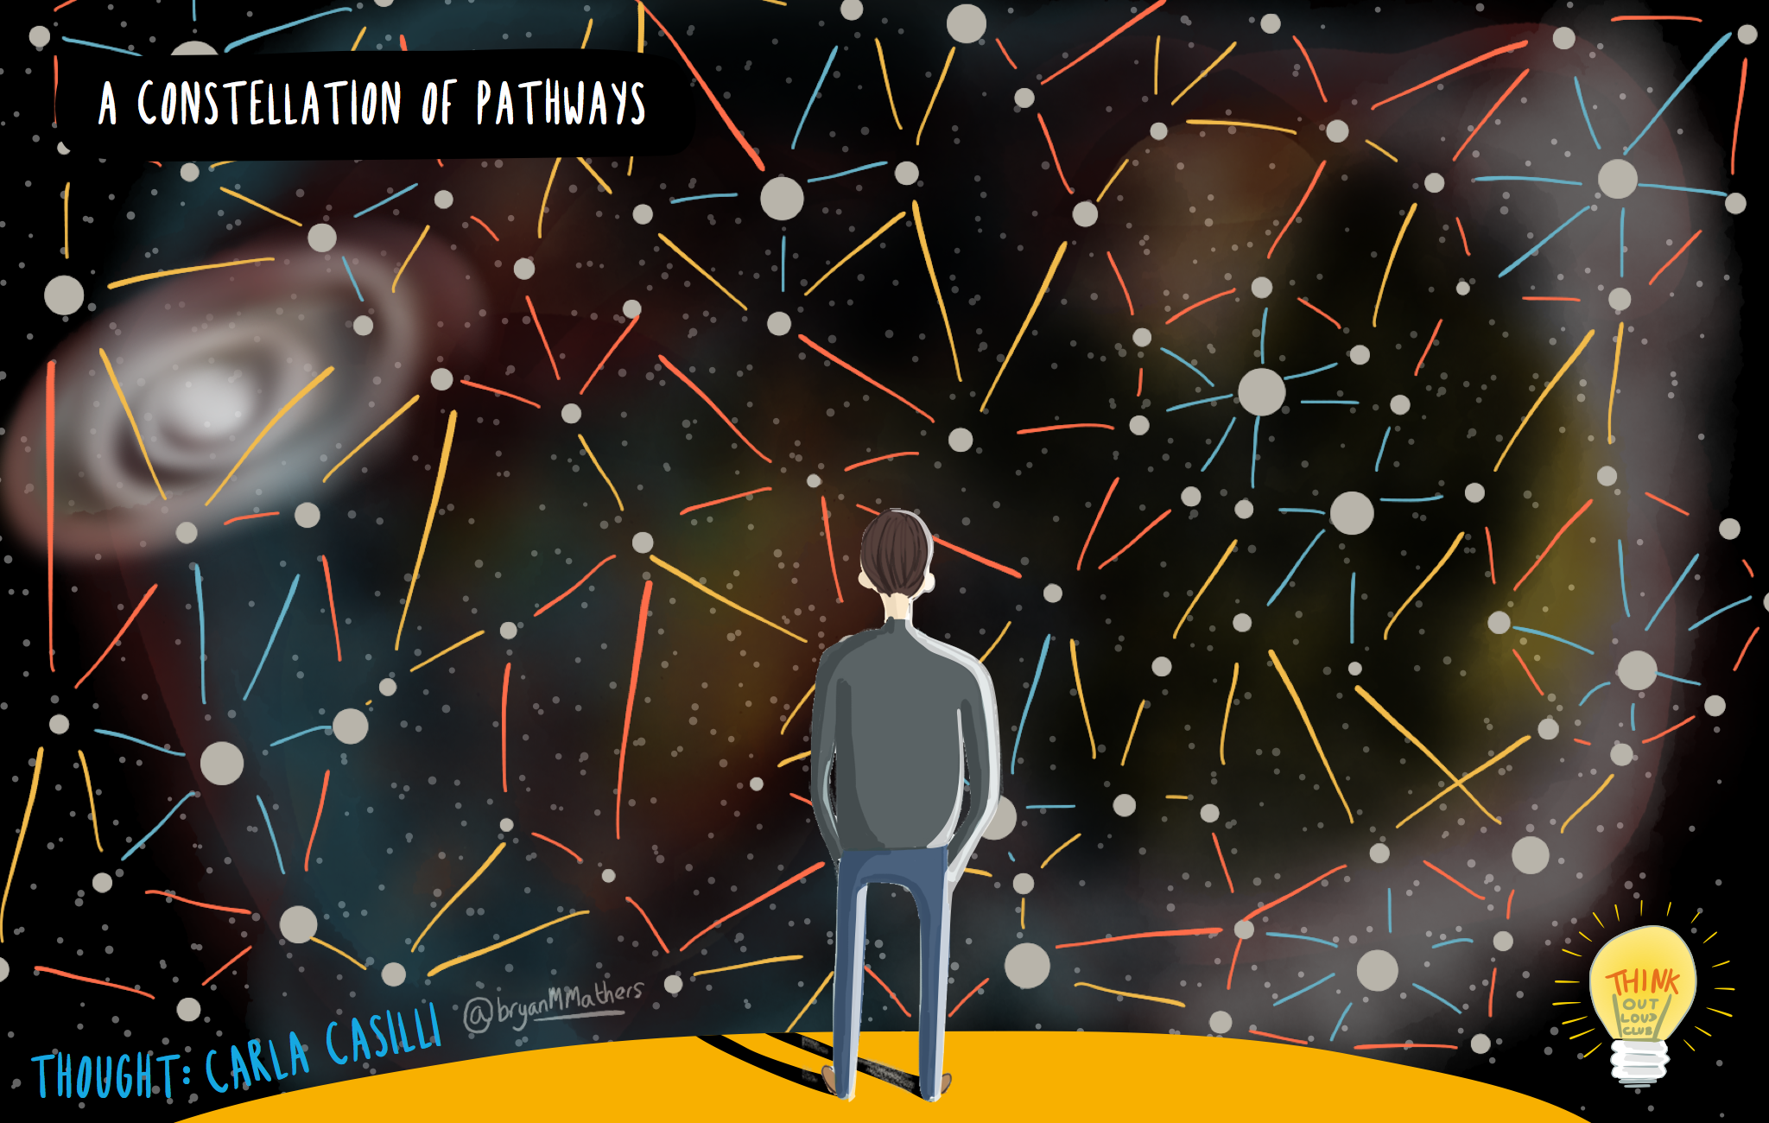

Slide 26
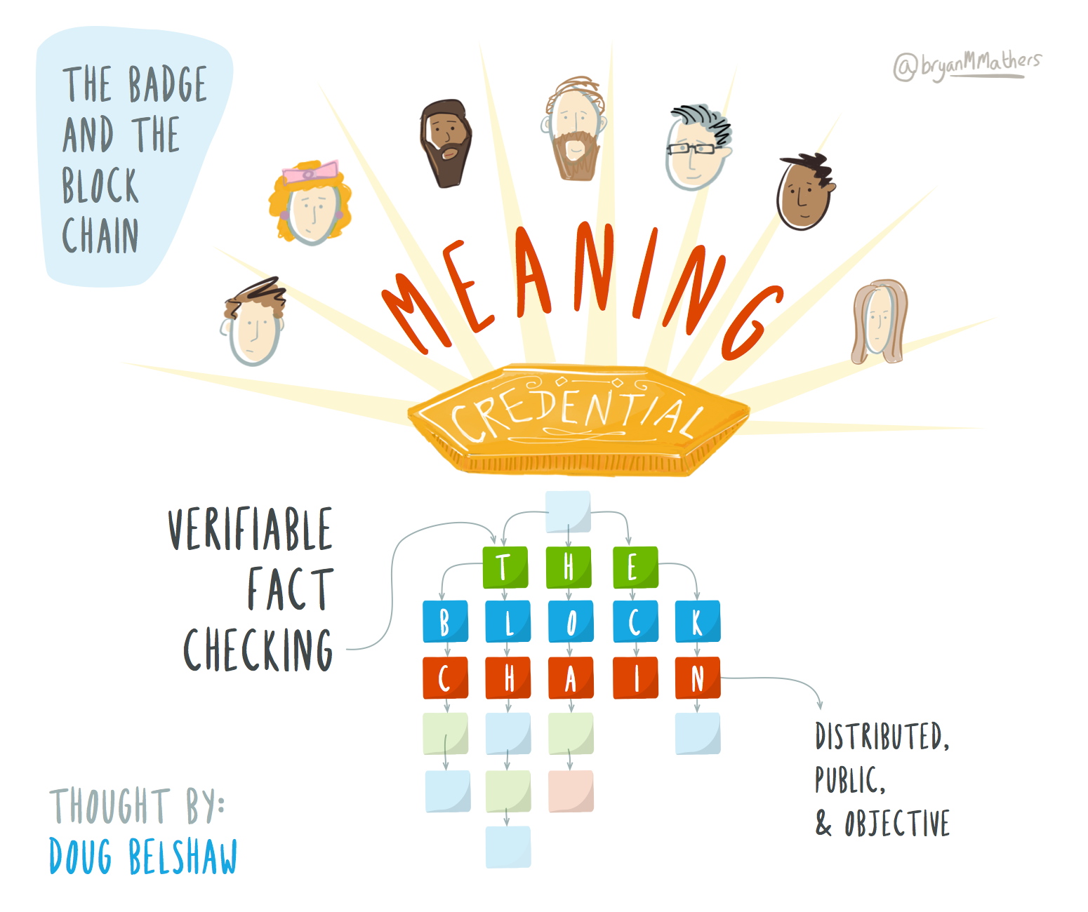

Slide 27
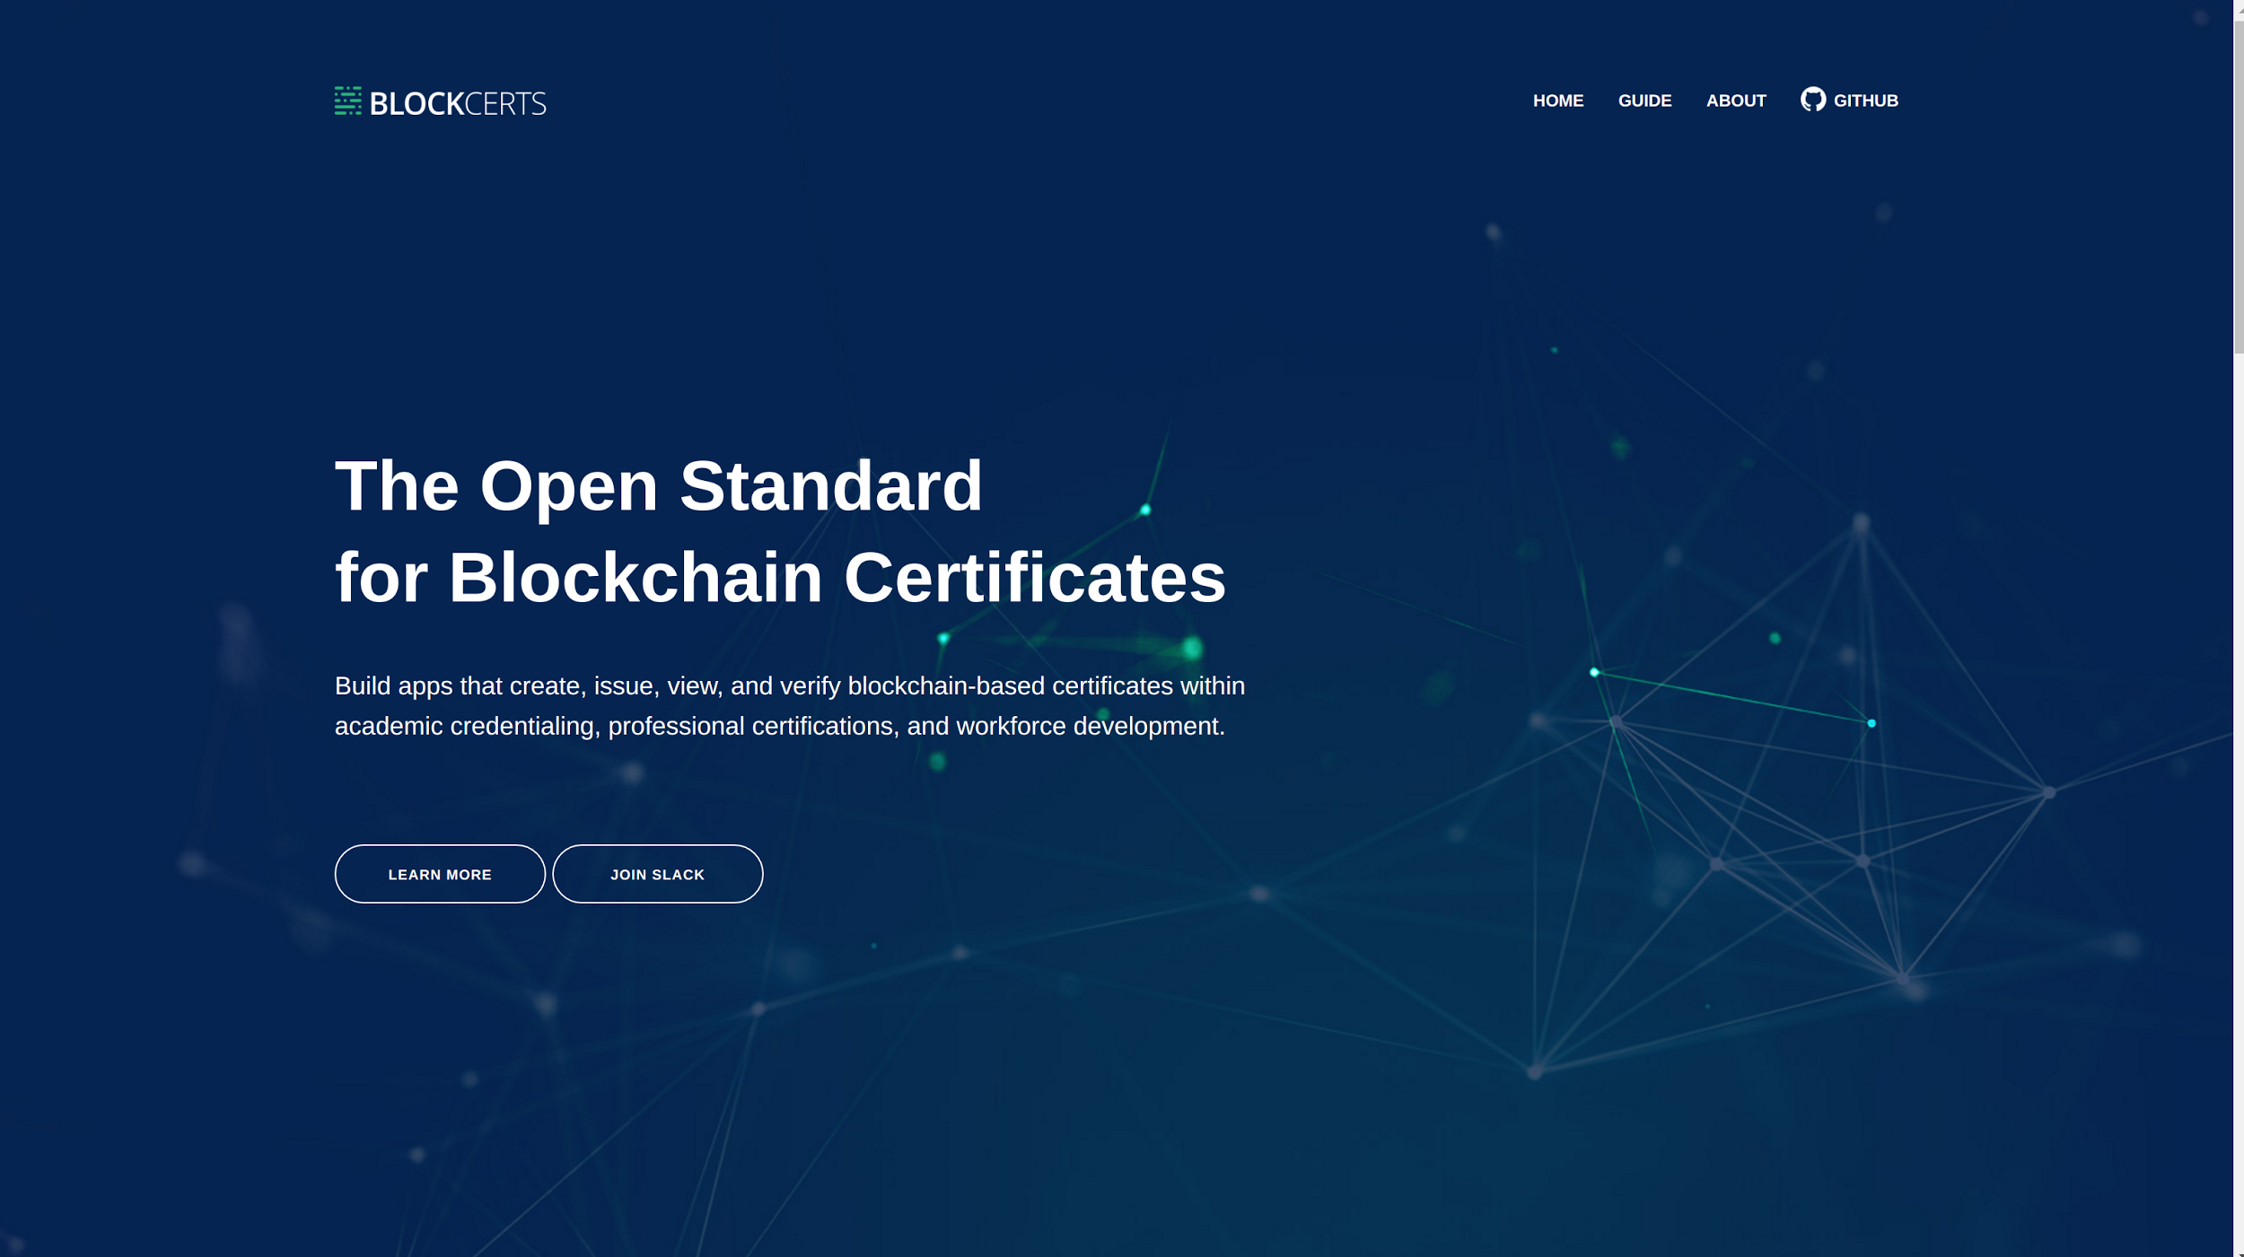

Slide 29
10 potential benefits of building a global badge ecosystem for Higher Education
Reduced costs by building on a collaboratively-defined framework
Recognition for students who can't continue their studies
Recruitment into university and on to employment
Retrospective badging (e.g. alumni)
Re-aligning with employer priorities
Re-igniting interest in less popular courses
Rehabilitating struggling staff/students
Re-interpreting existing courses and making interdisciplinary links
Retention of students
Rewarding staff and students who go beyond minimum expectations

Slide 30
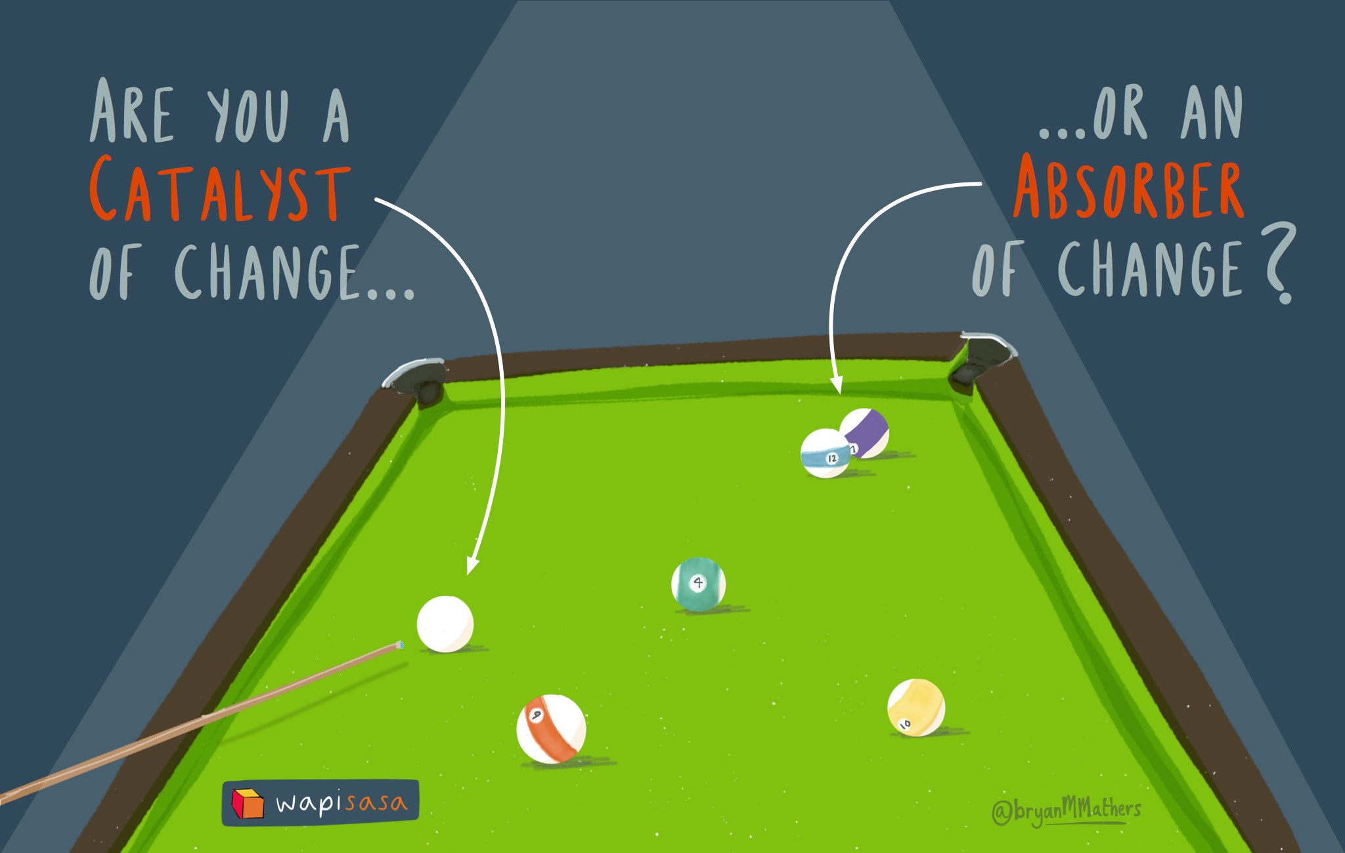

Slide 31
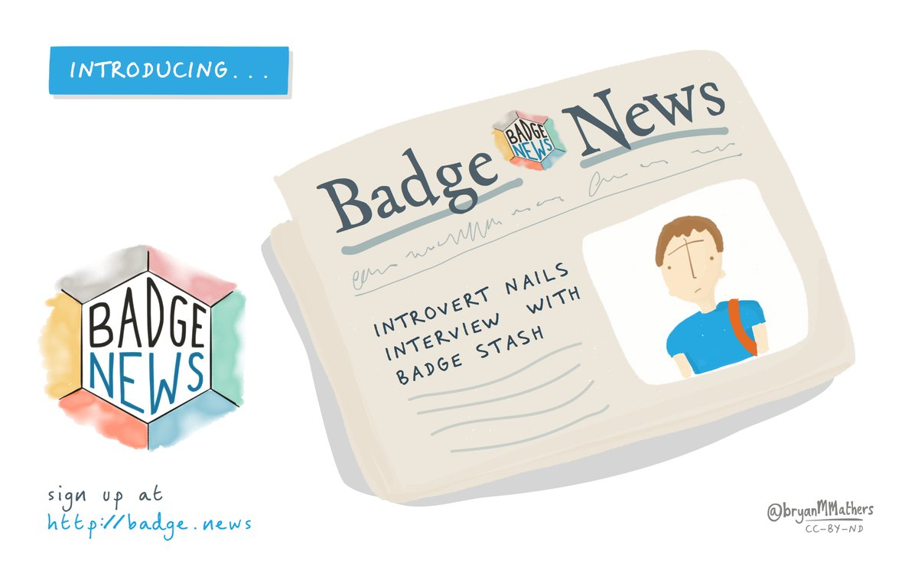

Slide 32
Get in touch!
Twitter: @dajbelshaw
Email: hello@dynamicskillset.com
Slides: https://goo.gl/etvz30

